Slide 1
LEPC EXERCISE FINAL REPORT
Indiana Emergency Response Commission
2025

Slide 2
Exercise Final Report
Why do LEPC’s need a Final Exercise Report
Helpful Reminders
How To Enter the Report Into Hazconnect

Slide 3
Why do the LEPCs need an Exercise Final report?
LEPCs must comply with Indiana Codes, 4-2-7-3, 13-25-1-6, 13-25-2-5, 13-25- 2-10.6(b), 13-25-2-10.7 and 13-25-2-14 to receive funding. To meet funding and IERC requirements, the following documents/information must be submitted annually through the LEPC online reporting system (Hazconnect) at
https://tier2.dhs.in.gov/Account/Login.aspx

Slide 4
Helpful Reminders:
Have a list of the documents that are required to be uploaded for the type of Exercise that was held (either HSEEP or Non-HSEEP). Also, Tabletop, Full-scale, etc.
Be sure that the Exercise Proposal has been marked complete by the LEPC Program Manager before trying to complete the Exercise Final Report because the reports have linked information.
If applying for the HMEP grant you must have conducted an HSEEP Exercise.
There is more information about Exercises on the IDHS Exercise Section webpage located here: DHS: Exercise Section

Slide 5
Helpful Reminders Cont.:
Non-HSEEP Exercise paperwork requirements:
  Agenda (must include, date, time, location, type of exercise and a full description of the Exercise Scenario)
  Agency Participant List (to include the list of people participating, with contact information)
  Sign-in Sheet
  After-Action Report

Slide 6
Helpful Reminders Cont.:
HSEEP Exercise paperwork requirements:
  Exercise Planning Meeting Sign-in sheets (3 or more is best)
  Exercise Planning Meeting Agenda and Meeting Minutes (for each Planning meeting)
  Exercise Agenda
  Exercise Budget
  Exercise Scenario
  Exercise Sign-in sheet
  Exercise After Action Report
  Exercise Agency Participants List with contact information
  *The paperwork requirements are subject to change, check out the IDHS Exercise Section webpage located at this link for up-to-date information: DHS: Exercise Section

Slide 7
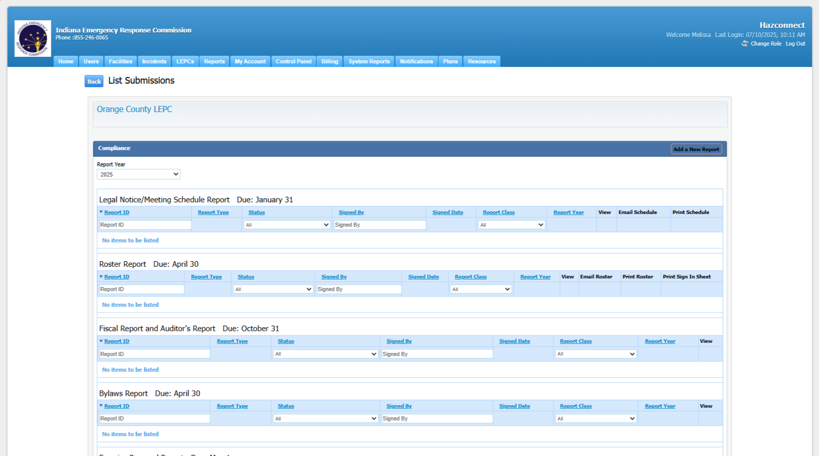
How to enter the Exercise Final Report into Hazconnect:
Go to the counties LEPC Reports page:

Slide 8
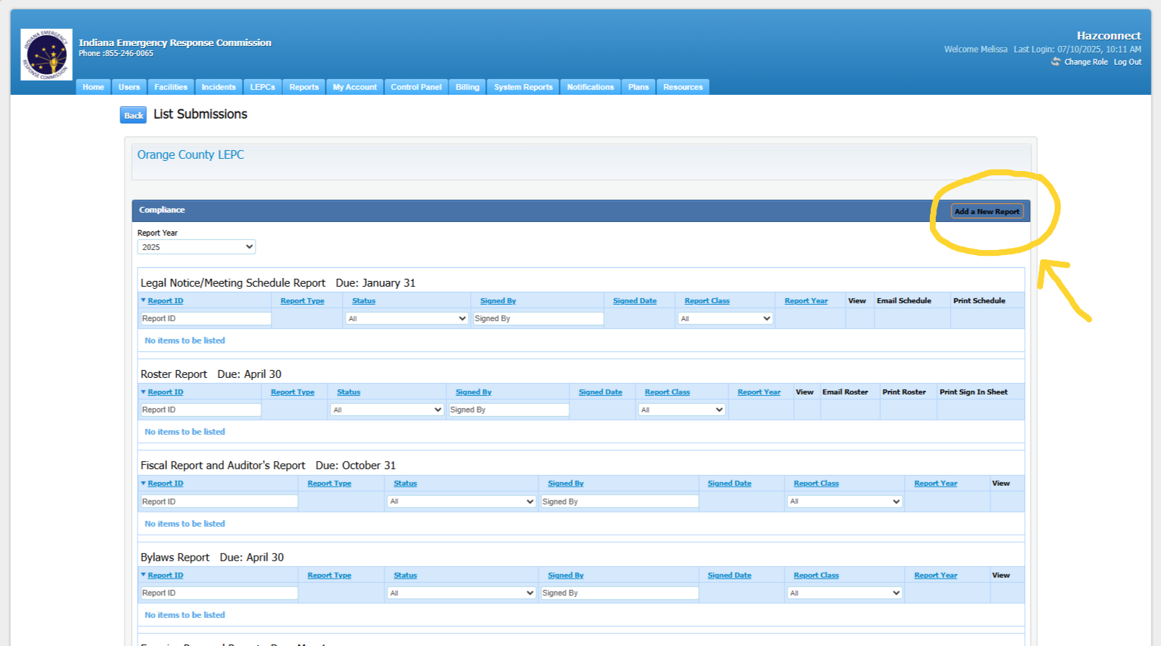
Entering the Exercise Final Report, Cont.:
2. Choose Add a New Report (at the top right of the page.)

Slide 9
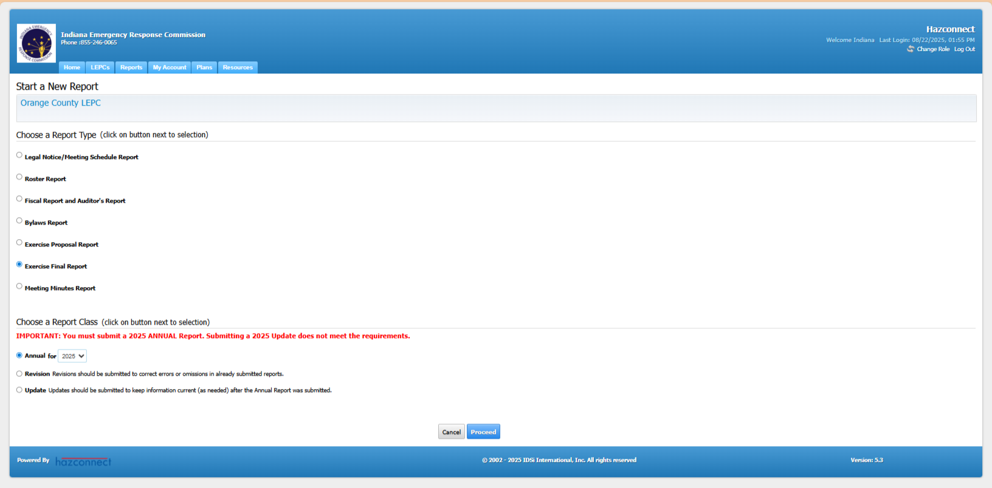
Entering the Exercise Final Report, Cont.:
3. Choose Exercise Final Report and then Annual for the current year. Then choose Proceed.

Slide 10
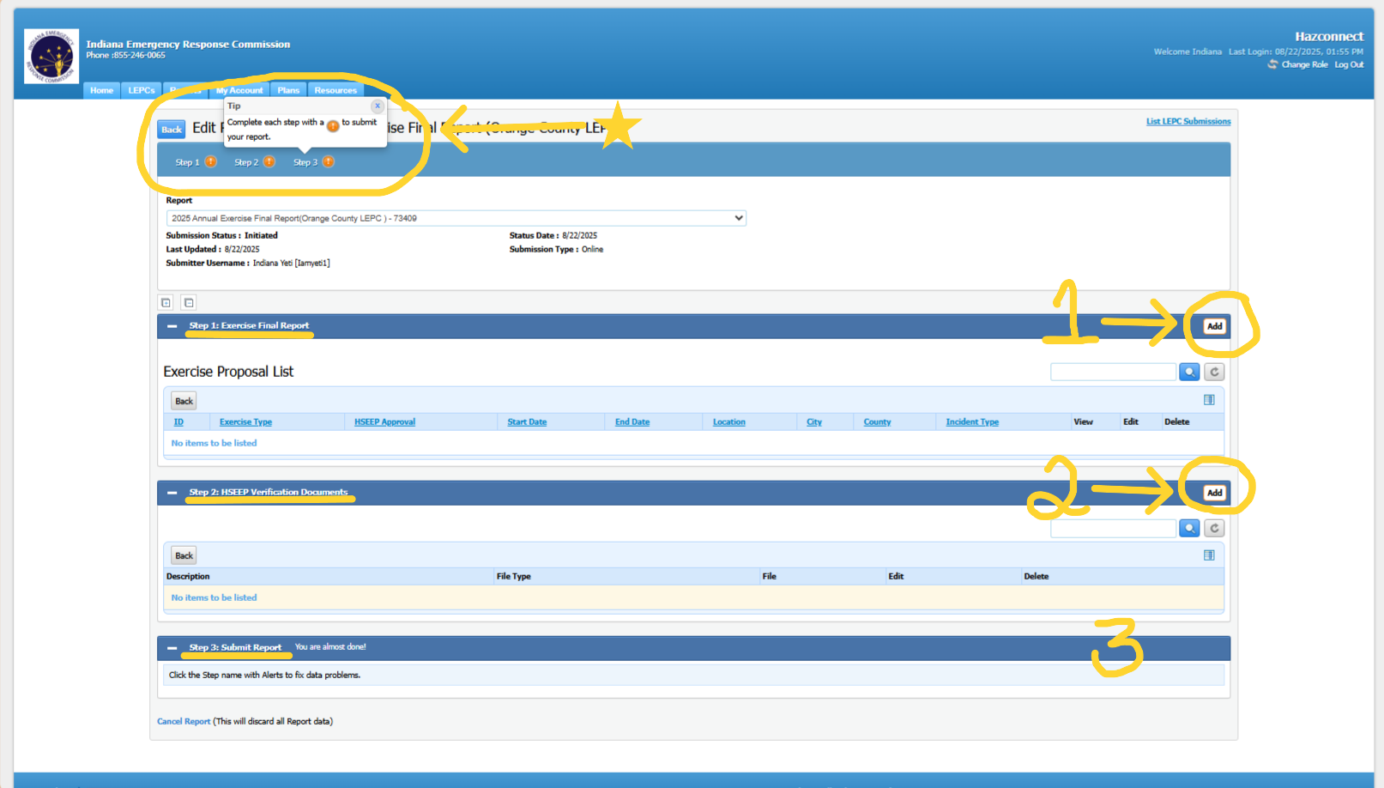
Entering the Exercise Final Report, Cont.:
4. There are 3 steps to complete this report. Step1 is the Exercise Final Report to begin this step choose Add to the right of the report name. You will do the same when you are ready for Step 2 HSEEP Verification Documents (add all exercise documents here whether it was a HSEEP or Non-HSEEP exercise). Step 3 will be a Continue button that will show up after Step 1 and Step 2 are complete.

Slide 11
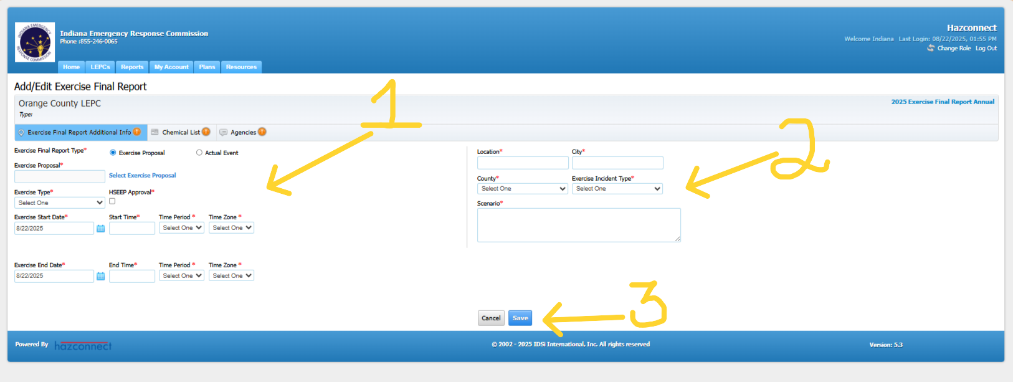
Entering the Exercise Final Report, Cont.:
5. When you choose the Add button for Step 1 Exercise Final Report this screen will appear. (1) Enter all the information with an asterisk. (2) Enter all the information with an asterisk. (3) Choose Save then this will take you to the next tab the Chemical List.

Slide 12
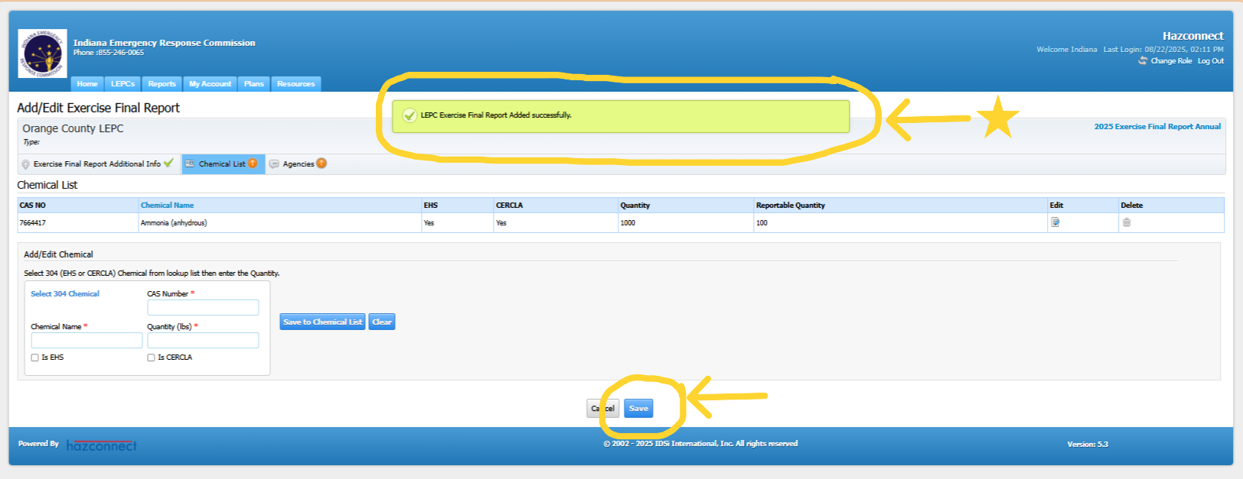
Entering the Exercise Final Report, Cont.:
6. The green box shows that the information you just entered was uploaded successfully. Next enter the chemical information in the boxes with the asterisks. You must have at least 1 EHS chemical. When finished entering all chemicals choose Save.

Slide 13
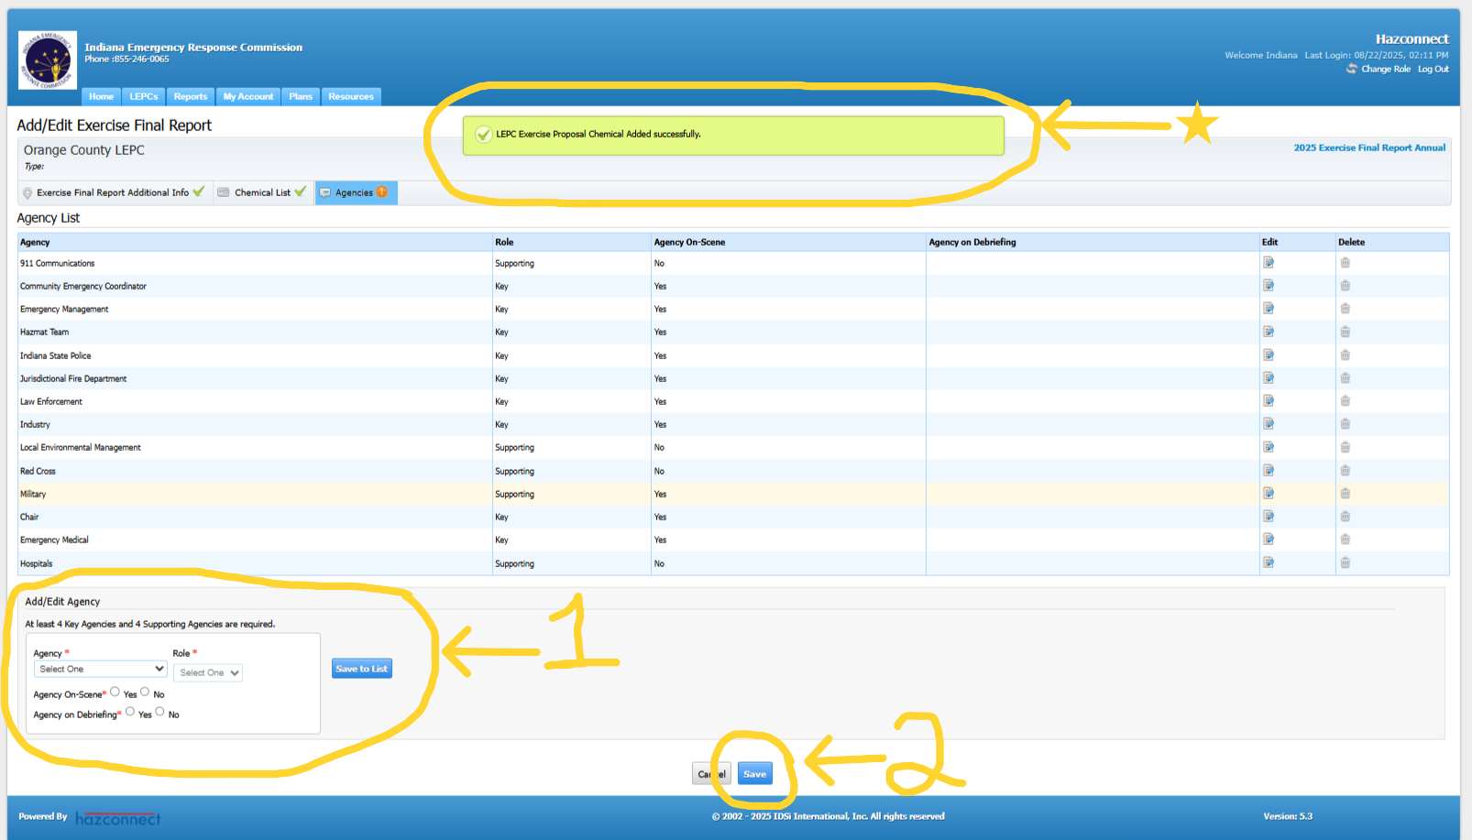
Entering the Exercise Final Report, Cont.:
7. The green box at the top of the page shows that the Chemical List was uploaded successfully. Next add the agencies that participated in the exercise. In Step 1 add the information with the asterisks and choose Save to List. Repeat this step until you have entered all agencies that participated. Then choose the Save button Step 2 at the bottom of the page.

Slide 14
Entering the Exercise Final Report, Cont.:
8. After Step 1 of the report is complete, Step 2 HSEEP Verification Documents can be started by choosing the Add button to the right of the report name. This is where the documents for the Exercise will be uploaded.

Slide 15
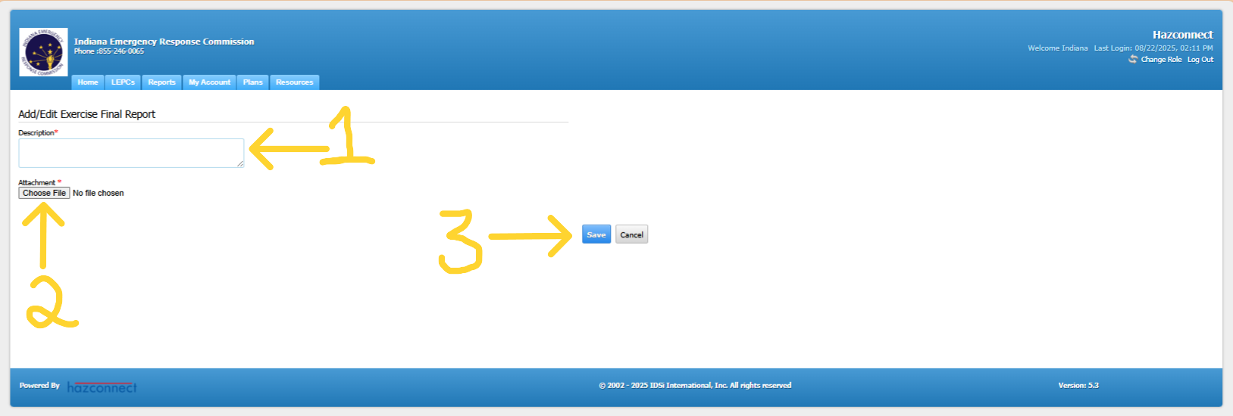
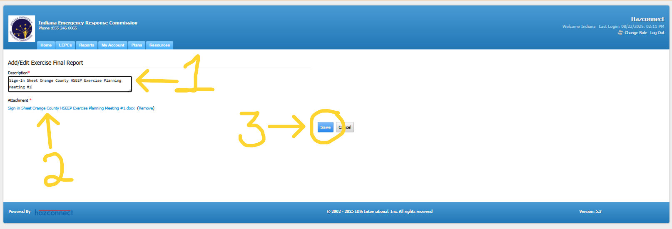
Entering the Exercise Final Report, Cont.:
9. Step 1, add a description of the upload. Step 2 Choose a File to upload. Step 3 choose Save. Repeat these steps until you have all the documents uploaded.

Slide 16
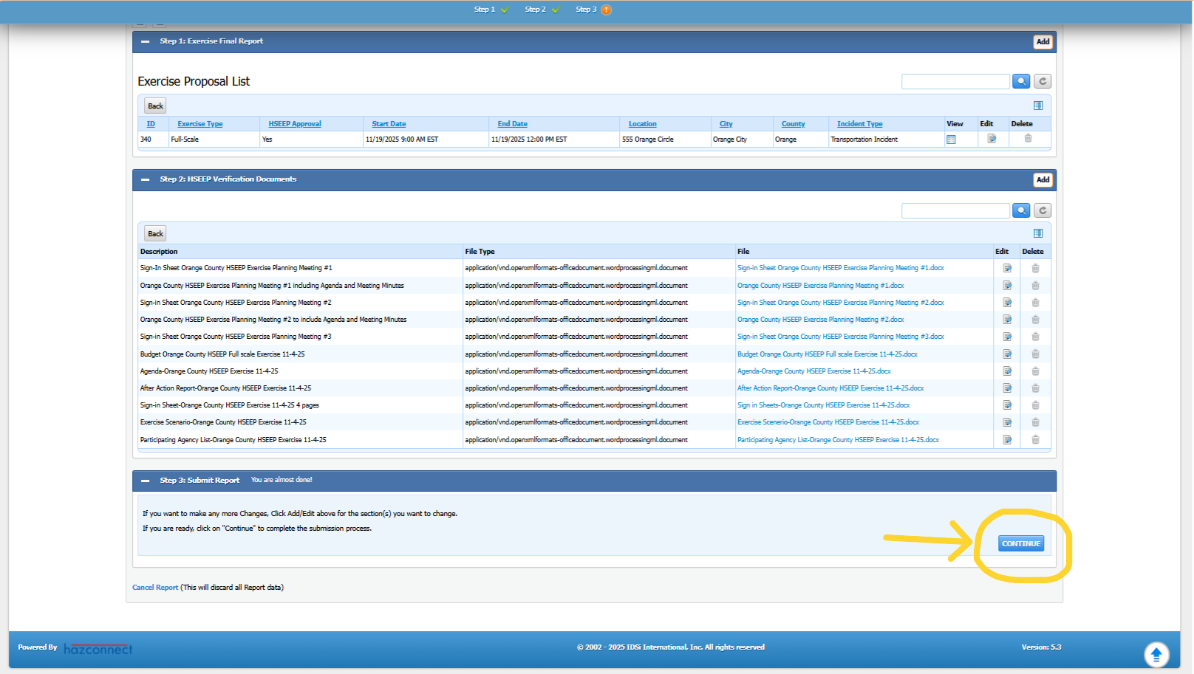
Entering the Exercise Final Report, Cont.:
10. When Steps 1 and 2 are complete, Step 3 (the Final step) is to choose the Continue button at the bottom right of the screen.

Slide 17
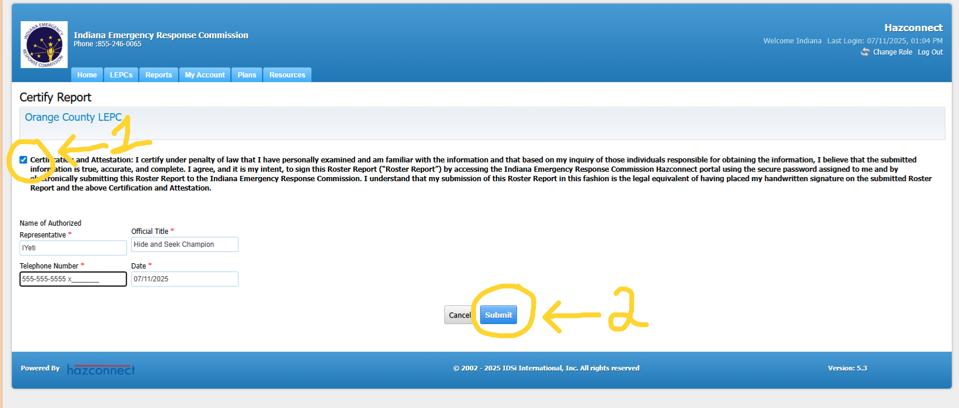
Entering the Exercise Final Report, Cont.:
11. When certifying the report Step (1) check the Certify box and fill in the information with the asterisks. Step (2) choose the Submit button.

Slide 18
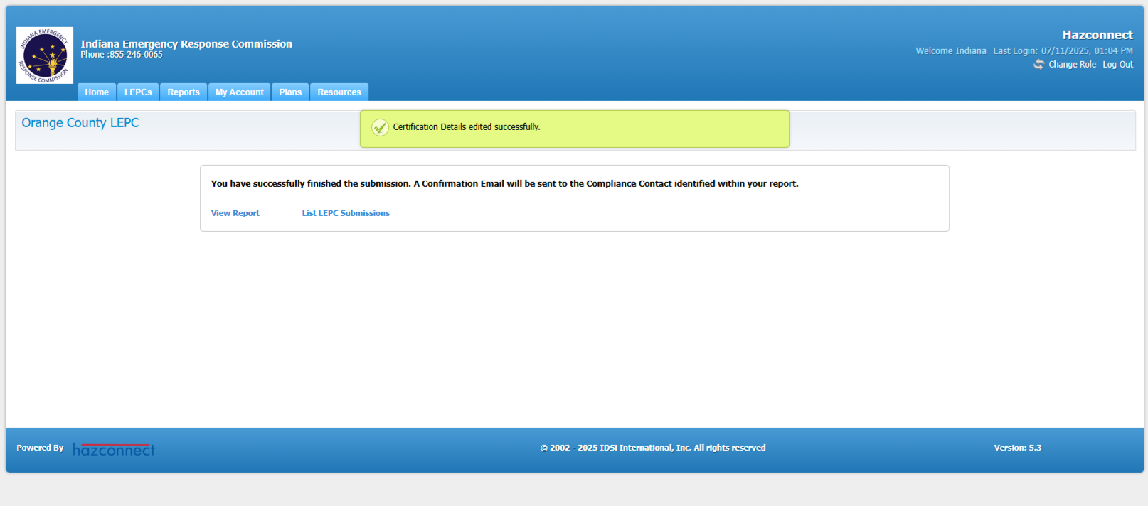
Entering the Exercise Final Report, Cont.:
12. After you have submitted the report, you will see confirmation in a green box saying that it was certified successfully. You have completed the report.

Slide 19





Feedback Is Welcomed
If you have any feedback or questions, contact the IERC inbox or the Indiana LEPC inbox or your LEPC Program Manager:
ierc@dhs.in.gov or
IndianaLEPC@dhs.in.gov

