Slide 1


Excise Allocation Worksheet & Reconciliation Worksheet
JANE COPE, Local Government Specialist
Indiana State Comptroller Elise Nieshalla

Slide 2
AGENDA
Introduction to Excise Taxes
Deep Dive:
Excise Allocation Worksheet
History of State Remittance Portion
Excise Reconciliation Worksheet
Best Practices for Excise Reconciliation with County Treasurer
Excise Frequently Asked Questions
Indiana State Comptroller Elise Nieshalla

Slide 3
EXCISE TAX
While it is tempting to only think about Property Taxes during Settlement, Excise Taxes appear on nearly all Settlement forms & worksheets:
Excise Tax Allocation Worksheet
Excise Tax Reconciliation Worksheet
49TC
Form 102’s/105
Quietus Worksheet
Indiana State Comptroller Elise Nieshalla

Slide 4
EXCISE TAX, cont.
Excise presents unique challenges during the Settlement process:
Property Tax is based on a fixed geographic location – taxes are collected at a local level & can be distributed based on the location.
Excise Tax refers to 7 different taxes collected by the State & distributed to local governments.
Excise Tax is tied to an individual – not a location – which means extra steps are needed to distribute the Excise Taxes.
During Settlement, a portion of Excise Tax distributed to the county is returned to the State.
Indiana State Comptroller Elise Nieshalla

Slide 5
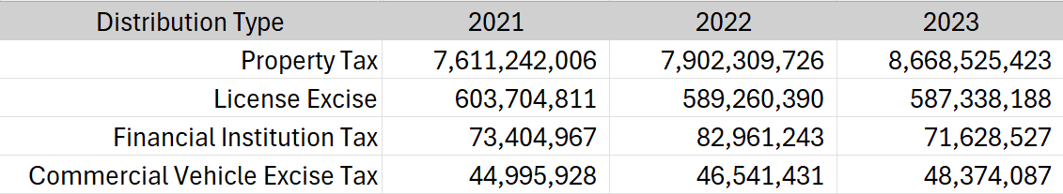
EXCISE TAX, cont.
Based on data reported on the Form 22, Excise Taxes represent almost $1.7B of revenue for local governments over the last three years.
Indiana State Comptroller Elise Nieshalla

Slide 6

EXCISE TAX ALLOCATION
Indiana State Comptroller Elise Nieshalla

Slide 7
EXCISE TAX ALLOCATION Worksheet
The Excise Tax Allocation Worksheet is a required part of every County’s Settlement submission.
The worksheet calculates & presents both:
The amount of Excise Tax to be distributed to each taxing district.
The amount of Excise Tax that will be remitted to the State.
Indiana State Comptroller Elise Nieshalla

Slide 8
EXCISE TAX ALLOCATION Worksheet Sections
Section A:
County Specific
taxing district
Section B:
Excise Tax included in the calculation of portion subject to state remittance
Section C:
State Fund Deduction Allocation Factors.
Section D:
Excise Tax excluded from the calculation of portion subject to state remittance.
Indiana State Comptroller Elise Nieshalla

Slide 9

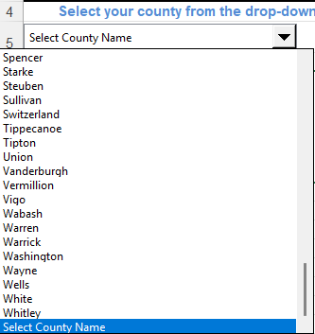
EXCISE TAX ALLOCATION – Section A
Section A - Taxing Districts
Select your county name
Taxing districts will prepopulate
Taxing districts are largely based on taxing district names & numbers from 2014 budget data
Indiana State Comptroller Elise Nieshalla

Slide 10
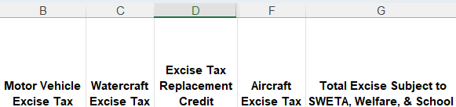
EXCISE TAX ALLOCATION – Section B
Section B – Included Excise Tax
Excise Taxes included in the calculation of State Fund Deduction amounts & the State Remittance
Used with Section C to calculate the State Remittance Portion
Indiana State Comptroller Elise Nieshalla

Slide 11
EXCISE TAX ALLOCATION – Section B, cont.
The types of Excise Tax included in the calculation of State Fund Deduction amounts are:
Motor Vehicle Excise Tax
Watercraft Excise Tax
Excise Tax Replacement Credit
Aircraft Excise Tax
Indiana State Comptroller Elise Nieshalla

Slide 12
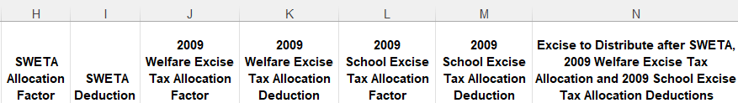
EXCISE TAX ALLOCATION – Section C
Section C – Deduction Allocation Factors
Used with Section B to calculate the State Remittance portion.
Additional information about the history of the factors will be detailed later in the presentation.
Indiana State Comptroller Elise Nieshalla

Slide 13
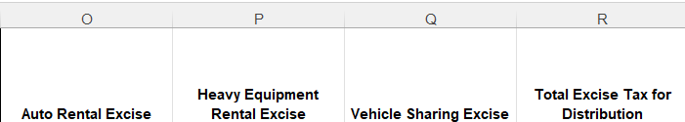
EXCISE TAX ALLOCATION – Section D
Section D – Excluded Excise Tax
Excise Taxes that will be included in Settlement but are not subject to State remittance calculation.
Indiana State Comptroller Elise Nieshalla

Slide 14
EXCISE TAX ALLOCATION – Section D, cont.
The types of Excise Tax excluded from the calculation of State Fund Deduction amounts are:
Auto Rental Excise Tax
Heavy Equipment Rental Excise Tax
Vehicle Sharing Excise Tax
Indiana State Comptroller Elise Nieshalla

Slide 15
EXCISE TAX ALLOCATION Phases
Sections B & C both reference the State Remittance portion of the excise calculation – this covers 2 major shifts in tax policy:
Phase 1 - Section C. SWETA Allocation Factor
Phase 2 - Section C. 2009 Welfare and Excise Tax Allocation Factor
Indiana State Comptroller Elise Nieshalla

Slide 16
EXCISE TAX ALLOCATION Phase 1
Phase 1. Section C. SWETA Allocation Factor:
Section 59 P.L. 273 Acts of 1999 required the calculation of the state welfare allocation to be made prior to the Excise Tax distributions calculations.
The 1997, 1998 and 1999 fund Property Tax rates for the Welfare Administration and the County Welfare funds were added together.
The 1997, 1998 and 1998 taxing district rates were added together.
The total of the 3-year fund rates were divided by the total of the 3-year taxing district rates to arrive at the Allocation Factor.
Indiana State Comptroller Elise Nieshalla

Slide 17
EXCISE TAX ALLOCATION Phase 2
Phase 2. Section C. 2009 Welfare and Excise Tax Allocation Factor
Beginning with 2008 pay 2009 the 5 welfare funds and 2 school funds were no longer funded by Property Tax.
Allocation Factors for the Welfare Funds were calculated based on pay 2006, 2007 and 2008 fund Property Tax rates.
The 2006, 2007 and 2008 Welfare Fund rates were added together.
The 2006, 2007 and 2008 taxing district rates were added together.
The total of the 3-year fund rates were divided by the total of the 3-year taxing district rates to arrive at the updated Allocation Factor.
Indiana State Comptroller Elise Nieshalla

Slide 18
EXCISE TAX ALLOCATION Phase 2, cont.
Phase 2. Section C. 2009 School Excise Tax Allocation Factor
Allocation Factors for the School Funds were calculated based on pay 2006, 2007 and 2008 fund Property Tax rates.
The 2006, 2007 and 2008 Property Tax rates for the School Funds were added together.
The 2006, 2007 and 2008 taxing district rates were added together.
The total of the 3-year fund rates were divided by the total of the 3-year taxing district rates to arrive at the Allocation Factor.
Indiana State Comptroller Elise Nieshalla

Slide 19

Excise Tax Reconciliation
Indiana State Comptroller Elise Nieshalla

Slide 20
EXCISE TAX RECONCILIATION Worksheet
The Excise Tax Reconciliation Worksheet is a required part of every County’s Settlement submission.
The worksheet is designed to reconcile the Excise Tax certified by the County Treasurer to the County Auditor’s funds ledger.
The reconciliation ensures that the Excise Tax total is accurate.
Verifies all excise is being distributed to the units.
Ensures the starting point for the next Settlement is accurate.
Indiana State Comptroller Elise Nieshalla

Slide 21

EXCISE TAX RECONCILIATION Worksheet, cont.
Counties will complete the 10 Lines of the “Recon WKS” tab.
The “Line Descriptions” tab provides additional instruction, context, and guidance for each of the 10 Line of the “Recon WKS” tab.
Indiana State Comptroller Elise Nieshalla

Slide 22
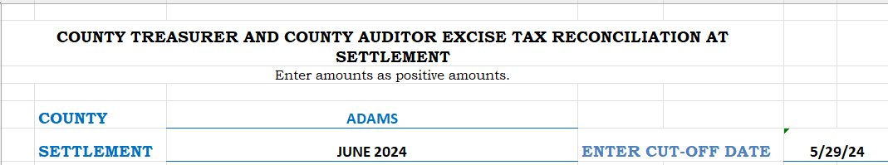
EXCISE TAX RECONCILIATION Worksheet, cont.
The County Auditor’s cut-off date is used by the Comptroller to calculate an expected variance of Excise reported between the County Auditor & County Treasurer.
Indiana State Comptroller Elise Nieshalla

Slide 23
EXCISE TAX RECONCILIATION Worksheet, cont.
Line 1. County Treasurer Certified Excise Tax
The amount of total Excise Tax certified by the County Treasurer
Validated by the Comptroller against the “License Excise Tax Collected” line in Column 3 of the 49TC.
Includes all Excise types shown in the Other Sources Section of the County Treasurer’s cashbook as of the date of the County Treasurer’s certification.
Does not include Excise Sur Tax & Wheel Tax.
Indiana State Comptroller Elise Nieshalla

Slide 24
EXCISE TAX RECONCILIATION Worksheet, cont.
Line 2. Plus: Excise Tax Advance Total.
Enter the amount of Excise tax advanced to units since the last Settlement.
Line 3. Minus: Excise Tax to be Distributed at Settlement.
The amount entered on this lines is the total of column 8 of the 49TC & the total on the Excise Tax Allocation worksheet Total Excise Tax for Distribution column.
Entered as a positive number.
Indiana State Comptroller Elise Nieshalla

Slide 25
EXCISE TAX RECONCILIATION Worksheet, cont.
Line 4. Minus: Excise Tax to be Distributed to County General Fund for Reimbursement of Watercraft Excise Tax Refunds.
If the County refunded Watercraft Excise tax to a taxpayer out of the County General Fund, the amount would be entered on this line.
The refund amount should be deducted from applicable taxing district Excise Tax amount prior to the calculation of the allocation amount.
Entered as a positive number.
Indiana State Comptroller Elise Nieshalla

Slide 26
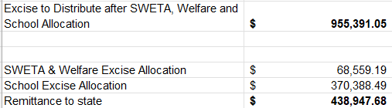
EXCISE TAX RECONCILIATION Worksheet, cont.
Line 5. Minus: Welfare and School Excise Tax Allocations.
This is the Remittance to State amount from the Excise Tax Allocation worksheet.
The amount will be entered as a positive number.
Indiana State Comptroller Elise Nieshalla

Slide 27
EXCISE TAX RECONCILIATION Worksheet, cont.
Line 6. Equals Treasurer and Auditor Excise Tax Difference.
County Treasurer certified amount, plus advances, minus the Excise distribution amount, minus Excise refunds, minus welfare and school Excise amounts.
Line 1 + Line 2 – Line 3 – Line 4 – Line 5.
Due to the difference in timing of reporting by the County Auditor & County Treasurer we would expect to see a difference in Line 6.
Indiana State Comptroller Elise Nieshalla

Slide 28
EXCISE TAX RECONCILIATION Worksheet, cont.
Line 7. Plus: State Comptroller Excise Tax Replacement Credit Distribution included by County Auditor in Excise Tax, but not received by County Treasurer by treasurer certification date and not included in treasurer’s certified amount.
The County Auditor included the Excise Tax Replacement Credit in the Excise distribution amount, but the County Treasurer did not include the Excise Tax Replacement Credit in the certified Excise Tax collections on the 49TC.
Indiana State Comptroller Elise Nieshalla

Slide 29
EXCISE TAX RECONCILIATION Worksheet, cont.
Line 8. Minus: Excise Tax Received after the Auditor Cut Off Date.
Excise tax received by the County Treasurer after the cut off date & is included the County Treasurer certified amount on the 49TC.
The amount is entered as a positive number.
This amount can be determined by reviewing the amounts received after the County Auditor’s cut off date and the date the County Treasurer certified Excise collections.
Indiana State Comptroller Elise Nieshalla

Slide 30
EXCISE TAX RECONCILIATION Worksheet, cont.
Line 9. Plus: Excise Tax included by the County Auditor in Excise Tax & is Excise Tax Received within the County Auditor’s Excise Tax cut off date, but not yet posted to the County Treasurer’s Cashbook and not included in the Treasurer’s Certified amount.
This item is much like Step 7 but is for other types of Excise than Excise Tax Replacement Credit.
There may not be an amount listed on Line 9.
Indiana State Comptroller Elise Nieshalla

Slide 31
EXCISE TAX RECONCILIATION Worksheet, cont.
Line 10. Equals: Reconciled Difference.
This calculation is the County Treasurer & County Auditor Excise Tax difference, plus the amount of Excise Tax Replacement Credit included by County Auditor but not certified by the County Treasurer, plus the Excise Tax included by the County Auditor but not certified by the County Treasurer, less the Excise Tax Received after the County Auditor’s cut off date.
Line 6 + Line 7 + Line 8 – Line 9.
Indiana State Comptroller Elise Nieshalla

Slide 32
EXCISE TAX RECONCILIATION Worksheet, cont.
Line 10. Equals: Reconciled Difference.
The Reconciled Difference amount should be $0.00.
If not zero, the difference should be investigated & appropriate reporting/distribution corrections made.
The amount entered on Line 8 must not be forced to make the Line 10 Reconciled Difference equal $0.00.
Indiana State Comptroller Elise Nieshalla

Slide 33
EXCISE TAX RECONCILIATION Worksheet, cont.
Line 10. Equals: Reconciled Difference.
When a reconciled difference appears, the County may:
Review the worksheet data entry errors.
Verify each of the types of Excise Tax being distributed by the County Auditor agrees with the amounts on the County Treasurer Cashbook as of the cut off date.
Compare the receipts from the County Treasurer to County Auditor Excise Tax Ledger.
Verify the amounts recorded on the County Treasurer’s Cashbook for all types of Excise after the County Auditor cut off date agrees with the distribution reports the County Auditor has received from DOR, BMV & Comptroller.
Indiana State Comptroller Elise Nieshalla

Slide 34

Excise Frequently Asked Questions
Indiana State Comptroller Elise Nieshalla

Slide 35
EXCISE TAX FAQ’S
Question: I didn’t receive a report for Aircraft Excise Tax in July. Can you provide the report for our county?
Answer: Aircraft Excise Tax reports are originated by the Department of Revenue (“DOR”). The missing report can be requested directly from the email address: aircrafttax@dor.in.gov.
Indiana State Comptroller Elise Nieshalla

Slide 36
EXCISE TAX FAQ’S
Question 2: I didn’t receive a Watercraft (boat) Excise report for Watercraft Excise Tax in August 2024?
Answer: Watercraft (boat) Excise reports are generated by the BMV and should be on the BMV FTP site. To request copies of the report, please contact Tamytha Cooper at tcooper@bmv.in.gov.
Indiana State Comptroller Elise Nieshalla

Slide 37
EXCISE TAX FAQ’S
Question 3: My daily report for Excise Tax Replacement Credit does not match the amount on the June 2024 BMV Summary report #1234 sent with the Excise Tax Replacement Credit distribution?
Answer: Review the report on the FTP site to ascertain if there were any changes to the specific report. If there are no changes, contact Tamytha Cooper at tcooper@bmv.in.gov.
Indiana State Comptroller Elise Nieshalla

Slide 38
EXCISE TAX FAQ’S
Question 4: Our County Treasurer received an ACH for “Vehicle Sharing Excise.” Is there a report somewhere with the breakdown by taxing district?
Answer: IC 6-6-16 guidance given for the collection of this tax only requires the taxpayer to provide the county in which the tax was paid, not the taxing district. The Comptroller suggests two options:
1. Distribute the funds proportionally between all taxing districts.
2. Distribute the funds to the largest taxing district.
Indiana State Comptroller Elise Nieshalla

Slide 39
EXCISE TAX FAQ’S
Question 5: There is no column on the Excise Tax Allocation Worksheet for me to enter the Wheel and Sur Tax collections. Is there a reason for this?
Answer: Wheel and Sur Tax collections are not included with Property Tax and Excise Tax Settlement distributions. Based on statute, Wheel and Sur Tax follow an entirely different process to allocate the revenue to the units and are processed monthly outside of the Settlement process.
Indiana State Comptroller Elise Nieshalla

Slide 40

At Your Service
FRED VAN DORP JANIE COPE
Accounting and Reporting Director Local Government Specialist
State Comptroller Elise Nieshalla State Comptroller Elise Nieshalla
317-232-3309 317-233-1712
fvandorp@comptroller.in.gov jcope@comptroller.in.gov
LOCAL GOVERNMENT
localgovernment@comptroller.in.gov
Indiana State Comptroller Elise Nieshalla

Slide 41

THANK YOU
JANE COPE
Local Government Specialist
Indiana State Comptroller Elise Nieshalla

