Slide 1


Indiana State Comptroller's Office
Janie Cope, Local Government Specialist
Jill Onion, Assistant Director Accounting & Reporting
Fred Van Dorp, Director of Accounting & Reporting and Local Government

Slide 2
DISCUSSION ITEMS
Settlement forms
Form 49TC
Form 102
Form 105
Settlement Checklist
Settlement Approvals
Indiana Transparency Portal & ACH notification
Indiana State Comptroller Elise Nieshalla

Slide 3
Introduction to Settlement
The county settlement process includes the balancing & distribution of both property & excise taxes to all units of government in the county.
After the County Treasurer has completed posting & reconciling tax collections, they submit the collections to the County Auditor.
The County Auditor completes the State prescribed settlement documents & submits to the Office of State Comptroller for review.
Once approved by the State, the County Auditor distributes the settlement dollars to the units of government in the county.
Indiana State Comptroller Elise Nieshalla

Slide 4
Settlement Documents to Upload
The following are the settlement forms & documentation to complete submission for approval:
Settlement Checklist
Form 49TC
Form 102
Form 105
Form 17TC
Excise Tax Allocation Worksheet
Excise Tax Reconciliation Worksheet
Quietus Worksheet
Distribution/Circuit Breaker Rates
Explanation of Form 105 Section C Totals (if needed)
Indiana State Comptroller Elise Nieshalla

Slide 5
49TC Treasurer Certificate of Tax Collections
The 49TC is completed by both the County Treasurer & Auditor
County Treasurer calculates & reports the certified tax collections
County Auditor calculates & reports the taxes to be apportioned & distributed
For counties with property tax relief, the Form 49TC includes the settlement of property tax relief.
Indiana State Comptroller Elise Nieshalla

Slide 6
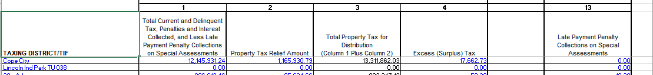
49TC County Treasurer Responsibilities
County Treasurer completes the “Statement of Tax Collections” based on the data on the cash book
Taxing District/TIF - Enter the district names
Column 1 - Enter the Total Current & Delinquent Tax, Penalties & Interest Collected, Less the Late Payment Penalty Collections on Special Assessments
Indiana State Comptroller Elise Nieshalla

Slide 7
49TC County Treasurer Responsibilities, cont.
Column 2 - Enter the Property Tax Relief Amount provided by the County Auditor
Column 3 - Contains an embedded formula to calculate the total property tax for distribution; Column 1 plus Column 2
Column 4 - Enter the Excess (Surplus) Tax
Column 13 - Enter the Settlement of Late Payment Penalties
Indiana State Comptroller Elise Nieshalla

Slide 8
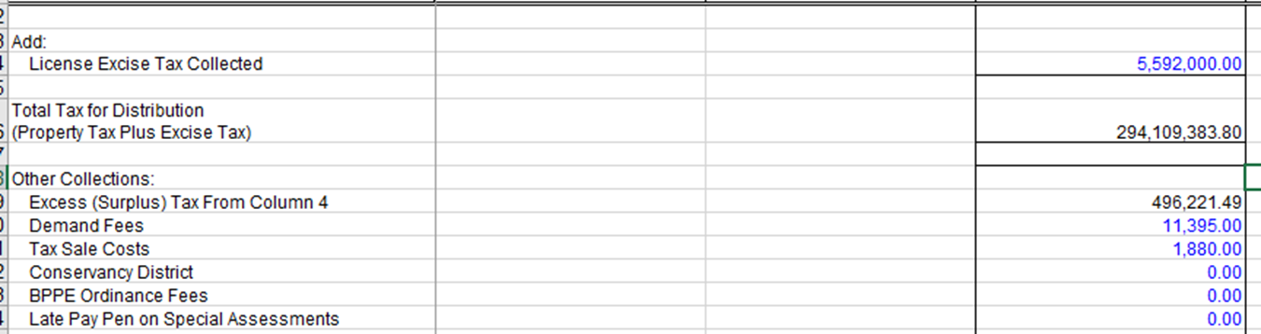
49TC County Treasurer Responsibilities, cont.
Treasurer will enter the License Excise Tax Collected & Other Collections in the lower section of column 3
Indiana State Comptroller Elise Nieshalla

Slide 9
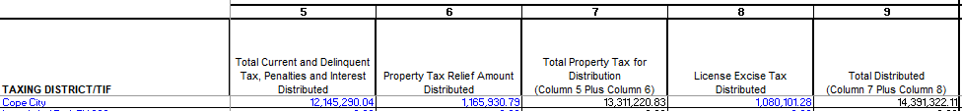
49TC County Auditor Responsibilities
County Auditor completes the balance of the 49TC with information from the tax system on the Form 102’s
Column 5 - Enter the Total Current & Delinquent Tax, Penalties & Interest being distributed
Column 6 - Enter the Property Tax Relief Amount being distributed
Indiana State Comptroller Elise Nieshalla

Slide 10
49TC County Auditor Responsibilities, cont.
Column 7 - Contains an embedded formula to calculate the total Property Tax for distribution by taxing district; Column 5 plus Column 6
Column 8 - Enter the License Excise Tax to be distributed
Column 9 – Contains embedded formula to calculate the total amount to be distributed by taxing district; Column 7 plus Column 8
Indiana State Comptroller Elise Nieshalla

Slide 11
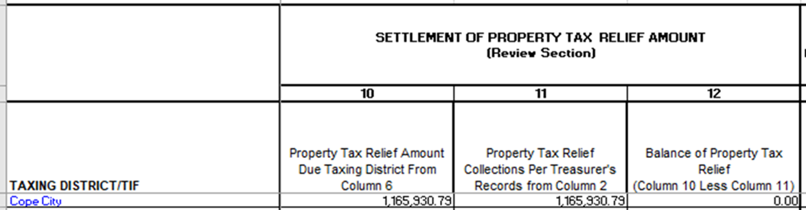
49TC Review Section
There will only be entries in this section if your county has property tax relief. If refunds are included in Form 102 Section A, there will be variance amount listed in column 12.
Column 12 determines if the treasurer needs more transferred from the PTR fund or if the treasurer has more PTR on the cash book that is needed for settlement
Indiana State Comptroller Elise Nieshalla

Slide 12
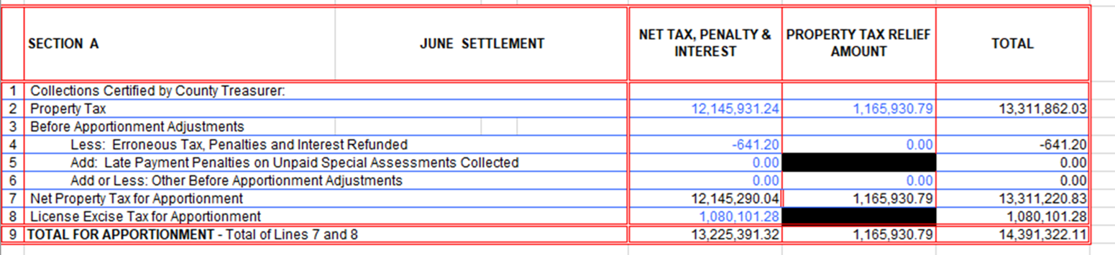
Settlement Form 102 Section A Line 2
Net Tax, Penalty & Interest column is the amount of property tax, penalty & interest collected for the taxing district
Property Tax Relief Amount column is the amount of property tax relief apportioned for the taxing district
Total column is the total net tax, penalty, & interest and the property tax relief apportioned for the taxing district
Indiana State Comptroller Elise Nieshalla

Slide 13
Settlement Form 102 Section A Line 4
Less: Erroneous Tax, Penalty & Interest column is the amount of property tax, penalty & interest refunded by taxing district from the Form 17TC
Property Tax Relief Amount column is the amount of property tax relief refunded by taxing district from the Form 17TC
Indiana State Comptroller Elise Nieshalla

Slide 14
Settlement Form 102 Section A Line 4, cont.
Total column is the total net tax, penalty & interest, and the property tax relief refunded by taxing district from the Form 17TC
Indiana State Comptroller Elise Nieshalla

Slide 15
Settlement Form 102 Section A Line 5
Add: Late Payment Penalties on Unpaid Special Assessments Collected in the Net Tax, Penalty & Interest column.
This references the amount of late payment penalties on unpaid special assessments collected shown in column 13 of the 49TC by taxing district.
You cannot enter PTR data on this line.
Indiana State Comptroller Elise Nieshalla

Slide 16
Settlement Form 102 Section A Line 6
Add or Less: Other Before Apportionment Adjustments
Net Tax, Penalty & Interest column is the amount of other adjustments, such as NSF fees, prior settlement adjustments.
Indiana State Comptroller Elise Nieshalla

Slide 17
Settlement Form 102 Section A Line 6, cont.
Add or Less: Other Before Apportionment Adjustments
Property Tax Relief Amount column is the amount of PTR applicable to the other adjustments
Total column is total of other adjustments
Indiana State Comptroller Elise Nieshalla

Slide 18
Settlement Form 102 Section A Line 7
Net Tax, Penalty & Interest column is the property tax amount less the amount of erroneous tax, penalties, & interest refunded, added late payment penalty on unpaid special assessments collected, & less or added other before apportionment adjustments.
(Line 2 - Line 4 + Line 5 +/- Line 6)
Indiana State Comptroller Elise Nieshalla

Slide 19
Settlement Form 102 Section A Line 7, cont.
Property Tax Relief Amount column is the property tax relief less property tax relief from erroneous tax, penalties & interest refunded. (Line 2 - Line 4)
Total column is the total net tax penalty & interest plus the property tax relief amounts in line 7
Indiana State Comptroller Elise Nieshalla

Slide 20
Settlement Form 102 Section A Line 8
License Excise Tax for Apportionment
Net Tax, Penalty & Interest column is the amount of excise tax to distribute from the final column of the Excise Tax Allocation worksheet by district
Indiana State Comptroller Elise Nieshalla

Slide 21
Settlement Form 102 Section A Line 8, cont.
Total column is the amount in the Net Tax, Penalty & Interest column
You cannot enter data PTR data on this line
Indiana State Comptroller Elise Nieshalla

Slide 22
Settlement Form 102 Section A Line 9
Net Tax, Penalty & Interest column is the total of Line 7 amount plus the line 8 amount
Property Tax Relief Amount column is the total of the line 7 amount
Total column equals the total of Line 7 amount plus the line 8 amount
Indiana State Comptroller Elise Nieshalla

Slide 23
Settlement Form 102 Section A-1
Section A-1 is completed for December Settlement only
More detail on this section will be provided later in the year, but note the increase in complexity in December compared to June.
Indiana State Comptroller Elise Nieshalla

Slide 24
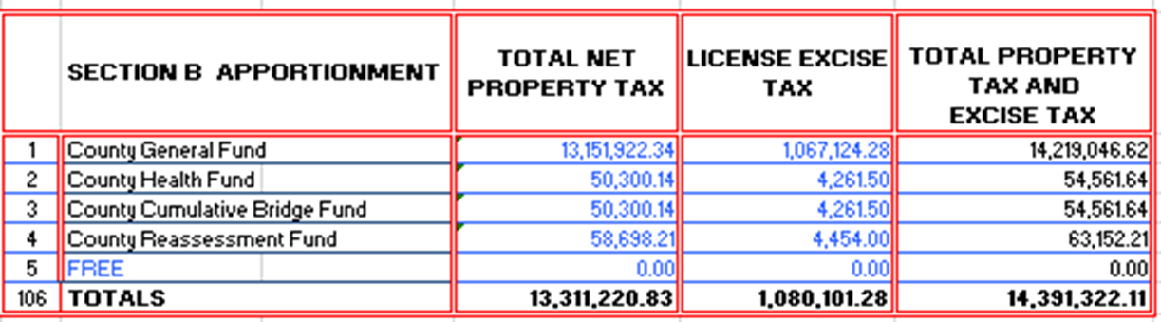
Settlement Form 102 Section B
The Form 102 is completed for each taxing district in the county
Section B will always display 106 rows of data
Section B uses the same net property & excise taxes available from Section A, but displays tax dollars by unit & by fund
Indiana State Comptroller Elise Nieshalla

Slide 25
Settlement Form 102 Section B, cont.
Total Net Property Tax – Enter the amount of property tax apportioned to each of the taxing district funds
The apportionment of the Net Property Tax is calculated using the Circuit Breaker Rates provided by DLGF
Indiana State Comptroller Elise Nieshalla

Slide 26
Settlement Form 102 Section B, cont.
License Excise Tax – Enter the amount of excise tax apportioned to each of the district funds
The apportionment of the License Excise Tax is calculated using the Certified Tax Rates provided by the DLGF
Indiana State Comptroller Elise Nieshalla

Slide 27
Settlement Form 105
The Form 105 is the aggregate total of each of the Form 102’s.
The Form 105 includes:
Section A: June Settlement
Section A-1: December Settlement
Section B: Apportionment
Section C: Fines and Fees due State amount
Indiana State Comptroller Elise Nieshalla

Slide 28
Settlement Form 105 Section C
Section C is pre-populated with the name of fines & fees due
More in-depth description of the Fines & Fees can be found in the Settlement Instructions, Section C
Indiana State Comptroller Elise Nieshalla

Slide 29
Settlement Form 105 Section C
Fines & Fees are various dollars collected by the county based on Indiana Statute
Not every county will have every fine or fee listed in Section C
Fines & Fees are to be remitted electronically to the Office of State Comptroller once county settlement is pre-approved
The remittance to the State must occur by June 30th for the Spring Settlement & by December 31st for the Fall Settlement
Indiana State Comptroller Elise Nieshalla

Slide 30
Settlement
Below is a chart displaying the numbers of submissions for June & December 2023 settlements
When a submission comes in, the State does a complete review of all the data fields
If any issue(s) is (are) identified, the county is contacted, the correction(s) is (are) made, then resubmitted & re-reviewed
Indiana State Comptroller Elise Nieshalla

Slide 31
Settlement Checklist
Settlement Checklist was created for the county to use to verify their data prior to submitting settlement for approval
The Checklist simulates “most” of the State’s review
The Checklist allows the county to self-review their information prior to submission for consistency across forms in reporting
Provided by the State during settlement process
Submit to State upon completion
Indiana State Comptroller Elise Nieshalla

Slide 32

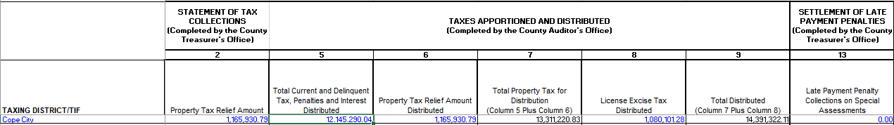
Settlement Checklist Example 1
Form 102 Section A
49TC
Form 49TC Column 7 amount is Section A, Line 7 “Net Property Tax for Apportionment” Total column of Form 102
Form 49TC Column 9 amount is Section A, Line 9 “Total For Apportionment” Total column of Form 102
Indiana State Comptroller Elise Nieshalla

Slide 33
Settlement Checklist Example 2
Form 102 Section A
49TC
Form 102 Line 7, Net Property Tax for Apportionment, is the amount on the Form 49TC Column 5
Form 49TC Column 2 is the LIT Property Tax Relief Amount received from County Auditor
Indiana State Comptroller Elise Nieshalla

Slide 34

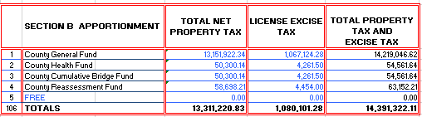
Settlement Checklist Example 3
Form 102 Section A
Form 102 Section B
Form 102 Section B, “Total Net Property Tax” column total equals Section A, Line 7
The “License Excise Tax” column is the total of Section A, Line 8
Total Property Tax and Excise Tax column total is the total of Section A, Line 9
Indiana State Comptroller Elise Nieshalla

Slide 35
Settlement Pre-Approval & Approval
Submission of Settlement forms to the Comptroller FTP site/email
State Comptroller review
Pre-Approval notification sent to County Auditor & Treasurer
Form 105 Certification (E-Signature form) placed on FTP site/email
County Auditor completes E-Signature form & uploads completed form to FTP site/email
Indiana State Comptroller Elise Nieshalla

Slide 36
Settlement Pre-Approval & Approval
Remit to State Comptroller
Section C Fines & Fees
Excise Tax due to the State
Outstanding items listed below as applicable
Judges Supplemental: One-half of the total due for the year must be remitted - Due Feb 1, 2024 & May 1, 2024
Fines & Forfeitures - Due May 1, 2024
Once all steps are completed & remittance collected, the final approval email will be sent to the County Auditor & Treasurer
Indiana State Comptroller Elise Nieshalla

Slide 37
Settlement Pre-Approval & Approval, cont.
The statutory deadline to complete Spring Settlement is June 30
Includes the County submission, State review, State approval & County distribution of taxes to each unit in their county
County Auditor must report to DLGF the taxes distributed via the DECAF application on Gateway
The amounts will be reported by unit & by fund and will be separated by Property Tax, Excise, Examination of Records, FIT & CVET
The statutory deadline for reporting to DLGF is July 15
DLGF will use these amounts during each unit’s budget certification
Indiana State Comptroller Elise Nieshalla

Slide 38
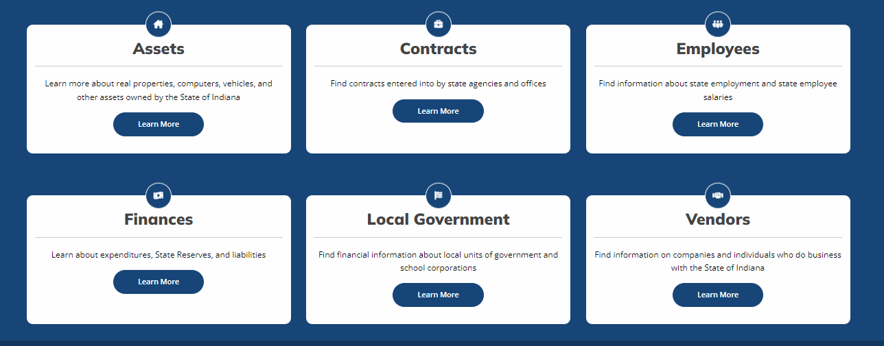
Indiana Transparency Portal (ITP)
IN.gov/ITP
Direct link on the State Comptroller’s website
Indiana State Comptroller Elise Nieshalla
Notes:
The following options available to view:
Assets owned by the State of Indiana
State contracts
State employee salaries
State financial data including information on expenditures, reserves, and liabilities
Local government financial information

Slide 39
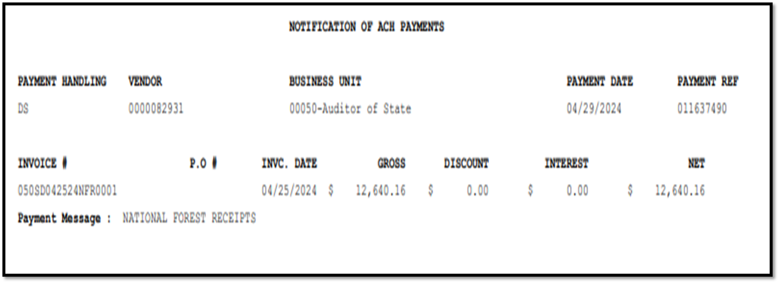
Automated Clearing House (ACH) Notifications
ACH notification provides:
Vendor number
Payment date
Reference number
Dollar amount
Business unit number
Agency name
Payment message
For entities receiving an ACH notification who are uncertain what the remittance is for, we have a listing of Agency Contacts to assist in answering those questions.
Indiana State Comptroller Elise Nieshalla

Slide 40
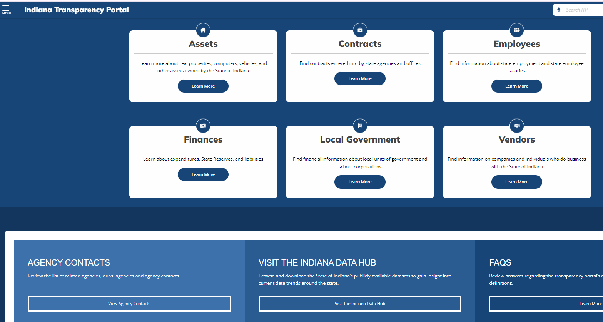
ITP Resources for ACH Notifications
Visit ITP to access the Agency Contact listings
Scroll down to Agency Contacts & click on View Agency Contacts
Indiana State Comptroller Elise Nieshalla

Slide 41
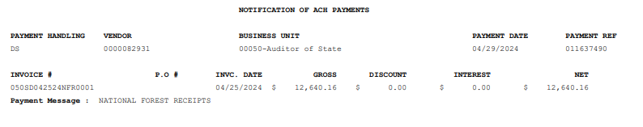
ITP Resources for ACH Notifications Example 1
Using the portal, the county can identify a contact email address for the state agency that triggered the distributions
Indiana State Comptroller Elise Nieshalla

Slide 42
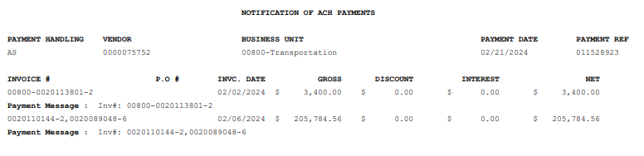
ITP Resources for ACH Notifications Example 2
Indiana State Comptroller Elise Nieshalla

Slide 43
ITP & ACH Notifications
ACH notifications are sent to the county employees as requested by the elected official
If a change in recipients is necessary, provide the name & email address of any employees needing to be removed or added to the list of recipients & forward to localgovernment@comptroller.in.gov
Indiana State Comptroller Elise Nieshalla

Slide 44
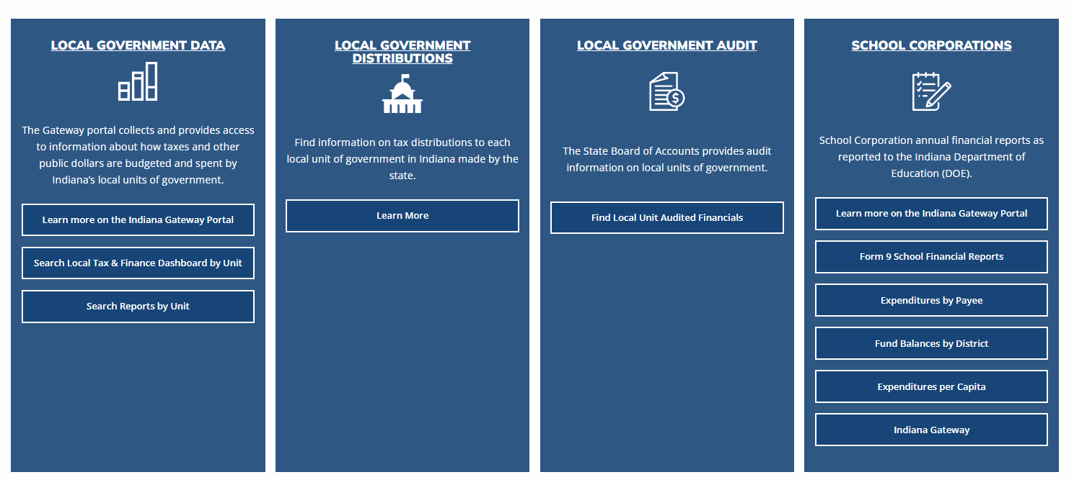
ITP Local Government Enhancements
Improved functionality and navigation on the Local Government Dashboard (in.gov/itp/local-government)
Indiana State Comptroller Elise Nieshalla

Slide 45
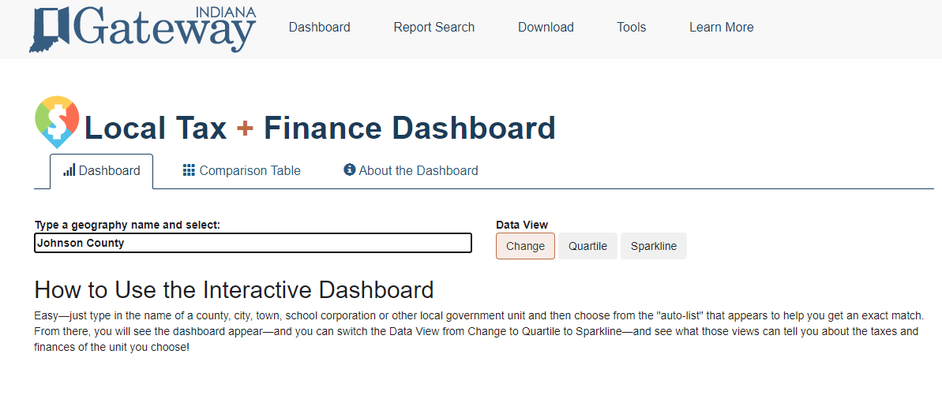
ITP Local Government Enhancements
Search Indiana Gateway's Local Tax & Finance Dashboard by unit
Indiana State Comptroller Elise Nieshalla

Slide 46
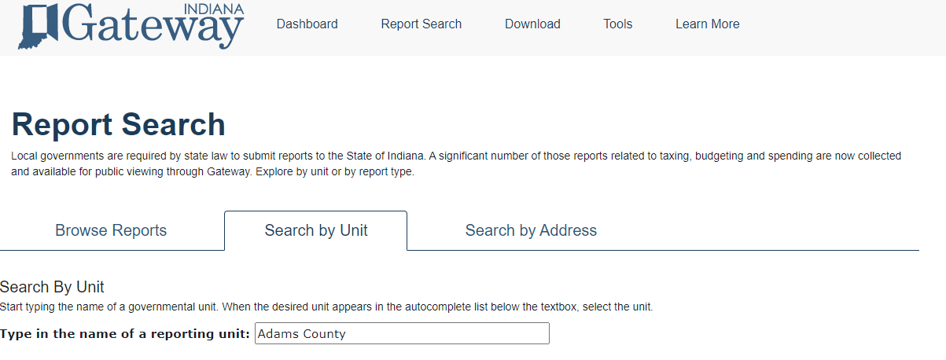
ITP Local Government Enhancements
Search Indiana Gateway reports by unit
Examples: Annual Financial Report, Budgets, County Abstract Public Reports, Debt Management
Indiana State Comptroller Elise Nieshalla

Slide 47

At Your Service
JANIE COPE JILL ONION
Local Government Specialist Assistant Director
317-233-1712 317-232-3328
jcope@comptroller.in.gov jonion@comptroller.in.gov
FRED VAN DORP GENERAL EMAIL
Accounting & Reporting Director localgovernment@comptroller.in.gov
317-232-3309
fvandorp@comptroller.in.gov
Indiana State Comptroller Elise Nieshalla

Slide 48

THANK YOU
JANIE COPE, JILL ONION & FRED VAN DORP
Office of Indiana State Comptroller Elise Nieshalla

