Slide 1


Indiana State Comptroller's Office
Fred Van Dorp
Director of Accounting & Reporting and Local Government

Slide 2

State Comptroller Core Responsibilities – State Level
Accounting & Reporting
Maintains the state’s accounting system
Reports the state’s financial position
  Annual Comprehensive Financial Report (ACFR)
  Schedule of Expenditures of Federal Awards (SEFA)
Accounts Payable
Approves all payments & manages vendor administration for the State
Researches & issues replacements of lost/missing state warrants
Payroll
Processes payroll for 30,000+ employees
Hoosier START
  Administers the state’s deferred compensation plan
  Indiana Transparency Portal
Indiana State Comptroller Elise Nieshalla

Slide 3
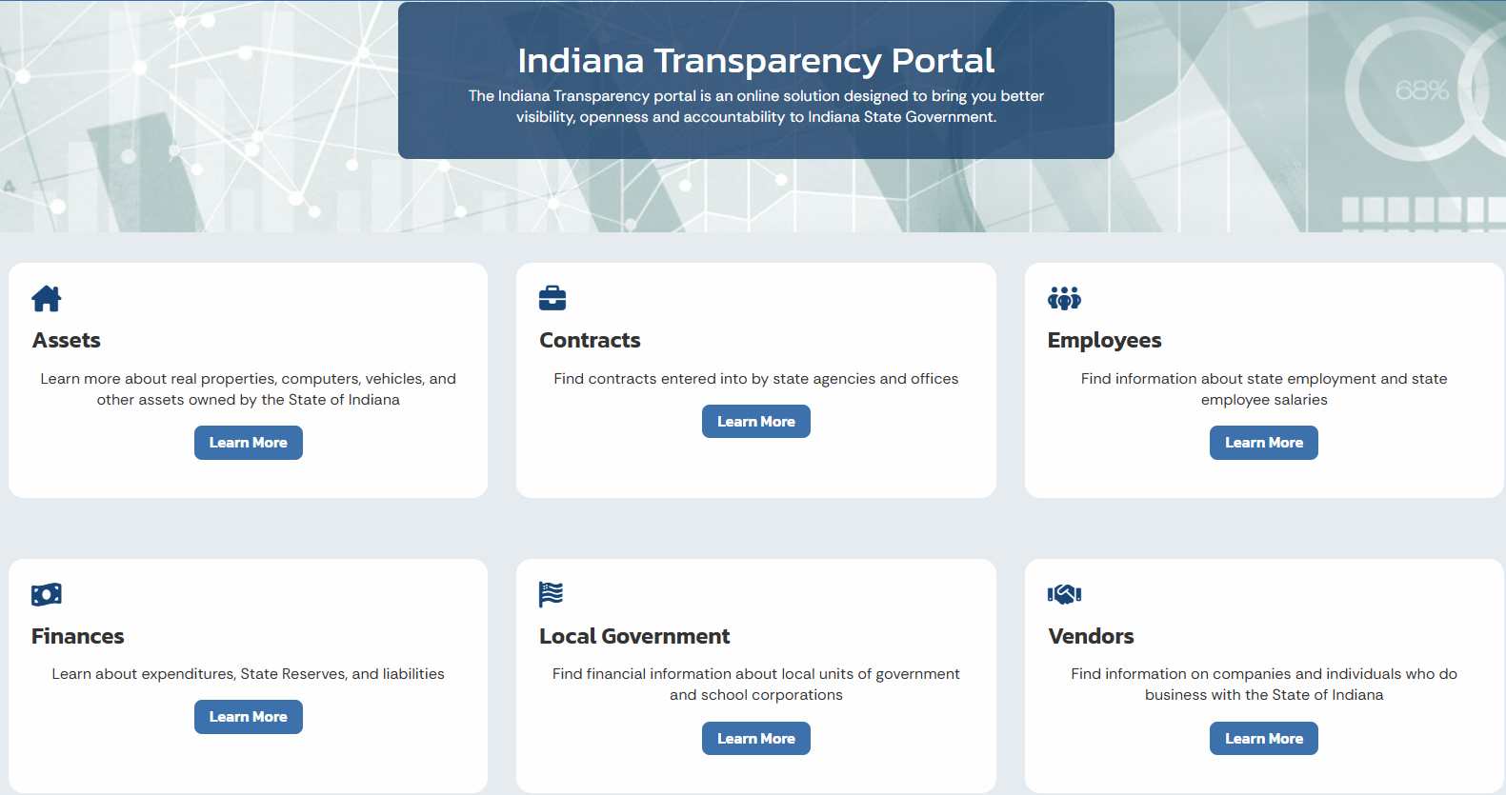
Comptroller Core Responsibilities – ITP
The Indiana Transparency Portal or ITP is an online solution designed to bring better visibility, openness & accountability to government in Indiana.
www.in.gov/itp
Indiana State Comptroller Elise Nieshalla

Slide 4
State Comptroller Core Responsibilities – Local Level
  Reviews Semi-Annual Property Tax Settlement
  Receives the State’s portion of various taxes collected at the local level (State Tax Remittances)
  Calculates & distributes local taxes collected at a State level (State Distributions)
Indiana State Comptroller Elise Nieshalla

Slide 5
Semi-Annual Property Tax Settlement
While property taxes are billed, collected & spent at a local level, the Comptroller’s Office will work closely with the County Auditor & County Treasurer to review the property & excise taxes before local tax distributions begin.
County Auditors must submit various state forms, spreadsheets & reconciliations to the Comptroller’s Office semi-annually for review before the tax distribution deadline.
  The deadlines for property tax distributions are June 30 & December 31
  https://www.in.gov/comptroller/departments/settlement-forms/
Comptroller Office’s review helps to ensure a smooth & accurate tax distribution to the local political subdivisions across the State.
Indiana State Comptroller Elise Nieshalla

Slide 6
State Tax Remittances from Local Government
Comptroller’s Office serves as a singular collection entity for various taxes initially collected at a local level.
Money remitted to the Comptroller’s Office will be deposited on behalf of the appropriate state agency referenced in statute.
Calendar Year Total | Total Remittance
2022 | $347M
2023 | $338M
2024 (Year to Date) | $192M
Indiana State Comptroller Elise Nieshalla

Slide 7
State Tax Distributions to Local Government
Comptroller’s Office initiates, calculates & distributes state taxes collected by DOR & BMV to local recipients across the State.
  Tax Distributions & Remittance Calendar
Money distributed will be deposited into the appropriate local bank account, previously provided to the office & will initiate an email notification with short explanation of what the money is for.
Historical information about all payments from the State, including ones initiated by the Comptroller, is available upon request.
Indiana State Comptroller Elise Nieshalla

Slide 8
State Tax Distributions to Local Government
General Tax Category | Distribution Amount January 1 - November 30
Local Income Tax | $ 4,006,923,968.56
Motor Vehicle Highway | $ 544,982,008.74
Excise | $ 216,294,262.12
Various Gaming Taxes | $ 191,905,655.15
Stadium | $ 188,122,375.60
Local Road and Street | $ 144,597,066.41
Financial Institution Tax | $ 58,865,788.14
Food and Beverage Tax | $ 52,850,679.08
Commercial Vehicle Excise Tax | $ 47,697,787.70
Innkeepers Tax | $ 29,550,192.73
Alcoholic Beverage Tax Gallonage | $ 10,645,156.70
Other Various Taxes | $ 5,270,883.44
Indiana State Comptroller Elise Nieshalla

Slide 9
State Tax Distributions to Local Government
Comptroller-initiated statutory distributions vary in complexity, calculation & recipients.
  State Comptroller Distribution Factors
  Commercial Vehicle Excise Tax Report (CVET)
  Financial Institutions Tax (FIT)
  Local Motor Vehicle Highway (MVH) & Local Road and Street (LRS) Account
  Local Option Income Tax Reports (LOIT)
  Riverboat Revenue Sharing Distribution
Additional information, calendars & resources are posted on the Comptroller’s website.
Indiana State Comptroller Elise Nieshalla

Slide 10
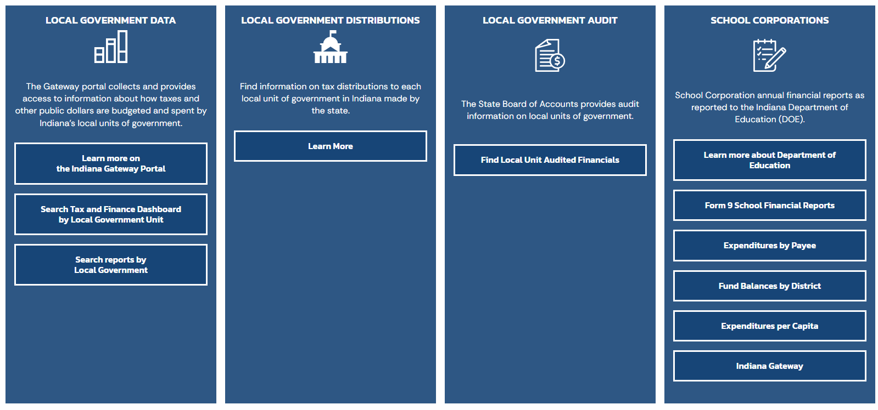
Comptroller Core Responsibilities – Local Level
ITP also contains information related to local units of governments.
Provides a direct link to information posted on the Gateway.
Indiana State Comptroller Elise Nieshalla

Slide 11
At Your Service
FRED VAN DORP JANIE COPE
Accounting & Reporting Director Local Government Specialist
317-232-3309 317-233-1712
fvandorp@comptroller.in.gov jcope@comptroller.in.gov
GENERAL EMAIL
localgovernment@comptroller.in.gov
Comptroller Website
https://www.in.gov/comptroller/
Indiana State Comptroller Elise Nieshalla

