Slide 1

2025 SASP RFP Webinar
October 3, 2024

Slide 2



Thanks for joining us today:
Please keep your lines muted during the presentation.
Webinar is being recorded and will be posted on the ICJI website.
Questions and Answers at the end.
Feel Free to utilize the chat box during the webinar.

Slide 3

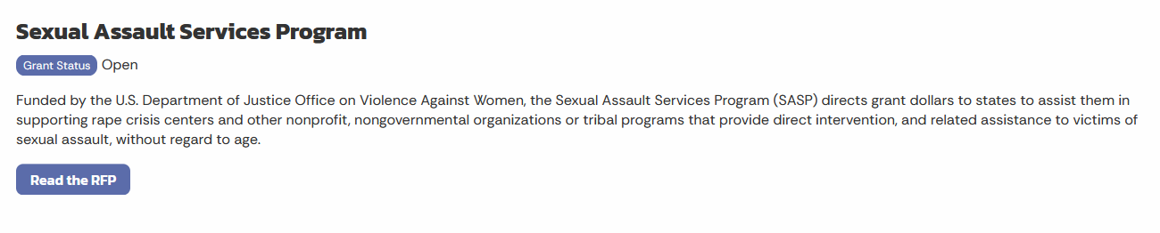
Accessing the Request for Proposal
In.gov/cji → Victim Services → Sexual Assault Services Project (SASP) → 2025 SASP RFP
https://www.in.gov/cji/victim-services/sasp/

Slide 4
2025 SASP (Sexual Assault Services Program) Violence Against Women Formula Grant Application
Application opened: September 24th, 2024
Application closes: October 31st, 2024
Applicants are strongly encouraged to submit applications 48 hours prior to the deadline.
Award period for SASP: January 1, 2025, to December 31, 2025
(12-month award period)
Projects should begin on January 1, 2025, and must be in operation no later than 60 days after this date. Failure to have the funded project operational within 60 days from January 1, 2025, will result in the cancellation of the grant and the de-obligation of all awarded funds.

Slide 5
SASP Overview:
The Sexual Assault Services Program (SASP) was created by the Violence Against Women and Department of Justice Reauthorization Act of 2005, 34 U.S.C. § 12511. The program directs grant dollars to states to assist them in supporting rape crisis centers and nonprofit, nongovernmental organizations that provide core services, direct intervention, and related assistance to victims of sexual assault.

Slide 6
SASP Funding Eligibility
Eligible applicants include:
  Nonprofit, nongovernmental rape crisis centers
  Nonprofit, nongovernmental dual programs that provide sexual assault and domestic violence services
  Governmental entity rape crisis (or dual) centers.
    The entity may not be part of the criminal justice system (such as a law enforcement agency) and must be able to offer a comparable level of confidentiality
  Faith-based organizations that have staff specifically trained to serve victims of sexual assault
  Other state, local public, and nonprofit agencies such as mental health or counseling centers or other programs that have staff specifically trained to serve victims of Sexual Assault
Other Requirements include:
  Registered UEI
  Active and current registration with SAM.gov
  Good standing with the Department of Revenue (DOR), Department of Workforce Development (DWD), and Secretary of State (SOS)

Slide 7
SASP Purpose Areas
  Funds under this program must be used to provide intervention and related assistance to:
    Adult, youth, and child victims of sexual assault;
    Family and household members of such victims; and
    Those collaterally affected by the victimization, except for the perpetrator of such victimization
  Funds under this program must be used to support the establishment, maintenance, and expansion of rape crisis centers and other nongovernmental or tribal programs and activities that provide direct intervention and related assistance to individuals who have been victimized by sexual assault, without regard to the age of individual.

Slide 8
SASP Allowable Activities and Costs
The activities and associated costs for the activities below are allowable
24-hour hotline services providing crisis intervention services and referral;
Accompaniment and advocacy through medical, criminal justice, and social support systems, including medical facilities, police, and court proceedings;
Crisis intervention, short-term individual and group support services, direct payments, and comprehensive service coordination and supervision to assist sexual assault victims and family or household members;
Information and referral to assist sexual assault victims and family or household members;
Community-based, culturally specific services and support mechanisms, including outreach activities for underserved communities; and
Development and distribution of materials on issues related to the services described above.
Equipment or supplies, applicant shall reveal in application and budget narrative whether they are purchasing, renting, or leasing all listed and proposed equipment or supplies. The applicant shall comply with:
2 C.F.R. § 200.216 and 2 C.F.R. § 200.317
when renting, purchasing, or leasing any telecommunications, video surveillance systems and service, or equipment.
The applicant shall comply with 2 C.F.R. § 200.465 regarding the lease and or rental of real property and equipment

Slide 9
SASP Allowable Activities and Costs Cont.
Direct payments to victims and their family or household members must be for costs related to the sexual assault. OVW encourages payments are paid to vendors directly. Examples of costs that direct payments may cover include, but are not limited to:
Replacement bedding, clothing, or other household items;
Securing new or temporary housing, including paying a security deposit, first month’s rent, or moving expenses;
Travel expenses;
Childcare expenses;
Emergency Food, including culturally appropriate food;
Utility assistance (other than utilities in arrears): and
Security measures such as re-keying locks, replacing a cell phone, or purchasing a motion detector or security camera that does not require installation
De Minimis Rate up to 15% of the Modified Total Direct Costs

Slide 10
SASP Priority Areas
Priority will be given to programs that can and will promote civil rights (including by meeting the needs of underserved and marginalized survivors), improve access to justice for survivors, and enhance survivor safety.

Slide 11
Ineligible Budget Items &
Out-Of-Scope Activities
Ineligible Budget Items
Out-Of-Scope Activities
Food & beverages except emergency food & beverages for victims.
Lobbying
Fundraising and time spent procuring funding
Purchase of real estate or vehicles
Construction and physical modification to buildings including minor renovations
Overtime is allowed, but to claim overtime rate, must be separate budget line item that includes overtime pay.
Research Projects
Activities focused on Prevention Efforts and Public Education
Criminal justice-related projects, including law enforcement, prosecution, courts, and forensic interviews.
Sexual Assault Medical Forensic Examiner programs
Sexual Assault Response Team(SART) coordination.
Providing training to allied professionals and the community.
Domestic violence services unrelated to sexual violence.

Slide 12
Unallowable Activities
This grant program does not fund activities that jeopardize victim safety, deter, or prevent physical or emotional healing for victims, or allow offenders to escape responsibility for their actions.
The following activities have been found to jeopardize victim safety, deter, or prevent physical or emotional healing for victims, or allow offenders to escape responsibility for their actions.
In planning a SASP proposal, please ensure that these activities are NOT included:
Procedures or policies that exclude victims from receiving safe shelter, advocacy services, counseling, and other assistance
Procedures or policies that compromise the confidentiality of information and/or privacy of persons receiving services.
Procedures or policies that require victims to take certain actions in order to receive services.
Procedures or policies that fail to include conducting safety planning with victims
Project designs, products, services, and/or budgets that fail to account for the unique needs of individuals with disabilities, limited English proficiency, Deaf or hard of hearing.
Using technology without addressing implications for victim confidentiality, safety planning, and the need for informed consent.
Partnering with individuals or organizations that support/promote practices that compromise victim safety and recovery or undermine offender accountability.
Materials that are not tailored to the dynamics of sexual assault or to the specific population(s) to be addressed by the project.
Policies that deny individuals access to services based on their relationship to the perpetrator.

Slide 13

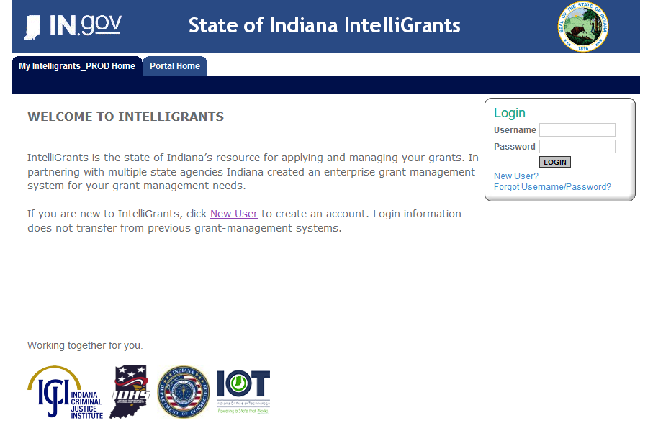
Initiating an application in IntelliGrants
https://indianaintelligrants.intelligrants.com/

Slide 14
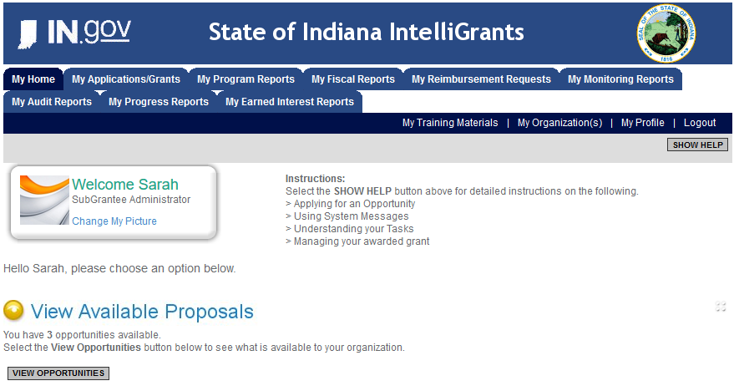
Steps to initiating an application
Log into your IntelliGrants account
  If you do not have an account, then you can obtain one on the home screen of IntelliGrants (New User?)
On the “MY HOME” page access the “VIEW AVAILABLE PROPOSALS” section
Click on VIEW OPPORTUNITIES
IntelliGrants will take you to the My Opportunities page
Access the 2025 SASP Grant
Select “Apply Now”

Slide 15
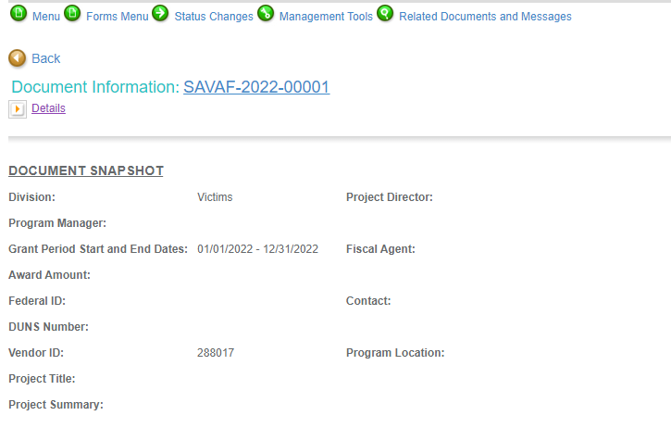
Forms that need to be completed
Contact
Project Information
Programmatic Information
Problem Statement & Analysis
Goals, Objectives, & Outcomes
Program description
Evidence Based/Best Practices
Use of Volunteers
Budget
Budget Narrative
Attachments

Slide 16
Contact
Points of Contact for the grant
(CJI will notify these individuals of your award notice)
Project Information
SAMs Registration must be up-to-date
Audit
If you receive more than $750,000 in federal grant funds, you are required to have an audit. This will be requested if CJI is aware that you receive more than $750,000.
Programmatic Information
Information about your proposed program
Problem Statement & Analysis
All government agency’s audits are included in the County audit and should all have one attached

Slide 17
Goal, Objective, and Outcomes
The goal should directly address the problem identified in the Problem Statement.
Objectives are the steps needed to achieve goals.
Example of Objective: By September 2022, a minimum of 50 culturally and linguistically appropriate support groups for survivors of sexual assault will be provided.
Outcomes measure objectives and are criteria for how the program is deemed to be effective.
Example of Outcome: 85% of participants will indicate that they have learned ways to act in their own best interest.
Program Description
What? Who? Where? Why? When? How?
Evidence Based/Best Practice
Use of Volunteers
Objectives should be concrete, action-oriented, measurable and Specific, Measurable, Achievable, Realistic, Timely (SMART).
Notes:
NOTE:
Goals/Objectives/Outcomes – We have included a Tips for Writing Goals, Objectives and Outcomes on our website that you may find useful when completing this section.
You may visit our website: https://www.in.gov/cji/victim-services/resources/
Remember when completing the Program Description do not include any SASP unallowable activities, include up to date data and answer each question thoroughly. For example, prevention and education activities and using funds to address domestic violence are both unallowable and should not be in the application.

Slide 18
Budget Narrative
  Be sure all items in the budget narrative are included in the Budget Narrative.
    Ex: Office Supplies (copy paper, pencils, pens)
  Grant reviewers are not required to contact you for clarification
  Any missing information in this section may disqualify that budget item for funding.
Attachments Required
  Total Agency Budget (TAB)
    Complete TAB (NON PROFIT/NON GOVERNMENTAL)
    Located: (https://www.in.gov/cji/victim-services/resources/)
  Sustainability Plan
    Plan to maintain program once the grant funds expire
  Timeline
    Outlines completion of project/or expenditures of grant funds
  Letters of Endorsement
    Letters endorsing this program specifically
  Miscellaneous
    Job descriptions for any position listed in personnel
    EEOP Certification
    Determination of Suitability (SASP Applicants)
    If applicable, attach other requested information
Notes:
Here are some helpful hints when completing the Budget Narrative:
Ensure all items being requested in the budget are in the budget narrative, the percentages, annual cost, personnel that are listed in the budget are the same in the narrative.
Administrative duties – please provide a percentage of time each grant funded position will spend on administrative activities which include: completing programmatic documentation, reports and statistics; collecting and maintaining grant records; conducting surveys and needs assessments to improve services delivered and prorated share of audit costs.
Do these positions receive funding from other sources? – Include all positions not 100% grant funded, either the percentage or dollar amount and funding source. Ensure the allocated amounts equal the annual salary amount.
Employee Benefits – For each position, list the percentage or cost paid for by the employer for each benefit. Indicate if this cost is monthly, yearly or per pay period (bi-weekly)
Supply/Operating Expenses – when requesting office supplies, make sure they are categorized by Consummable and NonConsummable, list out all items you intend on purchasing in those budget line items. If you are requesting utilities, technology we ask that you list out the utilities or technology companies in the narrative.

Slide 19
SASP Formula Program
Frequently Asked Questions
May SASP Formula Program funds be used to support services to children?
YES, SASP funds may be used to support projects that focus on direct services for children who are victims of sexual assault. Services rendered to child victims do not have to be provided in connection with serving an adult parent, and there is no age restriction on providing services to child victims. In addition, SASP funds may be used to provide services to children of victims of sexual assault.
May SASP Formula Program funds be used to support projects that include education and prevention activities?
NO, SASP funds may not be used for education and prevention. However, funds may be used for outreach to inform persons about the services provided by a specific program.
May SASP Formula Program funds be used to support projects implemented by child advocacy centers?
Generally, SASP funds cannot support CAC’s because the focus of the program is “establishment, maintenance, and expansion of RCC and projects to assist individuals who have been victimized by SA, without regard to the age of the individual.” SA services must be for victims of all ages. In addition, SASP funds may not be used for prosecution or LE projects such as forensic examinations or forensic interviewing, which are often components of the CACs.
May SASP Formula Program funds be used for volunteer-related expenses?
YES, SASP funds may be used to support volunteer-related activities, so long as those volunteers provide direct services for victims. Ex: training volunteers to provide crisis intervention and supervision volunteers.
Is there a limitation on the types of sexual assault that SASP Formula Program funds may be used to address?
NO, SASP funds may be used to address intimate partner, stranger and non-stranger sexual assault, as well as adult, adolescent, and child sexual violence, regardless when the assault occurred. Both male and female victims may be served.

Slide 20
SASP Formula Program
Frequently Asked Questions
May SASP Formula Program funds be used to address domestic violence?
NO, funds must be used to provide services to victims of SA. In cases when victims of DV disclose a history of SA, including by a current or former intimate partner, services may be provided with SASP funding to the extent that such victim expresses a need for services related to the SA.
May SASP Formula Program funds be used for advocate/staff training?
SASP funds may be used to train program staff (volunteer or employee) who will provide specific grant-funded victim services but may not be used to provide a generalized statewide training. For example, funds may be used to support skill-building training on providing sexual assault advocacy services or training on a particular therapeutic technique to assist SASP-funded counselors/therapists in providing more effective therapy.
May SASP Formula Program funds be used for trainings on sexual assault for other professionals (e.g., for law enforcement officers, mental health professionals, prosecutors, etc.)?
NO, SASP funds must be used for direct services. They may not be used for general training nor may the be used to develop training curricula.
May SASP Formula Program funds be used for Sexual Assault Response Teams (SARTs)?
NO. However, if an advocate position is funded under the grant, the advocate’s time in attending SART meetings may be covered as part of the advocacy they provide.
Can SASP Formula Program funds awarded be used towards items such as rent, office supplies, computer equipment, or office furniture?
YES, if the grant is also funding a staff or contract position to provide direct services. The office space and other office items (e.g., computer, phone, desk, etc.) associated with this position may be charged to the grant.

Slide 21

IMPORTANT NOTES
All grants from ICJI Victim Services are reimbursement grants, which means that the agency must first incur the expense prior to CJI reimbursing for the expense. Verification of expenses along with verification of payment of expenses must be provided to ICJI on a monthly or quarterly basis prior to reimbursement of expenses by ICJI.
No match required for SASP

Slide 22

For technical assistance contact the ICJI Helpdesk at CJIHelpDesk@cji.in.gov. Help Desk hours are Monday – Friday, 8:00 am to 4:30 pm ET, except state holidays.
ICJI is not responsible for technical issues with grant submission within 48 hours of grant deadline.
For assistance with any other requirements of this solicitation, please contact The Victim Services Division at ICJI.

Slide 23

Contact Info:
Dalayna Anderson, Victim Services Program Specialist
DaAnderson1@cji.in.gov
Becky Venus, Victim Services Senior Grant Manager
Rvenus@cji.in.gov

