Slide 1
New Administrators Training
Session 3
Fiscal Reporting

Slide 2
A few things to keep in mind for this webinar:
Please keep your lines muted during the presentation.
Webinar is being recorded. It will be posted on the CJI website.
Questions and Answers at the end.
Feel free to utilize the chat box during this webinar, we are monitoring the questions.
Thank you for joining us today.

Slide 3
Frequency of Reporting
The frequency of fiscal and program reporting is determined by the subgrantee agency during the grant approval process.
Options for reporting frequency are monthly or quarterly
Once you have selected the reporting frequency option it cannot be changed during the grant period.
Reporting dates for a subgrantee with monthly reports are the 20th of the month following the reporting period.
Reporting dates for a subgrantee with quarterly reports is the 20th of the month following the quarter.

Slide 4
Reporting Frequency Quarterly Reports with due dates
Quarterly Reports with a grant that starts 10/1
FR1 due 1/20 Period 10/1 – 12/31
FR2 due 4/20 Period 1/1 – 3/31
FR3 due 7/20 Period 4/1 – 6/30
FR4 due 10/20 Period 7/1 – 9/31
One-year grants will have 4 Quarterly reports and Two-year grants will have 8 Quarterly reports.
Monthly and Quarterly reports are based off the months/quarters in the Grant period not based on a calendar year or fiscal year.

Slide 5
Reporting Frequency – Monthly reports with due dates
FR1 due 11/20 Period 10/1 – 10/31
FR2 due 12/20 Period 11/1 – 11/30
FR3 due 1/20 Period 12/1 – 12/31
FR4 due 2/20 Period 1/1 – 1/31
FR5 due 3/20 Period 2/1 – 2/28
FR6 due 4/20 Period 3/1 – 3/31
FR7 due 5/20 Period 4/1 – 4/30
FR8 due 6/20 Period 5/1 – 5/31
FR9 due 7/20 Period 6/1 – 6/30
FR10 due 8/20 Period 7/1 – 7/31
FR11 due 9/20 Period 8/1 – 8/31
FR12 due 10/30 Period 9/1 – 9/31
For 1-year grants there will be 12 fiscal reports and for 2-year grants there will be 24 fiscal reports.

Slide 6
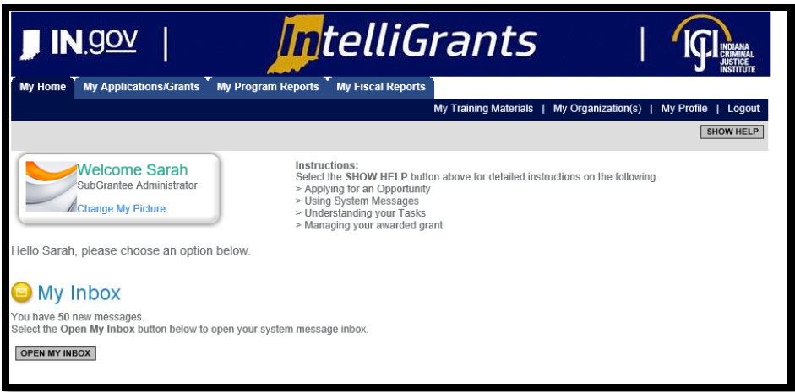
How to Initiate a Fiscal Report
Once logged in, you should see the following screen:
This would be your Home Screen for IntelliGrants.

Slide 7
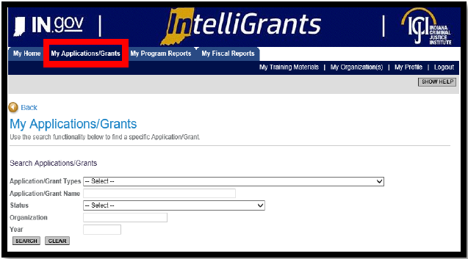
There are two ways to access your Grant
The first way is to go to My Applications/Grants

Slide 8
Accessing your Grant
Once you have clicked on My Applications/Grants then utilize the search fields to find a specific grant. Suggestion: clear out fields first (click on Clear button) as IntelliGrants keeps results of your last search in the fields.
Example on next page. All search fields were cleared and then we selected a grant to open, VOCA-2018. After utilizing either the line Application/Grant Type or Application/Grant Name and then Search.

Slide 9
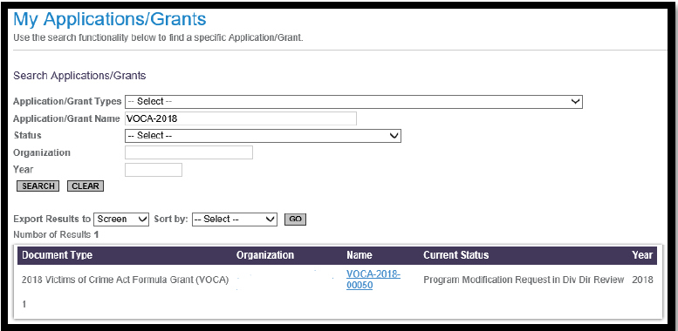
Accessing your Grant
To review the grant, you will want to click on the grant name. For example it would be VOCA-2018-00050. This will take you to the document snapshot page.

Slide 10
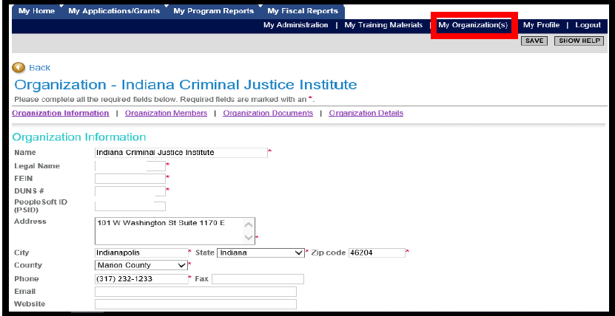
Accessing your grant
The second way you can access your grant is by using the My Organization page on the upper right side of the screen.

Slide 11
Accessing your Grant
Once you have selected My Organization then you should see your agency’s information prepopulate. To navigate to a particular grant select Organization Documents.
Organization Documents will pull up all the documents that your agency has initiated. You will want to select the specific grant for which you wish to initiate a report.

Slide 12
Accessing your Grant
Make sure you select the Grant Name. Once you click on the Grant name it will take you to that Grant’s Document Snapshot page.

Slide 13
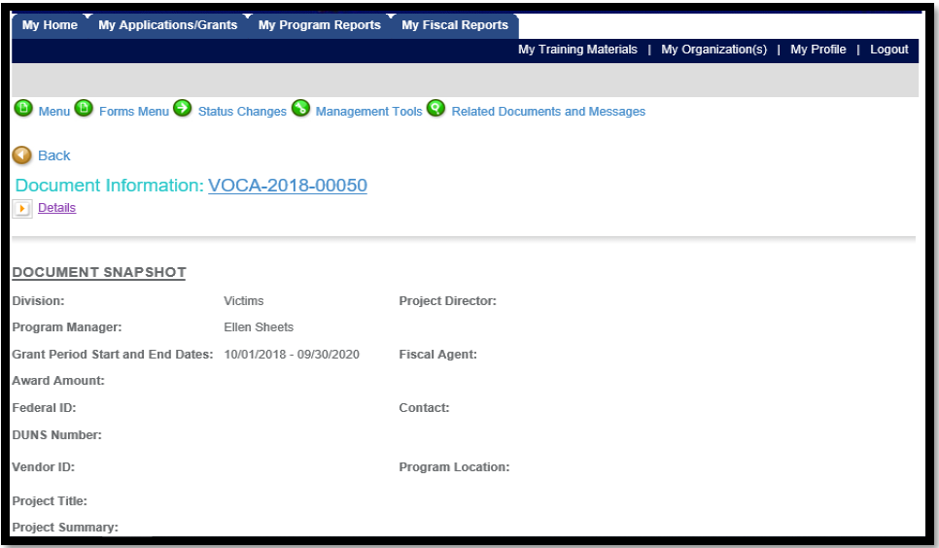
Initiating a Fiscal Report
Once you have reached the Document snapshot page, follow the next set of instructions to initiate the fiscal report.

Slide 14
Initiating a Fiscal Report
Click on the Related Documents and Messages link (5th green button) or hover over the link and scroll down.

Slide 15
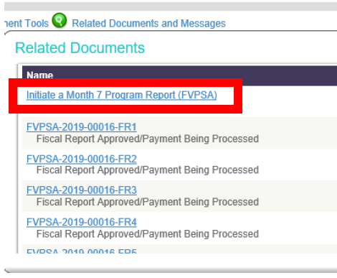
Initiating your Fiscal Report
There should be links to initiate reports- (fiscal and program). Example is Program but Fiscal looks the same.
Once you click on the report you wish to initiate, the system will send you to the Document Snapshot page for the fiscal/program report.

Slide 16
How to access an already created fiscal report
There are two ways you can access a fiscal report that has already been created, depending on where you are in IntelliGrants.
If you are on the home page of IntelliGrants that shows your Inbox, View Available Proposals and Task list then you will go to the My fiscal Reports tab at the top of the home page.

Slide 17
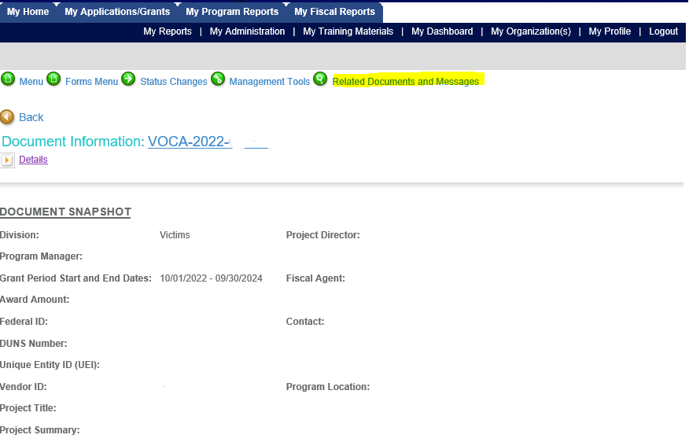
How to access an already created fiscal report
If you are on the Document Snapshot page of your grant, then to access a created fiscal report you go to Related Documents and messages and scroll down until you find it.
Once you select the fiscal report you want to review you will be taken to a new snapshot page that will show a list of fiscal reports and dates they were submitted and by whom.

Slide 18
Fiscal Reports
In the follow slides we will be discussing each of the pages within the fiscal reports, Program Income and required documentation. These will take up the most of our training time and will probably generate the most questions. Many of your questions will mostly likely occur when you are working on your first fiscal report. This PowerPoint can be used as a guide as well as policies that are on the CJI website which we will reference in this section.
The final few topics to be covered are frequently asked questions that almost every agency has asked at one time or another.
The examples used in the following slides have had identifying information about the agencies removed, this includes Position and Name of employees on the Personnel Section and Grant number.

Slide 19
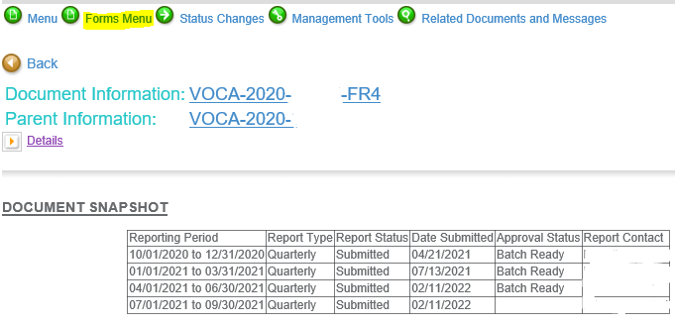
Financial Accounting and Claim Form
To access the Financial Accounting and Claim form from the fiscal report document snapshot page you go up to the Forms menu, which is the second green button at the top of the page. Hover over this and click on the Financial Accounting and claim form link.

Slide 20
Financial Accounting and Claim form
The Fiscal Accounting and Claim form is one page with 3 sections and we will discuss all 3 sections.
Many of the areas on the Financial Accounting and Claim form is pre-populated from the Grant or the Fiscal Report itself.

Slide 21
Top section of the Financial Accounting and Claim form
Project Start and End date is the Grant start and end dates
Report Start and end date is the period for which the fiscal report is claiming.
Submitted date will populate to show the date the report was first submitted.
Report due date is the date the report is due.

Slide 22
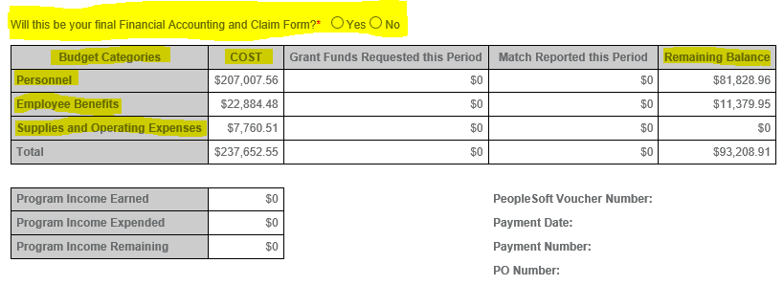
Financial Accounting and Claim form
The next section starts with the question “Will this be your final Financial Accounting and Claim form?” It is a required question. This should only be marked yes if you are submitting the final fiscal and should not be marked yes otherwise unless asked to by your CJI Grant Manager.

Slide 23
Financial Accounting and Claim form
The Budget categories will show only the categories in which grant funds have been approved on your Grant. In this example there was no request for Equipment in the grant application therefore there is no equipment line on the fiscal report.

Slide 24
Financial Accounting and Claim form
The cost column is the amount of grant funds that were approved in that category for the grant period. The remaining balance column shows the amount of grant funds remaining in each category after the reimbursement amounts are approved for the fiscal report. The numbers in the top grid are populated by the fiscal report itself and you will not need to fill this section out.

Slide 25
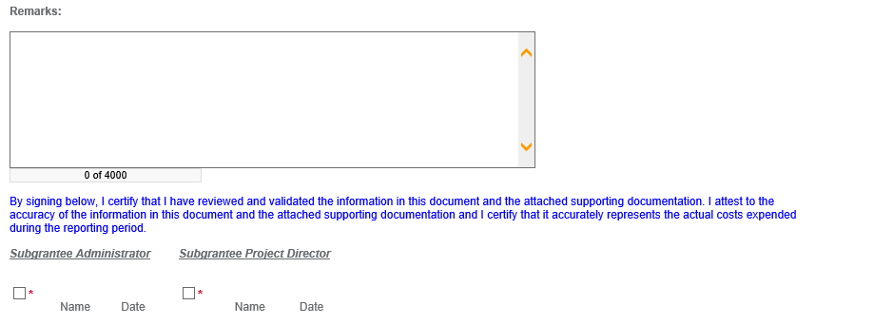
Financial Accounting and Claim Form
The remarks section of this page is for the agency to make a note about anything that has changed, is unusual or is missing. It can also be used if there is something you wanted to let your CJI grant manager know about the fiscal report.

Slide 26
Financial Accounting and Claim form
Signature section is required for 2 people to sign. 1 person must be in the IntelliGrants role of Subgrantee Administrator, and the other person must be in the role of Subgrantee Project Director. This means every agency must have 2 people review and approve fiscal reports before they are submitted. By signing this you are certifying that the report is accurate, and it represents the actual costs expended during the reporting period.

Slide 27
Financial Accounting and Claim form
Error Messages will generally present themselves in orange print with an orange handprint in an orange octagon. For this fiscal example there was an error message which once the fiscal report is complete will go away.

Slide 28
Personnel Page of Fiscal Report
Each of the pages of the fiscal report after the Financial Accounting and Claim form follow the same structure therefore, we will only view the personnel page of the fiscal report.
To locate the Personnel Page of the fiscal report you will hover over the Forms menu option at the top of the page and click on the link for Personnel. This is the same way you can select each of the other pages of the fiscal report.

Slide 29
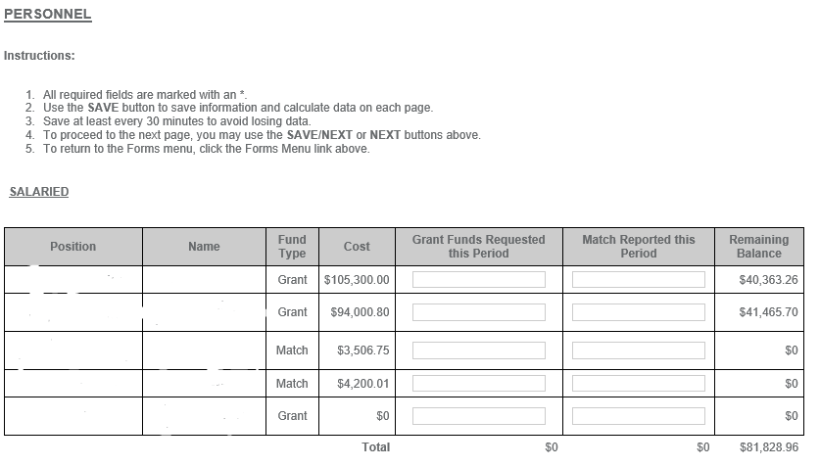
Personnel Page of Fiscal Report
There are two columns that allow for modification in the fiscal report, Grant funds Requested this period and Match Reported this period.
Position and Name have been removed from this example however there is normally information in this section of the fiscal report.

Slide 30
Personnel Page of the Fiscal Report
In this example you will see Fund Type Match. Match is required in many of our funding sources, however due to the Pandemic there has been some guideline updates and changes in requiring Match for certain grants. If you have a FVPSA ARP or FVPSA SA you will not have match on the grant. Match will be discussed in other funding sources during trainings for those grants.
If you are a new employee employed by an Agency who already has grants with CJI, you might have match on those grants. Feel free to reach out to your CJI Grant Manager to discuss questions about match on those grants.

Slide 31
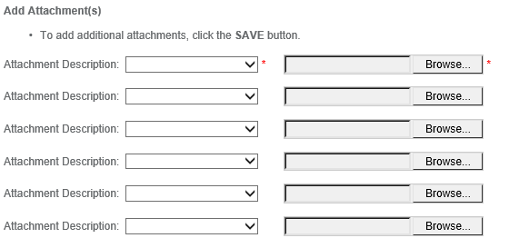
Personnel Page of the Fiscal Report
Every page of the fiscal report does have an attachment section. This is where the documentation required will be attached to the fiscal report.

Slide 32
Tips for attachments in Fiscal Reports
The amount of documentation and the organization of the documentation can have profound effects on how long it takes the CJI Grant Manager to review the documentation. It helps if the following points are followed:
Attach the proper documentation to the proper sections. If some documentation goes in multiple sections then it can be attached in one of the sections or all of them.
Ensure that ONLY the documentation needed for the fiscal period you are completing the report for is included in the attachments.
Please organize the documentation for Personnel as all paystubs in such a way that all paystubs and/or timesheets for one employee are together preferably oldest to newest. Paystubs and time sheets do not have to be together; they can be in separate attachments.

Slide 33
Tips for attachments in Fiscal Reports
In categories such as Supplies, Operating or Travel there may be multiple expenses in a line item. For these situations it is very helpful if there is a cover page for the documentation that verifies which expenses are in each line item. If there are expenses that should not be counted toward the grant funds that is included on an invoice or receipt, then identify those items on the receipt that are grant funded.
Try to keep expenses together such as utilities, office supplies, printing, etc rather than having all the documents mixed in together.

Slide 34
Program Income
Program Income is defined as gross income earned by the non-Federal entity that is directly generated by a supported activity or earned as a result of the Federal award during the period of performance.
Program Income should be used to offset allowable costs and may only be used for allowable costs or activities.
Program income is not grant funds, community received funds or donations.
Program income examples would be registration fees for a conference that the subgrantee was hosting and was using CJI Grant funds to fund some of the expenses of the conference. The registration fees would be program income.

Slide 35
Required Documentation
CJI has created a Required Documentation guide that will help agencies ensure they are attaching the correct documentation to their fiscal reports.
This document will describe the documentation needed throughout each of the fiscal report sections.
These are not new requirements, however, there have been some misunderstandings of these requirements therefore CJI felt it was important to put them all in writing so there is no longer any confusion.
If you have any questions about the required documentation, then please contact your CJI Grant Manager.

Slide 36
Submitting a Fiscal Report
Once a fiscal report is completed and there are no Orange notices at the top of the fiscal pages then you can submit the fiscal report.
Make sure you save the Fiscal report before submitting.
Go to the 3rd Green button at the top of the page, Status Changes

Slide 37
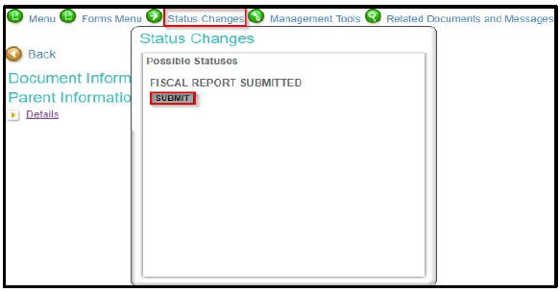
Submitting a Fiscal Report
In the Status Changes Drop down box you will see this screen.

Slide 38
Submitting a Fiscal Report
Once the submit button is clicked there will be a second question about submitting the fiscal and after that is completed the fiscal will be submitted. However, check to make sure there are no orange octagons with Orange hands and writing, if you see this there is an error, and the report did not submit.
How to determine if the fiscal report has been submitted. You can use the instructions for how to find an already created fiscal report. Once you find the fiscal report if it says something other than Fiscal Report Submitted then it is not submitted.

Slide 39
Equipment purchased through a Grant
If there is equipment on the budget for your grant, there will be additional documentation required before the fiscal report can be submitted.
An Inventory report will be required to be completed during the fiscal report in which you are asking reimbursement for that piece of equipment.
For something to be in the Equipment category, it must be valued at $500 or more per unit. (Your CJI grant manager will help make sure you have these items in the correct categories if your agency is awarded funds)
If there is no equipment on your grant then you will not see the inventory form.

Slide 40
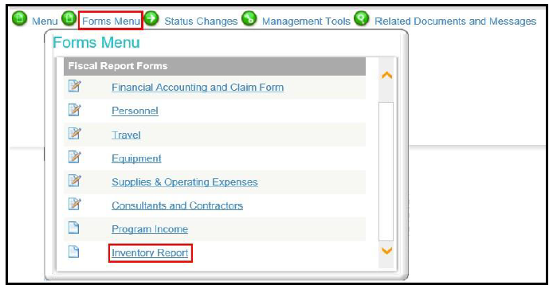
Equipment purchased through a Grant
The Inventory Form can be found within the Fiscal Report Forms section of the Forms menu.

Slide 41
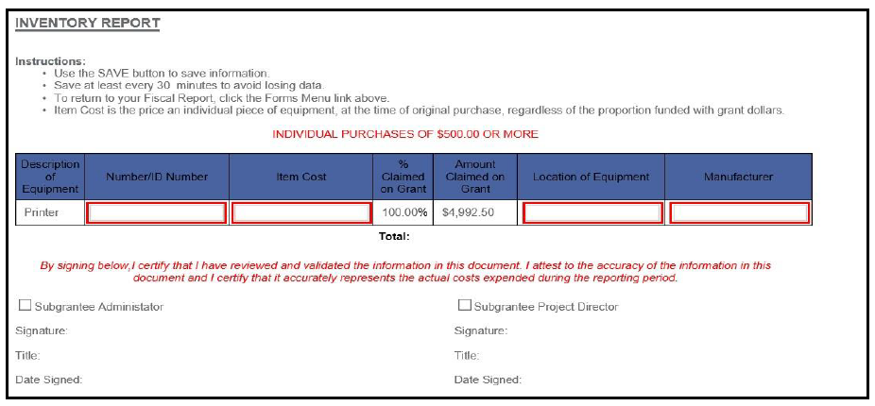
Equipment purchased through a Grant
All Fields within the row are required to be completed for each piece of equipment.
Equipment must be tracked and maintained by the agency as the CJI Grant Manager will ask to see the equipment during site visits.

Slide 42
When can the next Fiscal Report be created?
In most situations a new fiscal report cannot be created until the previous one is approved by the CJI grant manager and submitted for payment by the CJI fiscal team. The fiscal team normally pushed the fiscal report to payment within a day or two of the grant manager approving the fiscal report. The status of the fiscal report will be Fiscal Report batch ready.
The CJI grant mangers try to have the fiscal reports reviewed within 3 weeks of the report being submitted. If there are corrections or updates that need to be made, then there will be additional time before that fiscal report can be approved.
The CJI grant manager will return the fiscal report with instructions on what needs to be fixed on the report. You will receive an email from IntelliGrants with the grant manager’s notes on what needs to be changed.

Slide 43
The fiscal report was resubmitted, how do I know when it is approved?
To determine when the fiscal report has been approved, use the instructions on how to find a fiscal report that has already been created. You will then scroll to find the fiscal report you are looking for. The possible status’s of the fiscal report at this stage would be:
Fiscal Report Submitted- this means that the report has not been approved or returned. Waiting on CJI grant manager’s determination.
Fiscal Report modifications needed- this means that the CJI grant manager has sent the fiscal back for additional modifications or your corrections did not get resubmitted.
Fiscal Report Approved, Fiscal Report in Receiver Review or Fiscal Report Batch Ready - means that the fiscal report has been approved and is in the process of being paid.

Slide 44
The Report is approved, how long before we receive payment?
After a fiscal report is approved then in most situations payment is made within 3 weeks of the approval. However, this can be longer depending on many different factors. Since CJI depends on the State Auditor’s Office to complete the payment there are some things that are beyond our control when it comes to the payments. There can be other issues that also affect the time frame on payments, but we do try to keep it within the 3-week time frame.

Slide 45
Questions?
If you have questions as you are completing your fiscal reports, please feel free to reach out to your grant manager. We are all willing to assist in any way we can, and we understand that learning grant management is very difficult and confusing. Do not feel bad about bothering your grant manager, this is what we are here for, to help.

