Slide 1

2024-2025 FVPSA Sexual Assault RFP Webinar
July 12, 2024

Slide 2
Thanks for joining us today:
Please keep your lines muted during the presentation.
Webinar is being recorded. It will be posted on the ICJI website.
Questions and Answers at the end.
Feel Free to utilize the chat box during the webinar.

Slide 3
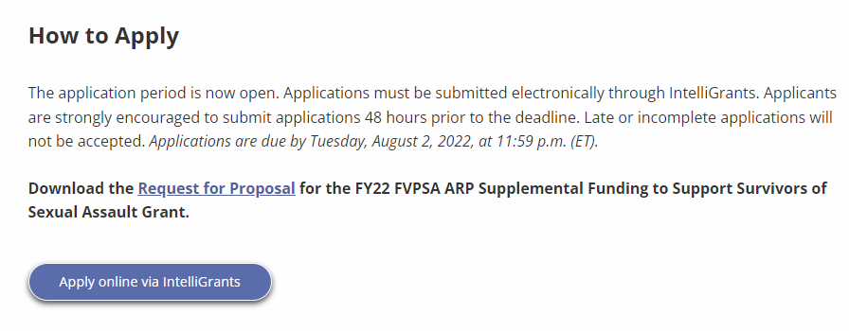
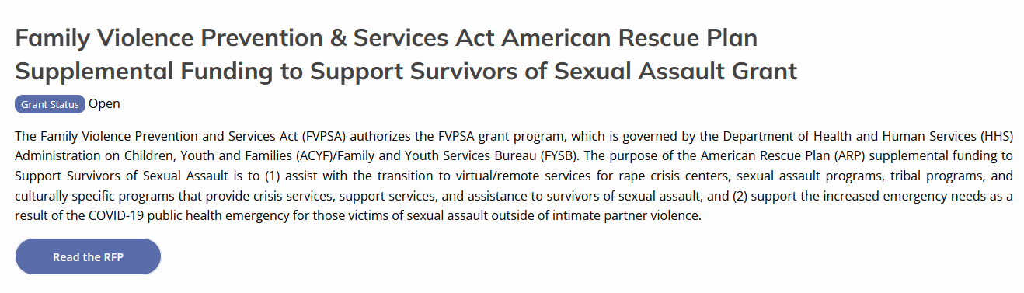
Accessing the RFP
Located on ICJI Website
CJI.in.gov → Victim Services → Family Violence Prevention Services Act (FVPSA) grant → FVPSA ARP (Sexual Assault) → Request for Proposal
https://www.in.gov/cji/victim-services/american-rescue-plan-grants-to-support-survivors-of-sexual-assault/

Slide 4
2024-2025 FVPSA ARP SA Grant Application
Application opened: Wednesday, July 3rd at 9:00 AM
Application closes: Tuesday, August 14th at 11:59 PM
Applicants are strongly encouraged to submit applications 48 hours prior to the deadline.
Award Period for FVPSA-SA: October 1, 2024 to September 30, 2025 (12-month award period)
Projects should begin on October 1, 2024 and must be in operation no later than 60 days after this date. Failure to have the funded project operational within 60 days from October 1, 2024 will result in the cancellation of the grant and the de-obligation of all awarded funds.

Slide 5
Overview:
The Family Violence Prevention and Services Act (FVPSA) authorizes the FVPSA grant program, which is governed by the Department of Health and Human Services (HHS) Administration on Children, Youth and Families (ACYF)/Family and Youth Services Bureau (FYSB). The purpose of the American Rescue Plan (ARP) supplemental funding to Support Survivors of Sexual Assault is to (1) assist with the transition to virtual/remote services for rape crisis centers, sexual assault programs, tribal programs, and culturally specific programs that provide crisis services, support services, and assistance to survivors of sexual assault, and (2) support the increased emergency needs as a result of COVID-19 public health emergency for those victims of sexual assault outside of intimate partner violence.

Slide 6

Funding Eligibility:
Eligible applicants include local public agencies and nonprofit private organizations including faith-based and charitable organizations, community-based organizations, tribal organizations and voluntary associations that assist victims (and their dependents) of sexual assault
Other Requirements include:
  Registered UEI number
  Active and current registration with SAM.gov
  Good standing with the Department of Revenue (DOR), Department of Workforce Development (DWD), and Secretary of State (SOS)

Slide 7
Purpose Areas:
The purpose of these supplemental funds is to prevent, prepare for, and respond to COVID-19. The activities that will be supported by these funds within these purpose areas include
Prevent
  Activities that assist sexual assault survivors by providing virtual services, supportive services, temporary housing assistance, mobile advocacy services, and supplies that will ensure survivors of sexual assault receive the care, support and services they need while reducing the exposure to and risk of contracting the COVID-19 virus. Activities include:
    Emergency Housing – Hotels, Motels, and Safe Houses
    Mobile Advocacy – laptops, software, meeting platforms and virtual platforms to provide services to victims
    Supplies – PPE, air purifiers, thermometers, COVID-19 rapid tests
Prepare
  Activities under this purpose area will focus on training, information, and assistance necessary to ensure the continuity of rape crisis centers and sexual assault services
    Organizational Planning, emergency operation plans and plans to address remote services operational capacity and staff absenteeism.
    Training & Assistance – maintain capacity to continue providing counseling services, support and peer groups, age-appropriate counseling and provide culturally and linguistically appropriate services

Slide 8
Purpose Areas:
The purpose of these supplemental funds is to prevent, prepare for, and respond to COVID-19. The activities that will be supported by these funds within these purpose areas include
Respond
  Activities and technical assistance for ensuring the continuity of sexual assault programs and rape crisis center services, which includes responding to issues such as adapting to fluctuating needs and changing circumstances. Please note that staffing enhancements, workforce supports, and workforce capacity building are allowable activities. The activities that will be supported by this funding include
    Counseling – Counseling to victims including continued telehealth options
    Youth Services – Provide for the emotional well being of children
    Legal Assistance – Civil legal assistance related to protective orders and evictions
    Rental Assistance – Short Term Rental, Deposit, and Utility Assistance
    Transportation – Costs associated with victims receiving treatment and gaining employment
    Staffing – Fund staffing increases, workforce supports for employees and hiring providers and staff to carry out SA services; COVID-19 mitigation strategies

Slide 9
Priority Areas
ICJI will give special emphasis to the support of community-based projects of demonstrated effectiveness that are carried out by nonprofit private organizations whose primary purpose is the operation of rape crisis centers and those organizations who provide meaningful sexual assault services who are working towards being a rape crisis center.

Slide 10
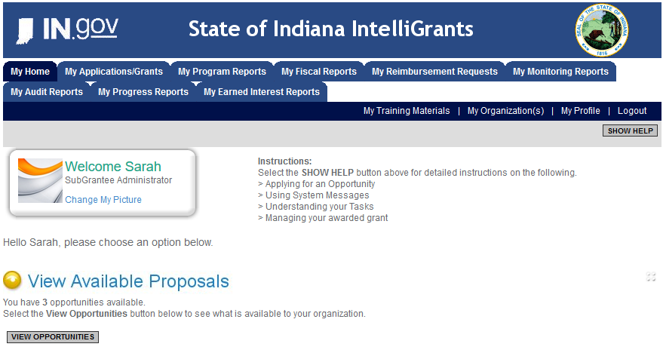
Initiating an Application
Log into IntelliGrants
  If you do not have an account, register by clicking “NEW USER”
On the “MY HOME” page, access “VIEW AVAILABLE PROPOSALS”
Click on “VIEW OPPORTUNITIES”
IntelliGrants will take you to “MY OPPORTUNITIES”
Access the “2024 FVPSA SA” Application
Select “APPLY NOW”
https://intelligrants.in.gov

Slide 11
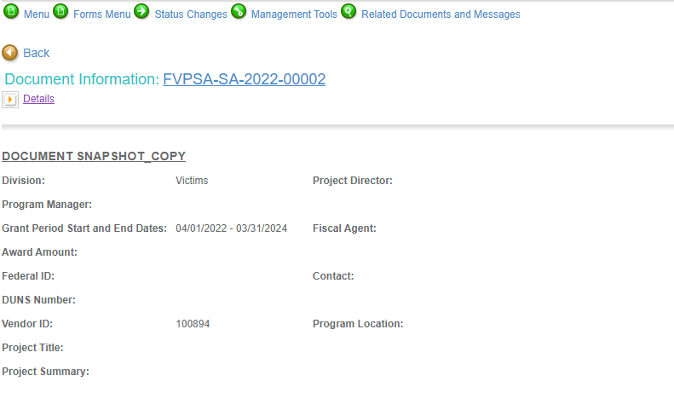




Navigating Forms Menu

Slide 12

Application Forms That Must Be Completed
Contact Information
Project Information
Programmatic Information
Goals, Objectives, and Outcomes
Problem Statement & Analysis
Program Description
Evidence Based/Best Practices
Use of Volunteers

Slide 13

All grants from ICJI Victim Services are reimbursement grants, which means that agency must first incur the expense prior to CJI reimbursing for the expense. Verification of expenses along with verification of payment of expenses must be provided to ICJI on a monthly or quarterly basis prior to reimbursement of expenses by ICJI.
There is no Match Requirement for this FVPSA Sexual Assault grant
Important Notes

Slide 14
Allowable Costs
Personnel costs including fringe benefits
Operational costs including rent, utilities, emergency victim supplies (food, clothing, toiletries), and language access
Emergency and immediate shelter including safe houses and motel/hotel vouchers
Mobile and virtual advocacy costs including equipment, mobile devices, online chat or text supports, technology service contracts, software, and leasing of vehicles
Supportive services for victims including counseling, employment services, transportation services, legal advocacy/assistance, childcare services and referral-based advocacy on behalf of victims and their dependents for health, behavioral health services, preventative health services and culturally linguistically appropriate services
Victim assistance including rental, hotel, utility assistance and transportation or vehicle repair
Emergency preparedness and COVID-19 testing consultants
COVID-19 related expenses including PPE, onsite testing and vaccines
Public awareness, outreach and COVID-19 prevention costs including development of materials and printing

Slide 15
Ineligible Budget Items
Administrative costs over 10% of the total grant budget
Direct financial assistance to a client such as cash, gift cards, or checks
Food and beverages
Lobbying and/or fundraising
Purchase of real estate or construction
Physical modification to buildings, including minor renovations (such as painting or carpeting)
Purchase of vehicles
Overtime is allowed but to claim the increased rate, there must be a separate line item in the budget that includes the overtime rate of pay.

Slide 16

Budget Narrative
Be sure all items in the Budget are included in the Budget Narrative.
  Ex: Office Supplies (copy paper, pencils, pens)
Grant reviewers are not required to contact you for clarification.
Any missing information in this section may disqualify that budget item for funding.

Slide 17

Attachments Required:
Total Agency Budget
  Found on ICJI’s website (https://www.in.gov/cji/victim-services/resources/) – Subgrantee Basic Budget (Nonprofit Applicant Budget Form)
Sustainability Plan
  Your plan to maintain the program once the grant funds expire
Timeline
  Outlining the completion of the project/ or expenditures of the grant funds
Letters of Endorsement
  For this program specifically
Miscellaneous
  Job Descriptions for any position listed in personnel
  If applicable any contracts

Slide 18
Assistance
For technical assistance, contact the ICJI Helpdesk at CJIHelpDesk@cji.in.gov.
  Help Desk hours are Monday – Friday, 8:00 am to 4:30 pm ET, except state holidays.
ICJI is not responsible for technical issues with grant submission within 48 hours of grant deadline.
  We strongly encourage you to submit your application before the 48-hour window prior to the deadline.
For assistance with any other requirements of this solicitation, please contact the Victim Services Division at victimservices@cji.in.gov

Slide 19

Questions?

Slide 20
Thanks for attending!
Presented by
Dalayna Anderson, Victim Services, Program Specialist
DaAnderson1@cji.in.gov
317-232-3482
Becky Venus, Victim Services, Senior Grant Manager
Rvenus@cji.in.gov
317-233-5681

