Slide 1



SERVICES*TRAINING*OFFICERS*PROSECUTORS
STOP GRANT 2025-2026
RFP WEBINAR

Slide 2




Welcome and Thank You for Joining
2025 STOP RFP Webinar
Keep lines MUTED during presentation.
Webinar is being RECORDED and will be posted on ICJI website along with Q & A.
Utilize CHATBOX during webinar.
Time allowed at end for Q & A.
Notes:
Thank you for attending the 2025 STOP RFP Webinar. Please review the RFP in its entirety as this webinar is only a basic overview of the STOP grant, important highlights about the program, and what to know before applying. Be advised there are many updates this year to the 2025 STOP requirements due to recent State and Executive Orders and we will go over those in this webinar, but please also refer to the RFP before applying.

Slide 3


HOW TO APPLY: Applicants must submit application via IntelliGrants
WHEN TO APPLY: Applications must be submitted no later than 11:59pm ET on:
July 30,2025
TECHNICAL ASSISTANCE:
Contact ICJI Helpdesk at CJIHelpDesk@cji.in.gov
IMPORTANT INFORMATION: Grants cannot be processed until ICJI receives Federal Award Letter, often arrives after grant period begins. Please be aware of this as you are writing your proposal.
AWARD PERIOD:
October 1, 2025-September 30, 2026

Slide 4

Services * Training * Officers * Prosecutors* (STOP) supports local communities, to develop and strengthen effective responses to victims of domestic violence, dating violence, sexual assault (including adult survivors of child sexual abuse), and stalking as well as victims of trafficking and female genital mutilation or cutting, or forced marriage.
Please thoroughly review RFP as additional requirements and guidance have been added due to recent state and federal Executive Orders.
OVERVIEW

Slide 5

PROGRAM SCOPE
Activities supported by this program are determined by state and federal statutes, federal regulations, executive orders, and ICJI policies.
Funded project is bound by provisions of this solicitation, any applicable special conditions, 2 CFR 200 and DOJ Grants Financial Guide, including updates to the guide after an award is made.
New DOJ guidance could impact terms and conditions and availability of funding for any grants executed from this solicitation.
ICJI will share new grant conditions, guidance, and requirements with all grantees as they become available.
In some instances, executed grant contracts may be revised or cancelled.
All grants from ICJI Victim Services are reimbursement grants.
Verification of expenses along with verification of payment of expenses must be provided to ICJI on a monthly or quarterly basis prior to reimbursement of expenses.

Slide 6
Eligibility
Unique Entity ID (UEI)
System for Award Management Registration (SAM)
Agency’s Good Standing with State
Review of agency’s good standing with Indiana Department of Revenue (DOR), Indiana Department of Workforce Development (DWD), and Secretary of State (SOS)
UEI issued through System for Award Management (SAM) is required to receive funding. For more information and/or to obtain a UEI, please visit website.
To enable ICJI to report subawards, subgrantees are required to register with the System for Award Management (SAM). SAM is a federally-owned and operated free website and used to reference information needed to report subaward information to federal government. To register, you must have a UEI number. Registration can be done by clicking here.
State Agency
Units of Local Government
Nonprofit Organizations
Faith Based Organizations
Notes:
Eligible entity types include: State Agencies, Units of Local Gov’t, Nonprofits and Faith Based organizations.
An entity may apply, but will not be eligible for a grant until the entity has prequalified through a series of threshold requirements including: UEI, SAM and Good Standing with State
When registering or renewing your SAM registration, please ensure you do NOT mark your agency as private, which will prohibit ICJI from verifying your registration.

Slide 7



PRIORITY AREAS
States and territories are encouraged to develop and support projects, to the extent consistent with the program’s authorizing statute, that address one or more of the priorities listed below:
Measures to combat human trafficking and transnational crime, particularly crimes linked to illegal immigration and cartel operations, that support safety and justice for trafficking victims who have also suffered domestic violence, sexual assault, dating violence, and/or stalking;
Projects to provide victim services, especially housing, and improve law enforcement response in rural and remote areas, Tribal nations, and small towns that often lack resources to effectively combat domestic violence and sexual assault; and
Proposals submitted by units of local government and public agencies that certify compliance with federal immigration law, including 8 U.S.C. § 1373.

Slide 8

Program Requirements
Confidentiality
Determination of Suitability to Interact with Participating Minors
Grant Eligibility Regarding Compelling Victim Testimony
STOP Requirements

Slide 9
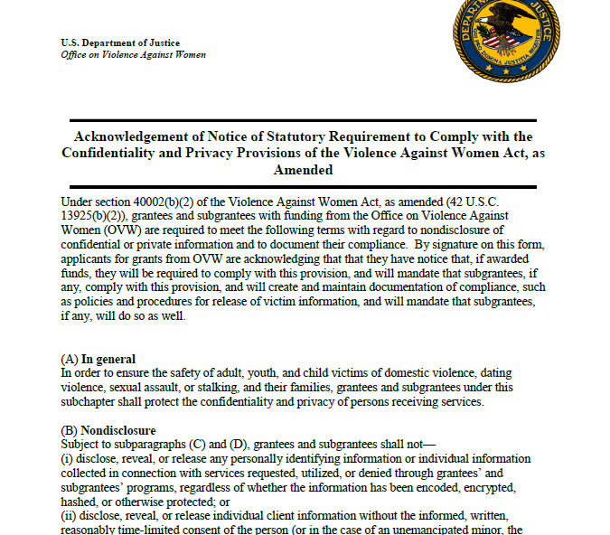
All grantees and subgrantees providing services to victims and receiving VAWA funding must comply with the VAWA Confidentiality Provision.
Subgrantees may not disclose, reveal, or release Personally Identifiable Information (PII) collected in connection with services regardless of whether information has been encoded, encrypted, or otherwise protected.
All applicants must sign and attach to their application: Acknowledgement of Notice of Statutory Requirement to Comply with the Confidentiality and Privacy Provisions of the Violence Against Women Act, as Amended.
I. Confidentiality

Slide 10
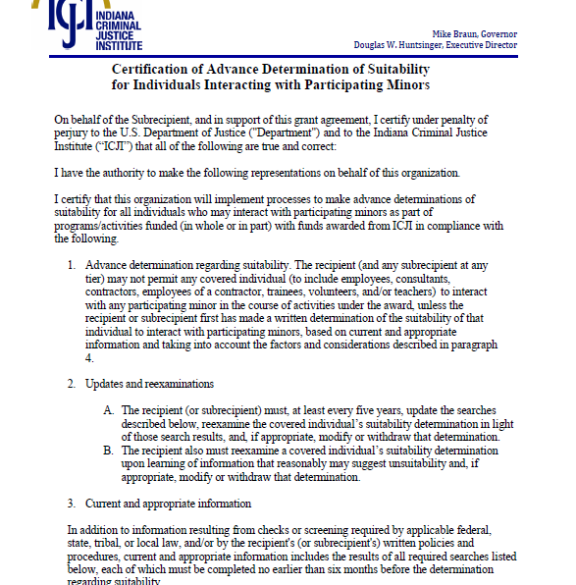
II. Determination of Suitability to Interact with Participating Minors
Recipient must make determinations of suitability before certain individuals may interact with participating minors.
This requirement applies regardless of an individual’s employment status.
The details of this requirement are posted on the OVW website in a PDF titled Award condition: Determination of suitability required, in advance, for “certain individuals who may interact with participating minors” .
A completed certification form must be attached to the application. This should be for your current STOP application and not for any previously funded programs. A link to the certification form may be found in the RFP or www.in.gov/cji/victim-services/resources/.

Slide 11
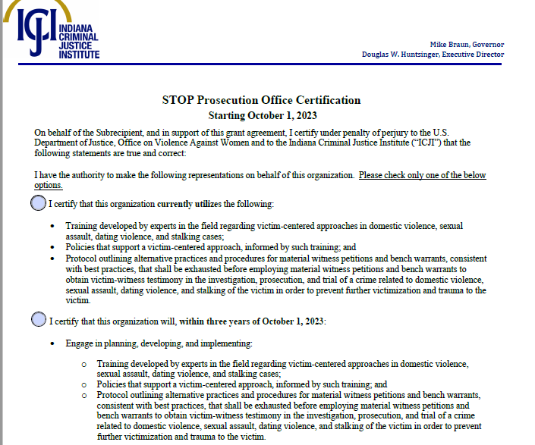
III. Grant Eligibility Regarding Compelling Victim Testimony (STOP Prosecution Office Certification)
For Prosecutor’s Office to be eligible to receive grant funds, head of office shall certify, to the State, that the office will, during the 3-year period beginning on the date on which the grant is awarded, engage in planning, developing, and implementing the items listed below.
A. Training developed by experts in field regarding victim-centered approaches in DV, SA, Dating Violence, and Stalking Cases;
B. Policies that support a victim centered approach, informed by such training; and
C. Protocol outlining alternative practices and procedures for material witness petitions and bench warrants.
Continuing programs have 3 years from October 1, 2023, to implement the above.
These programs will complete: Prosecutor Office Certification for Continuing Programs.
New Prosecutor Office applicants will complete: Prosecutor Office Certification for New Programs and will have 3 years from October 1, 2025, to implement the items above.
A completed certification form must be attached to application in IntelliGrants.

Slide 12
IV. STOP Requirements
Nondisclosure of confidential or private information
Approved Activities
Non-supplantation
Reports
Non-exclusivity
Prohibition on tort litigation
Prohibition on lobbying
Delivery of legal assistance
Civil Rights
Grantees and subgrantees shall protect the confidentiality and privacy of persons receiving services.
Federal funds shall be used to supplement, not supplant, non-Federal funds that would otherwise be available for STOP funded activities.
An entity receiving a grant shall submit to the disbursing agency a report on activities undertaken with grant funds.
Nothing in VAWA shall be construed to prohibit male victims of DV, dating violence, SA, and stalking from receiving STOP Program funded services
Funds under the STOP Program may not be used to fund civic representation in a lawsuit based on a tort claim.
Funds under the STOP Program are subject to prohibition in 18 U.S.C. 1913 (provision that broadly prohibits the use of appropriated funds for lobbying).
Grantees & Subgrantees providing legal assistance with STOP funds shall comply with requirements of 34 U.S.C. § 20121(d) (see Resources for Applicants (justice.gov) for a sample letter provided by OVW).
Grantees and subgrantees shall comply with all applicable federal civil rights laws and nondiscrimination provisions of 34 U.S.C. § 12291(b)(13)(A).
If grantees and subgrantees collaborate with or provide information to public officials and agencies to develop and implement policies and develop and promote legislation or model codes to reduce or eliminate DV, dating violence, SA, and stalking, must maintain confidentiality of victims (as required above) and ensure PII about victims is not included.
All grantees and subgrantees of STOP funding must state how they will meet the requirements of the applicable provisions of 34 U.S.C. 122912(b) as listed above. The certification can be found here.
Notes:
All grantees and subgrantees of STOP funding must state how they will meet the requirements of the applicable provisions of 34 U.S.C. 122912(b) as listed below. The certification can be found here.

Slide 13

Unallowable Costs &
Out-Of-Scope Activities
The activities presented on the following slides are out of program scope and will not be supported by STOP program funding.
Applicants proposing activities described in these categories will be asked to remove them from the application and may experience delay in access to funds.
Applicants must also ensure that any subcontractors or subrecipients do not offer any activities described in Unallowable or Out-Of-Scope activities.
NOTE: Recipients and subrecipients should serve ALL eligible victims as required by statue, regulation, or award condition.

Slide 14
Activities That Compromise Victim Safety and Recovery and Undermine Offender Accountability
Activities that jeopardize victim safety, deter or prevent physical or emotional healing for victims, or allow offenders to escape responsibility for their actions. Below are lists of these activities:
Excluding Eligible Victims from Receiving Services Based on Classifications
Compromising Confidentiality or Privacy
Requiring Victims to Take Certain Actions
Failure to Include Conducting Safety Planning with Victims
Failure to Account for Unique Needs of Individuals in Project Designs, Products, Services, and/or Budgets.
Using Technology without Addressing Implications for Victim Confidentiality, Safety Planning, and Informed Consent
Partnering with Individuals or Organizations that Support/Promote Practices that Compromise Safety/Recovery or Undermine Offender Accountability
Notes:
Policies or procedures….

Slide 15
Other Unallowable Costs
Grant funds under this program may not be used for the following:
Lobbying, except with explicit statutory authorization.
Fundraising and time spent procuring funding including completing federal and state funding applications.
Purchase of real property.
Physical modifications to buildings, including minor renovations (such as painting or carpeting).
Construction.
Purchase of vehicles.
Direct financial assistance to a client such as cash, gift cards, or checks.
Alcohol, food (except emergency food for victims), and entertainment costs.
Immigration Fees.
Activities Requiring Prior Approval
Surveys: Recipients must receive prior approval before using grant funds to support surveys, regardless of their purpose.

Slide 16
Out-Of-Scope Activities
Research projects.
Services to victims younger than 11.
Promoting or facilitating discriminatory programs or ideology as described in Exec Order 14173.
Programs that discourage collaboration with LE or oppose or limit role of police , pros, or immigration enforcement
Excessive funding for consulting fees, training, admin costs, or other expenses not related to violence prevention, victim support, and offender accountability.
Promoting or facilitating violation of federal immigration law.
Activities framing DV or SA as systemic social justice issues rather than criminal offenses.
Awareness campaigns or media that do not lead to tangible improvements in prevention, safety or offender accountability.
Any activity or program that unlawfully violates an Executive Order.
Inculcating or promoting gender ideology as defined in Exec Order 14168.
Generic community engagement or economic dev without clear link to violence prevention, victim safety or offender accountability.
Initiatives that priority illegal aliens over US citizens and legal residents receiving victim services & support.
Activities addressing human trafficking and/or Missing or Murdered Indigenous Persons (MMP) unrelated to domestic violence, dating violence, sexual assault, or stalking.
Activities that frame domestic violence or sexual assault as systemic social justice issues rather than criminal offenses and
***Activities listed above are out of program scope and will not be funded.****
Notes:
Out of Scope Activities is all brand new. Agencies will be required to sign a form to certify they read these.

Slide 17
PURPOSE AREAS
STOP program funds must be used for one or more of the purposes listed in the RFP. Carefully review all 24 Purpose Areas as applicants will be asked to select up to 3 Purpose Areas in their application. Some examples include:
Jessica Gonzales Victim Assistance & Crystal Judson Victim Advocates (both require special approval from ICJI).
Policies for investigation and prosecution of SA cases
Address SA in Correctional or Detention settings
SA Evidence Collection Kit backlog
Prevention & Education programming
Culturally specific victim services for female genital mutilation or cutting.
State or local agencies supporting & advocacy to Indian victims
Paying fees for furnishing birth certificates, passports, or ID cards.
Training, developing, or expanding LEO, judges & prosecutors
Police, court and pros. policies, protocols, services
Data collection and communication systems
Victim services and legal assistance programs
Multidisciplinary Resource Coordination
Training Sexual Assault Forensic Medical Examiners
Immigration matters
SART Teams
Policies that enhance best practices
Individuals over 50, disabled, and Deaf
Notes:
STOP grant funding assists violent crimes against women, including the crimes of sexual assault, domestic violence, dating violence, and stalking. While those crimes may not be written out in these slides they are referenced in the RFP and were omitted from PowerPoint due to character limitations.

Slide 18
MATCH REQUIREMENT
Matching funds MUST:
Be verifiable from subgrantee’s records;
Not be included as contributions for any other federal award;
Be necessary and reasonable for accomplishment of project or program objectives;
Be allowable under 2 C.F.R. 200.400;
Not be paid by federal government under another federal award, except authorized by federal statue;
Be included in the subgrantee’s approved budget;
Conform to all other provisions of 2 C.F.R Part 200;
25%
Match Requirement for Government Agencies
Notes:
Match is restricted to the same use of funds as allowed for federal funds.
If an expenditure is not allowable with federal funds, it is not allowable with match funds.
Applicants must identify all sources of the non-federal portion of the total project costs (i.e., match funds), and applicants must explain how the match funds will be used in the budget narrative section of the application within IntelliGrants.

Slide 19
MATCH REQUIREMENT EXAMPLE
Determining Match:
STEP 1: Award amount / % of Federal Share = Total Project Cost
STEP 2: Total Project Cost – Award Amount = Required Match
Example Match Requirement:
$150,000 Award in federal funding with 25% match requirement.
STEP 1: $150,000 / .75 = $200,000 Total Project Cost
STEP 2: $200,000 - $150,000 = $50,000 Required Match

Slide 20






TRAVEL & PROGRAM
COSTS
TRAVEL COSTS
Travel for DIRECT SERVICES is allowable.
Expenses and reimbursements for mileage reimbursement must follow most current IDOA State Travel Policy or subrecipient’s travel policy, whichever is more restrictive.
All NON-ESSENTIAL travel is currently EXCLUDED under state policy.
PROGRAM COSTS
Must be necessary and reasonable for stated purpose of grant.
Must be in accordance with general accepted accounting principles.
Conform to any limitations/exclusions set forth in 2 CFR 200 or STOP Grant Program Requirements
Consistent with policies & procedures of this grant program and applied uniformly.
Adequately documented with supporting materials, including receipts, invoices, timesheets, paystubs, etc.

Slide 21
APPENDIX A: APPLICABLE LAWS & MANDATORY REQUIREMENTS
I. GENERAL
This award is governed by 2 C.F.R. Part 200 and the DOJ Grants Financial Guide. All applicants must adhere to all provisions set forth in federal and state statutes, regulations, and rules. Failure to abide by federal and state mandates may, at discretion of the state, be considered a material breach. Consequences of a material breach include, but are not limited, to:
Ineligibility for this grant funding opportunity;
Repayment of any grant funds already received;
De-obligation of grant funds; and
Factor in scoring process for future grant applications.
Applicant may not obligate, expend, or draw down grant funds until federal Office of the Chief Financial Officer notifies the state that the grant has been awarded to Indiana. The state shall not reimburse an applicant for expenditures outside the grant period of performance.
Pursuant to 2 C.F.R. Part 200, all applicants are required to establish and maintain grant accounting systems and financial records to accurately account for funds awarded to them.
Applicant understands and agrees it cannot use federal funds from different funding sources for one or more of identical cost items, in whole or in part. If this scenario presents itself, the applicant must contact ICJI program manager in writing and refrain from expenditure, obligation, or draw down of any federal funds awarded from ICJI concerning the identical cost items.

Slide 22
APPENDIX A: APPLICABLE LAWS & MANDATORY REQUIREMENTS
II. Civil Rights Laws & Requirements
Nondiscrimination
Services to Limited English Proficiency Individuals
Ensuring Equal Treatment for Faith-Based Organizations
Using Arrest & Conviction Records in Employment
Complying with Safe Streets Act
Meeting EEOP Requirement
Ensuring Access to Federally Assisted Programs
Enforcing Civil Rights Laws
Meeting Requirement to Submit Findings of Discrimination
Pursuant to IN Civil Rights Law, Civil Rights Act of 1964, Age Discrimination in Employment Act, and Americans with Disabilities Act, applicant shall not discriminate against any employee or applicant for employment relating to this grant with respect to hire, tenure, terms, conditions or privileges of employment or any matter directly or indirectly related to employment, because of employee or applicant’s race, color, national origin, religion, sex, age, disability, ancestry, status as a veteran, or any other characteristic protected by federal, state, or local law (“Protected Characteristics”).
Faith-based organizations are prohibited from using financial assistance from DOJ to fund inherently (or explicitly) religious activities. While faith-based organizations can engage in non-funded inherently religious activities, they must hold them separately from program funded by this grant, and recipients cannot compel beneficiaries to participate in these activities.
OCR issued an advisory document for recipients on proper use of arrest and conviction records in making hiring decisions. Misuse of arrest or conviction records to screen either applicants for employment or employees for retention or promotion may have a disparate impact based on race or national origin, resulting in unlawful employment discrimination.
Recipient organizations of financial assistance subject to nondiscrimination of Safe Streets Act, must meet 2 obligations: 1) comply with federal regulation pertaining to development of an EEOP (see 28 C.F.R. pt.42, subpt. E) and (2) submit to OCR findings of discrimination (see 28 C.F.R. §§ 42.204(c),.205(c)(5)).
Agencies are required to review the EEOP Requirements and either claim exemption if applicable or prepare Utilization Report and complete Section B of Certification Form.
Laws applying to recipients of federal grant awards prohibit discrimination on basis of actual or perceived race, color, national origin, religion, sex, age, disability, ancestry, status as veteran or any Protected Characteristics in funded programs or activities. Federal law also prohibits recipients from discriminating on basis of age in delivery of services.
All recipients of federal assistance are subject to prohibitions against unlawful discrimination.
Organizations receiving adverse findings of discrimination in past three years, after a due process hearing, must send copy of finding to OCR and to the state.
In accordance with DOJ guidance pertaining to Title VI of Civil Rights Act of 1964, 42 U.S.C. § 2000d, recipients of federal financial assistance must take reasonable steps to provide meaningful access to their programs and activities for persons with Limited English Proficiency (LEP).
Notes:
Please carefully review the RFP to read in entirety each Civil Rights Laws and Requirements as this PPT only provides a synopsis.

Slide 23
APPENDIX A: APPLICABLE LAWS & MANDATORY REQUIREMENTS
III. STATE LAWS & REQUIREMENTS
Recipients of grant funds are required to adhere to all state laws concerning receipt and use of grant funds from federal and state funding sources. Please review RFP for full details of the State Laws & Requirements. Those laws include, but are not limited to, the laws set forth below:
State Ethical Requirements
Indiana Secretary of State
Telephone Solicitation of Consumers; Automatic Dialing Solicitations
Drug-Free Workplace Certification
Employment Eligibility Verification – Please review as they differ from previous STOP funding due to recent IN Code and Executive Orders.
As required by IC § 22-5-1.7 and Executive Order 25-29, the applicant hereby swears or affirms under the penalties of perjury that:
Applicant has enrolled in and verified work eligibility status of all his/her/its employees, through the E-Verify program;
Applicant has provided documentation to the State affirming its enrollment and verification of employees through the E-Verify program;
Applicant does not knowingly employ or contract with and has not knowingly employed or contracted with an unauthorized alien; and the applicant shall require its contractors who perform work under this grant agreement to certify to applicant that contractor does not knowingly employ or contract with an unauthorized alien and that the contractor has enrolled and is participating in the E-Verify program. The applicant shall maintain this certification throughout the duration of the term of a contract with a contractor and shall provide to the State any and all such certifications promptly upon request.
Applicant shall not retain an employee and shall not contract with a person that the applicant subsequently learned or learns is an unauthorized alien.
State may terminate for default if the applicant fails to cure a breach of this provision no later than thirty (30) days after being notified by the State.
ICJI Policies & Requirements

Slide 24

VICTIM COMPENSATION
Application Submission in IntelliGrants

Slide 25


APPLICATIONS COMPLETED AND SUBMITTED VIA INTELLIGRANTS
Website link: indianaintelligrants.intelligrants.com/

Slide 26

APPLICATION FORMS THAT MUST BE COMPLETED IN INTELLIGRANTS
Contact Information
Project Information
Programmatic Information
Goals, Objectives, and Outcomes
Problem Statement & Analysis
Program Description
Evidence Based/Best Practices
Use of Volunteers

Slide 27
FYI – Provide thorough and detailed responses in these sections as these areas within the application either receive lower scores or are returned for modifications.
Programmatic Information
Goals, Objectives, and Outcomes
See Tips for Writing Goals, Objectives and Outcomes on website
Problem Statement & Analysis
Specifically relate responses to your STOP Funded Program
Program Description
Provide DETAILED DESCRIPTIONS when providing responses to these questions.

Slide 28
SERVICES, TRAINING, OFFICERS, PROSECUTORS (STOP)
Indiana must allocate STOP funding within the parameters of the Act as indicated in the graph.
20%
Two categories must be allocated for programs or projects that meaningfully address SA, including stranger rape, acquaintance rape, alcohol or drug-facilitated rape, and rape within context of an intimate partner relationship.
10% must go to culturally specific community-based organizations

Slide 29
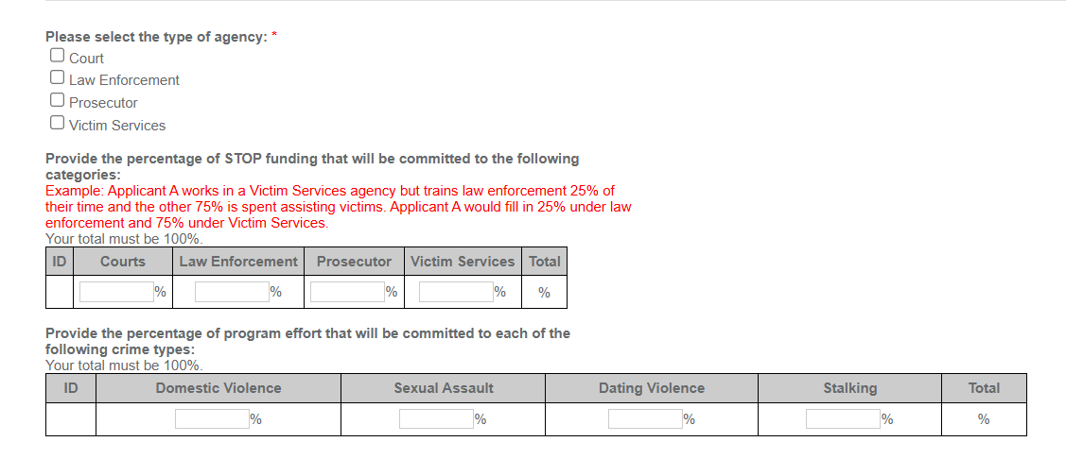
PROGRAMMATIC INFORMATION
Grant managers will review applicants' budget and narrative to determine if allocation is accurate during application review.

Slide 30
PROGRAMMATIC INFORMATION
Sexual Assault Set-Aside
STOP federal program requires states set aside 20% of total amount allocated for projects, across two or more allocation categories (courts, LE, prosecution, victim services) that meaningfully address sexual assault crimes.
Projects & Programs funded under the set aside must have legitimate focus on SA and funded personnel have sufficient expertise & experience on SA.
Dual multi-service agencies that provide services to DV survivors must demonstrate they have staff with specific expertise in serving sexual violence outside realm of DV.
Culturally Specific Community Based Organizations
STOP federal program requires states allocate 10% of Victim Service allocation to culturally specific programs.
Program will qualify for culturally specific allocation if primary mission is to address needs of racial and ethnic minority groups or if has developed a specific expertise regarding a particular racial or ethnic minority group.
Organization does more than merely provide services to a targeted group; rather, the organization must provide culturally competent services designed to meet the specific needs of the target population.
20%
10%

Slide 31
Supplanting
Federal funds must be used to supplement existing funds for program activities and cannot replace or SUPPLANT non-federal funds that have been appropriated for the same purpose.
Supplanting occurs when a state, local, or tribal government reduces state, local, or tribal funds for an activity specifically because federal funds are available (or expected to be available) to fund the same activity.

Slide 32
 | Required By
Application Item | Victim Services | Prosecutor Office | Law Enforcement | Court | Attached
Total Agency Budget | Yes | No | No | No
Indirect Cost Rate or de minimis calculation | Yes, if claiming federal approved indirect cost rate or de minimis
Sustainability Plan | Yes | Yes | Yes | Yes
Timeline | Yes | Yes | Yes | Yes
Letter of Endorsement | Yes | Yes | Yes | Yes
Suitability to Interact with Minors | Yes | Yes | Yes | Yes
STOP Requirements | Yes | Yes | Yes | Yes
Confidentiality Notice Form | Yes | Yes | Yes | Yes
Certification of Out-of- Scope Activities | Yes | Yes | Yes | Yes
Consultation Form | No | Yes | Yes | Yes
Prosecutor Certification | No | Yes | No | No
Legal Assistance Certification Letter | Yes, if using STOP funds to support legal assistance
Job Descriptions (grant and match positions) | Yes | Yes | Yes | Yes
ATTACHMENTS REQUIRED WITH APPLICATION
CHECKLIST
***Additional attachments may be required at a later date, including after execution of a contract, pending new federal guidance.***
Notes:
The RFP includes a checklist with a list of Required Attachments. Applicants should ensure if required, attachments are uploaded prior to submitting application. Applications are reviewed to ensure all required documentation is completed in its entirety, signed and dated

Slide 33
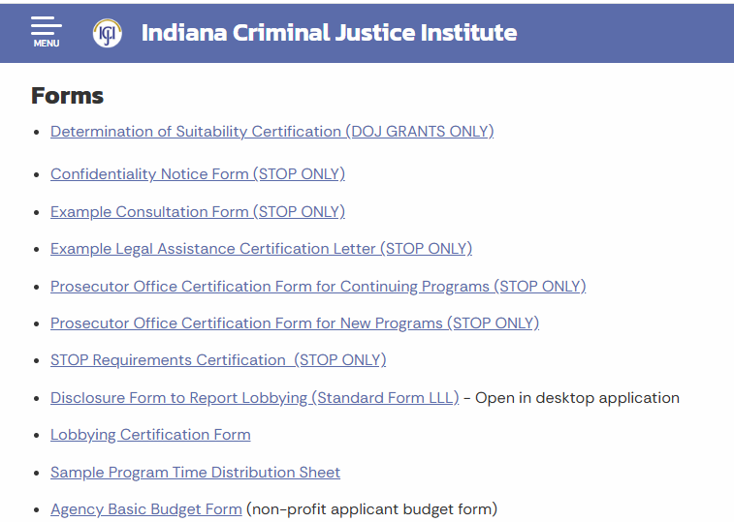
Links to REQUIRED attachments located on CJI website: in.gov/cji/victim-services/resources
Notes:
CJI website and the RFP includes links to download all required STOP application Forms.

Slide 34
Thank you
Presented by:
Katherine Barnes, Victim Services, Program Specialist
katbarnes@cji.in.gov
(317)-232-7610
Becky Venus, Victim Services, Senior Grant Manager
rvenus@cji.in.gov

