Slide 1



SAVAF-2026 Program Report Updates
Presentation by Katherine Barnes and Becky Venus

Slide 2




Welcome and Thank You for Joining
SAVAF-2026 Program Report Updates Webinar
Keep lines MUTED during presentation.
Webinar is being RECORDED and will be posted on ICJI website along with Q & A.
Utilize CHATBOX during webinar.
Time allowed at end for Q & A.

Slide 3
Presentation Agenda
General Overview
FTE Calculations
Total Individuals Served
Demographics Tables
  Age
  Race
  Other
Services
County
Community Education
Flex Funding
ICESA Engagement & Support
Impacts and Challenges
Reporting Frequency
Q & A
End

Slide 4
Changes in reporting questions
All changes discussed today will be effective at the start of the SAVAF-2026 grant cycle.
New questions have been added to the template. These will be highlighted during today’s presentation.
Important Note

Slide 5


FTE of Grant Funded Staff
FTE should be based on your budget and only include GRANT funded staff.
ICJI Website Resource Page now includes FTE calculator (NEW!)

Slide 6
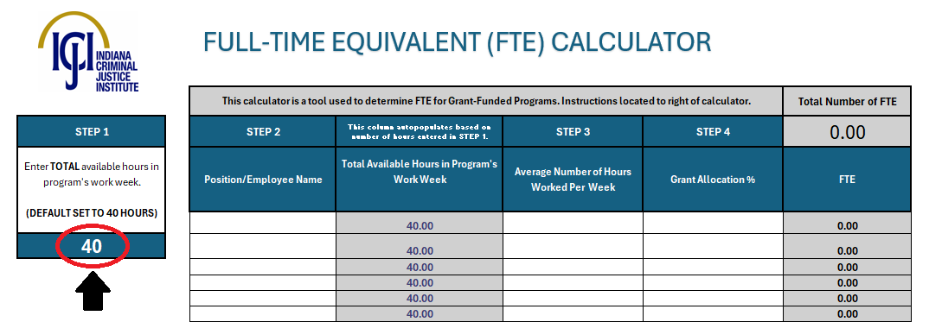
FTE Calculator (Step 1)
Step 1: Enter total available hours in your program's work week (default is set to 40 Hours) in the Dark Blue box under “Step 1”.
This number will autopopulate for all positions in Total Available Hours in Program's Week Column.
See resource page of website: https://www.in.gov/cji/victim-services/resources/ (first link under “Guidance”)

Slide 7
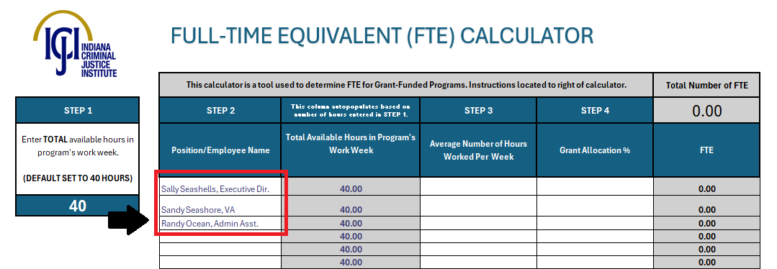
FTE Calculator (Step 2)
Step 2: Enter Name of Grant-Funded Personnel and/or Position Title in the white boxes under “the Step 2” column.
See resource page of website: https://www.in.gov/cji/victim-services/resources/ (first link under “Guidance”)

Slide 8
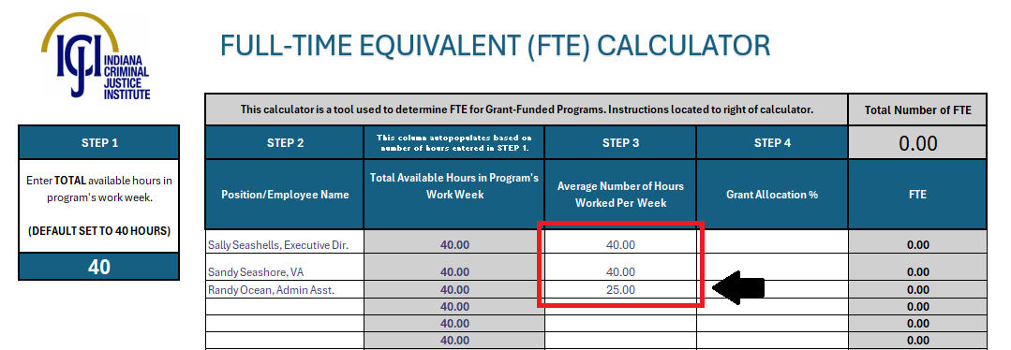
FTE Calculator (Step 3)
Step 3: Enter average number of hours employee works per week in the white boxes under the “Step 3” column.
Note: the Grey boxes to the left of these should NOT be edited. They were autopopulated in Step 1
See resource page of website: https://www.in.gov/cji/victim-services/resources/ (first link under “Guidance”)

Slide 9
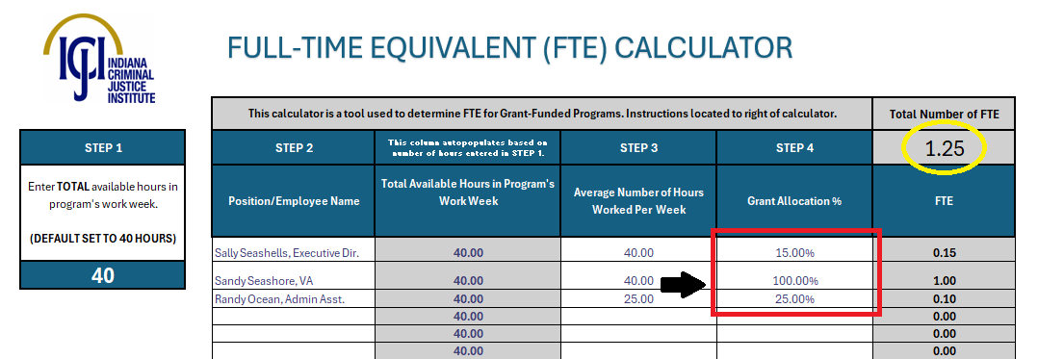
FTE Calculator (Step 4)
Step 4: Enter percentage of time allocated to the grant-funded program in the white boxes under the column labeled “Step 4”. The FTE for each employee will generate to the right (in decimal points).
Lastly: Once all Grant Allocation %’s have been entered, the FTE needed for your program report will be calculated at the top right (see yellow circle)
See resource page of website: https://www.in.gov/cji/victim-services/resources/ (first link under “Guidance”)

Slide 10
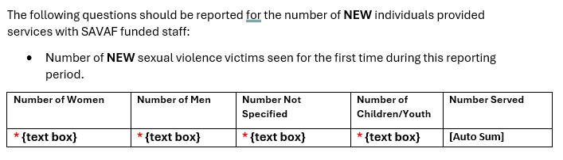
Individuals Served
Total Individuals
Both new and returning individuals for your SAVAF program ONLY.
Returning individuals are individuals that were also served during the last reporting period for your grant.
For PR1, all individuals would be considered NEW even if your SAVAF program is continuing from SAVAF-2024.
New Individuals
These individuals will be new to this reporting period for your SAVAF program ONLY.
Please note: the demographics of clients will have been recorded for returning clients on the report where they were new. Including returning clients will duplicate data.

Slide 11
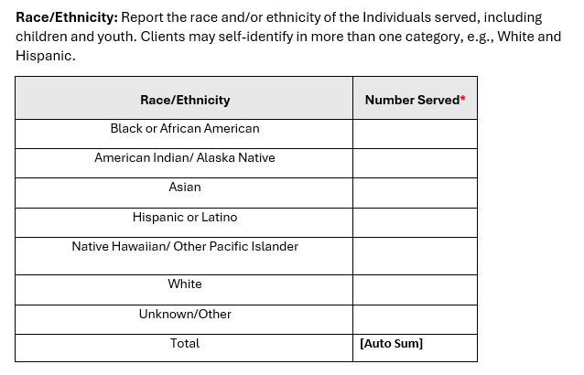
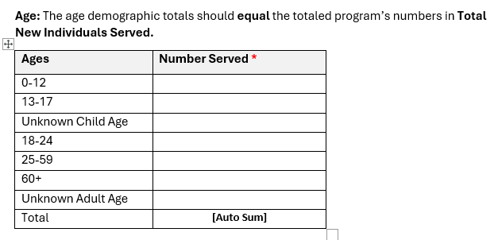
Demographics: Age & Race
Tables are for NEW INDIVIDUALS ONLY
Total clients listed in the Age table must equal number of new individuals reported.
Total clients listed in the Race/Ethnicity table must equal (or be greater than) number of new individuals reported

Slide 12
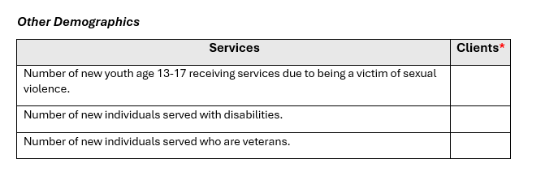
Demographics: Other (NEW DATA POINT)
NEW!!
Tables are for NEW INDIVIDUALS ONLY

Slide 13
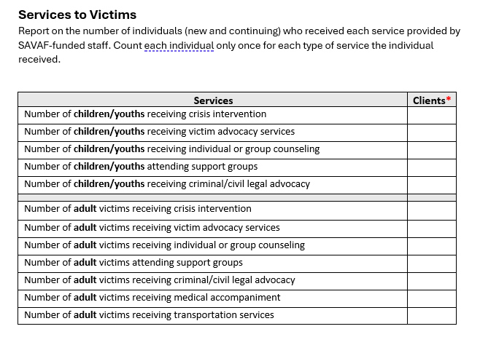
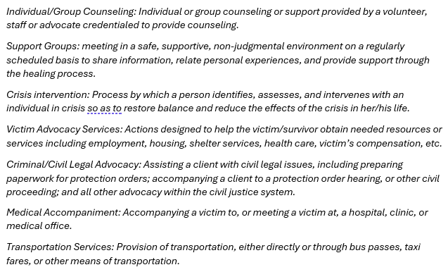
Services
Table is for BOTH new and continuing individuals

Slide 14
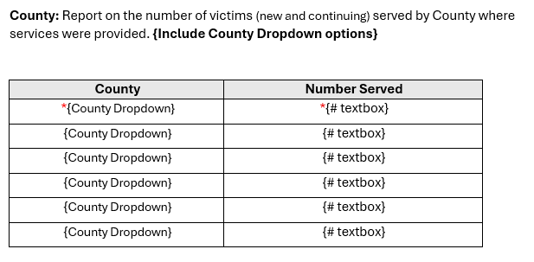
Demographics: County
Tables are for ALL SAVAF INDIVIDUALS: BOTH New AND Continuing.
Please ensure ALL clients are counted in this table. If you are unsure of the client’s county of origin, please select unknown.

Slide 15
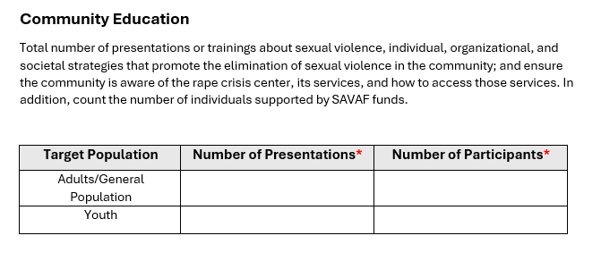
Community Education
Table is for TOTAL SAVAF

Slide 16
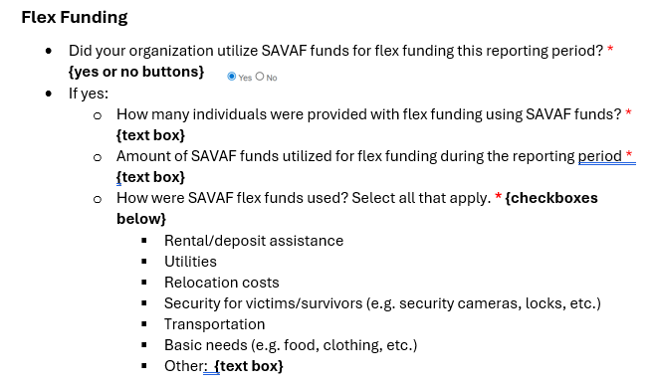
Flex Funding (NEW!)
How many individuals did you provide flex funding assistance to during this reporting period? This will need to equal what is submitted with the accompanying fiscal report(s) for the quarter.
How much was spent?
What were the requests for?
Provide data on the reach and use of flex funds

Slide 17
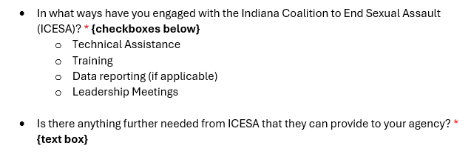
ICESA Engagement and Support (NEW!)
We will compile and provide this feedback to ICESA on a quarterly basis.

Slide 18

Impacts and Challenges
2 Free Response Questions
  Each text box has a limit of 4000 characters.
Question 1: Describe the impact SAVAF funding has had in this reporting period.
Question 2: Describe any challenges that your SAVAF funded program faced this reporting period.

Slide 19

Program Report
Due Dates
ALL program reports will be due on a QUARTERLY reporting basis regardless if you selected Monthly or Quarterly reporting for Fiscals.

Slide 20


Questions?

Slide 21
THANK YOU
Katherine Barnes, Senior Grant Manager: katbarnes@cji.in.gov
Becky Venus, Senior Grant Manager: rvenus@cji.in.gov
Kim Lambert, Division Director: kilambert@cji.in.gov

