Slide 1
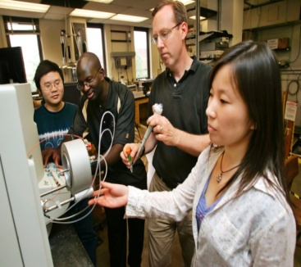
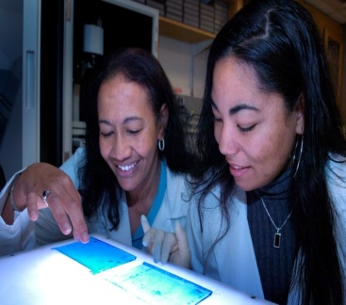
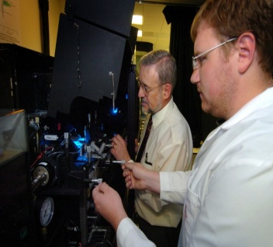
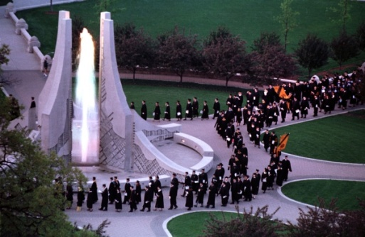
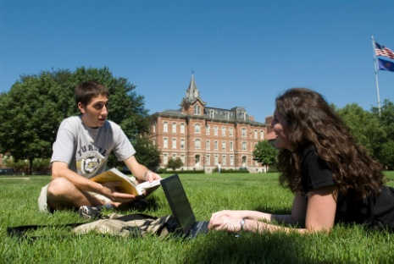
Student Success Corridor
Facilities Supporting the
Student Success Vision
Kevin P. Green

Slide 2
Balanced Capital Planning Approach
Three point approach:
Replace existing facilities with new where appropriate
Renovate existing facilities where feasible
Add new space only when needed
This approach will:
Reduce our deferred R&R backlog
Cut down on new investments in operating costs
Eliminate old, inefficient space
Add newer, more energy efficient space

Slide 3
West Lafayette Campus Master Plan
Five Long Term Goals
Promote compact growth within the existing campus
Establish State Street as a collaborative zone
Create program synergies through mixed-use districts
Encourage a simple, and integrated transportation system with a perimeter parkway
Preserve the western lands
Sasaki Associates 2008

Slide 4
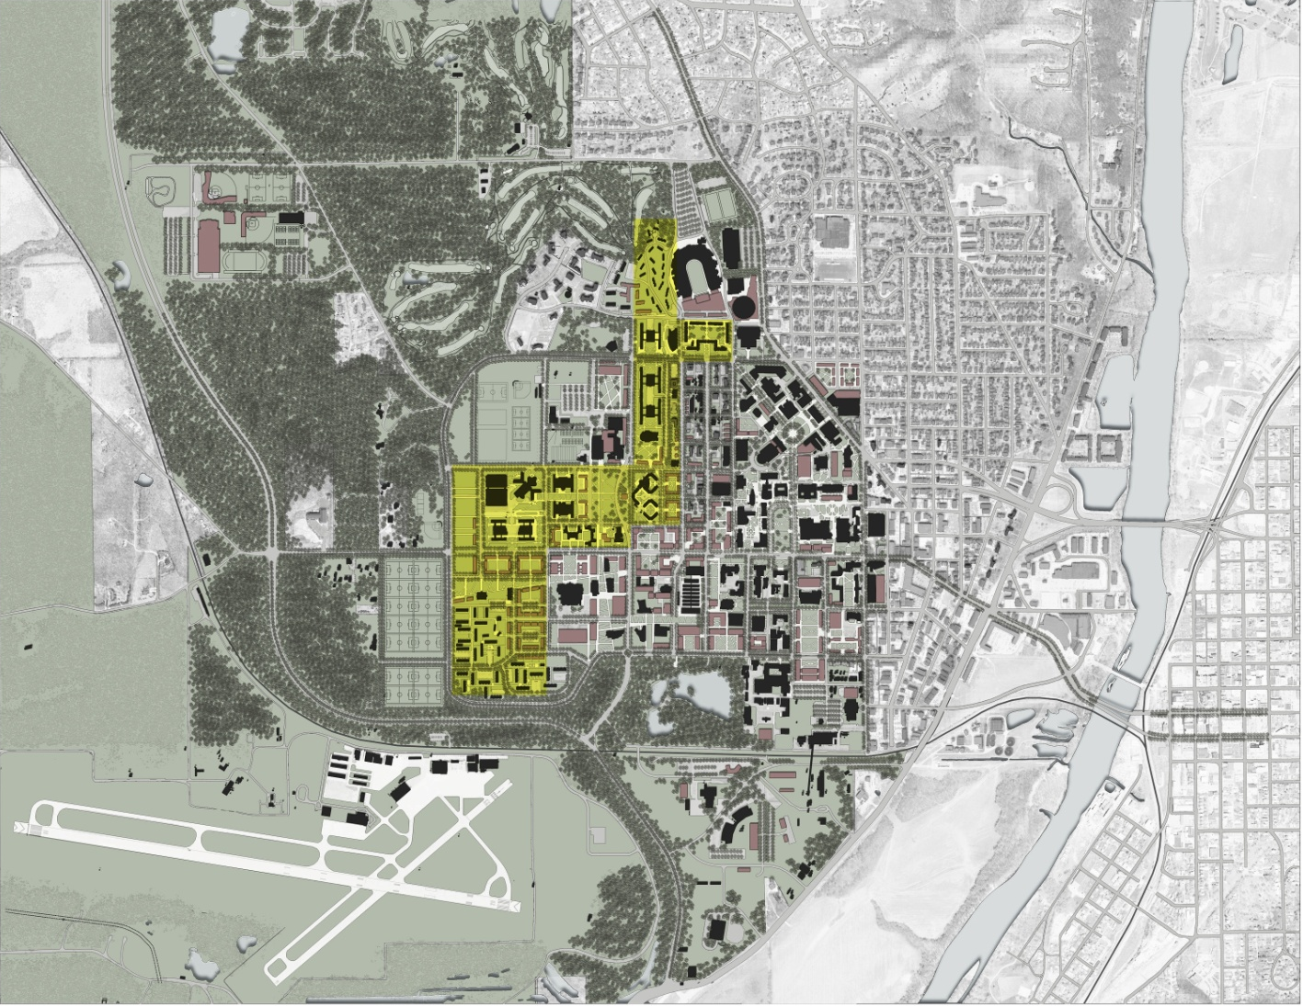
Current Campus Reference
Core Residential

Slide 5
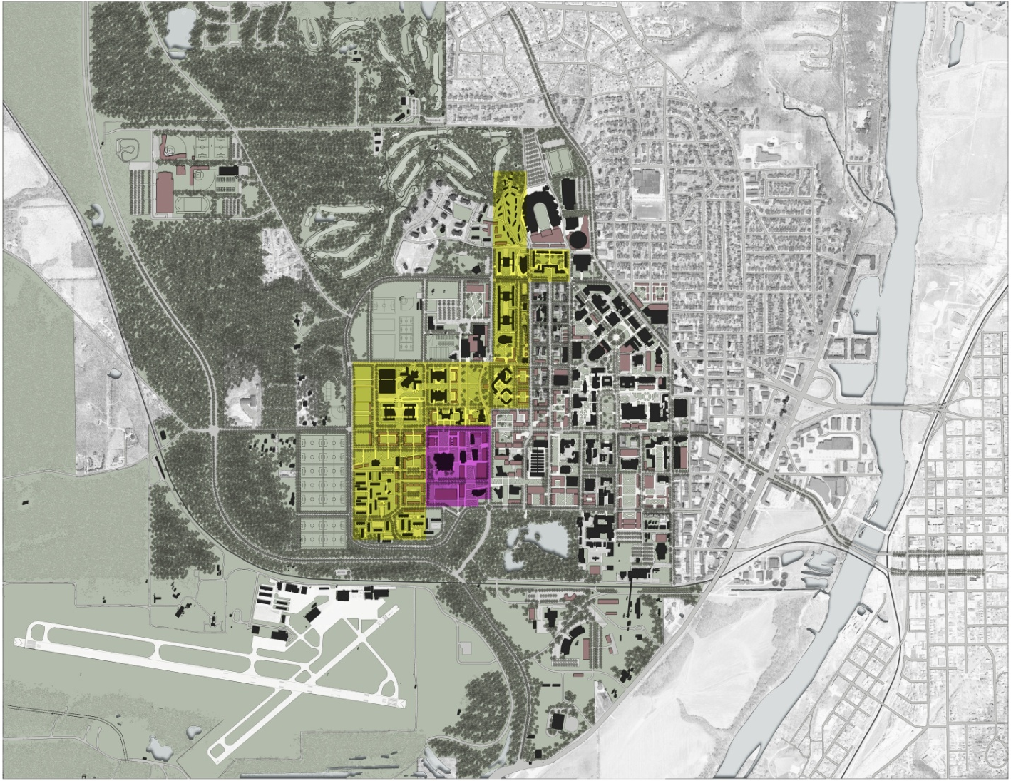
Current Campus Reference
Discovery Park

Slide 6
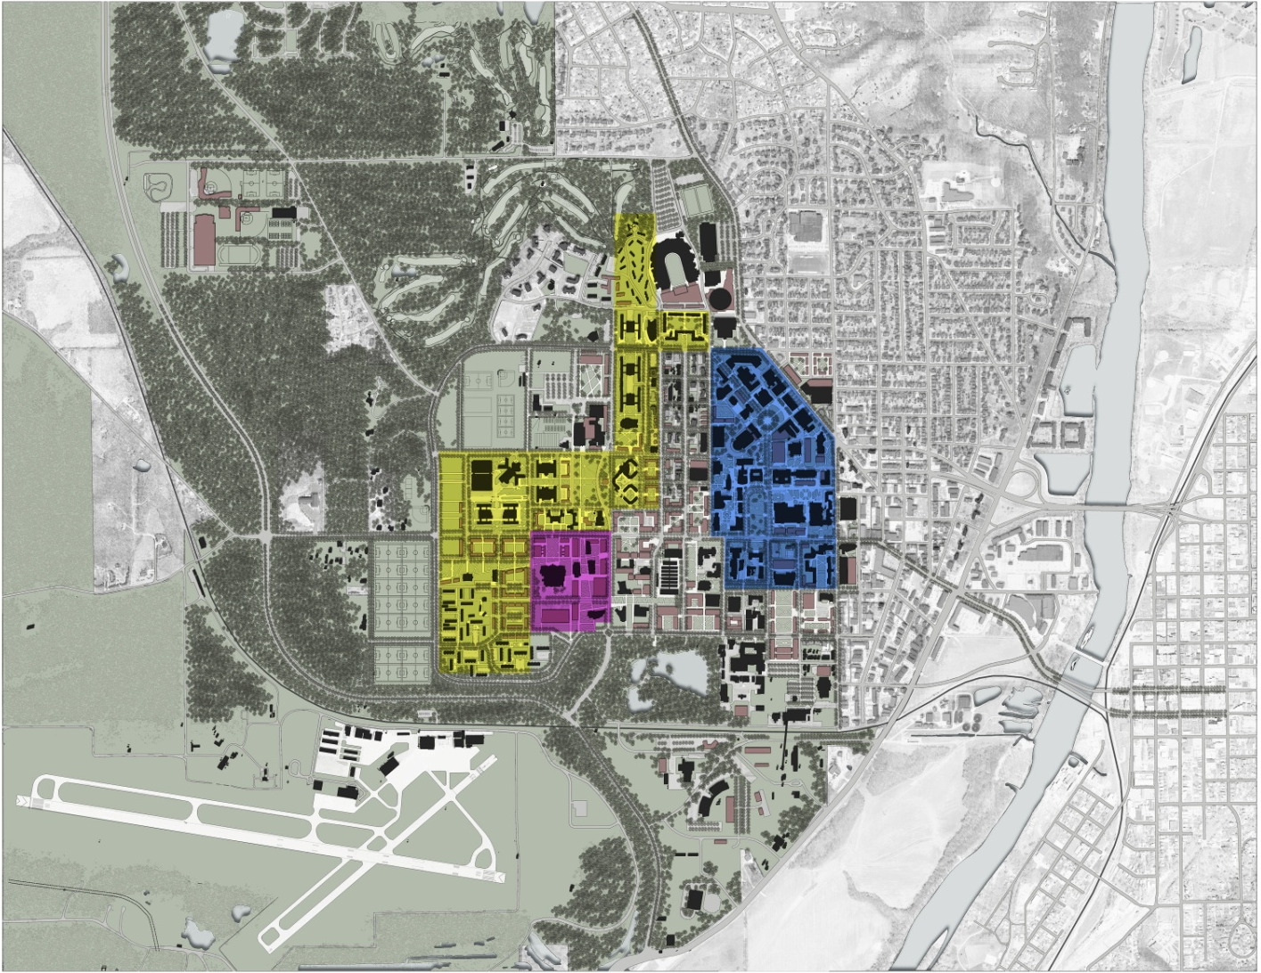
Current Campus Reference
Core Academic

Slide 7
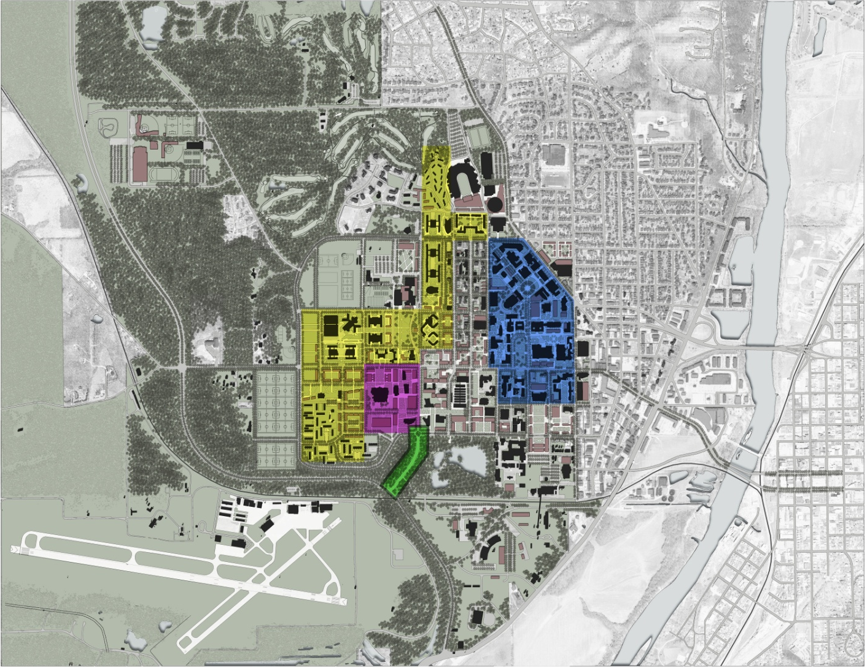
Current Campus Reference
South Gateway

Slide 8
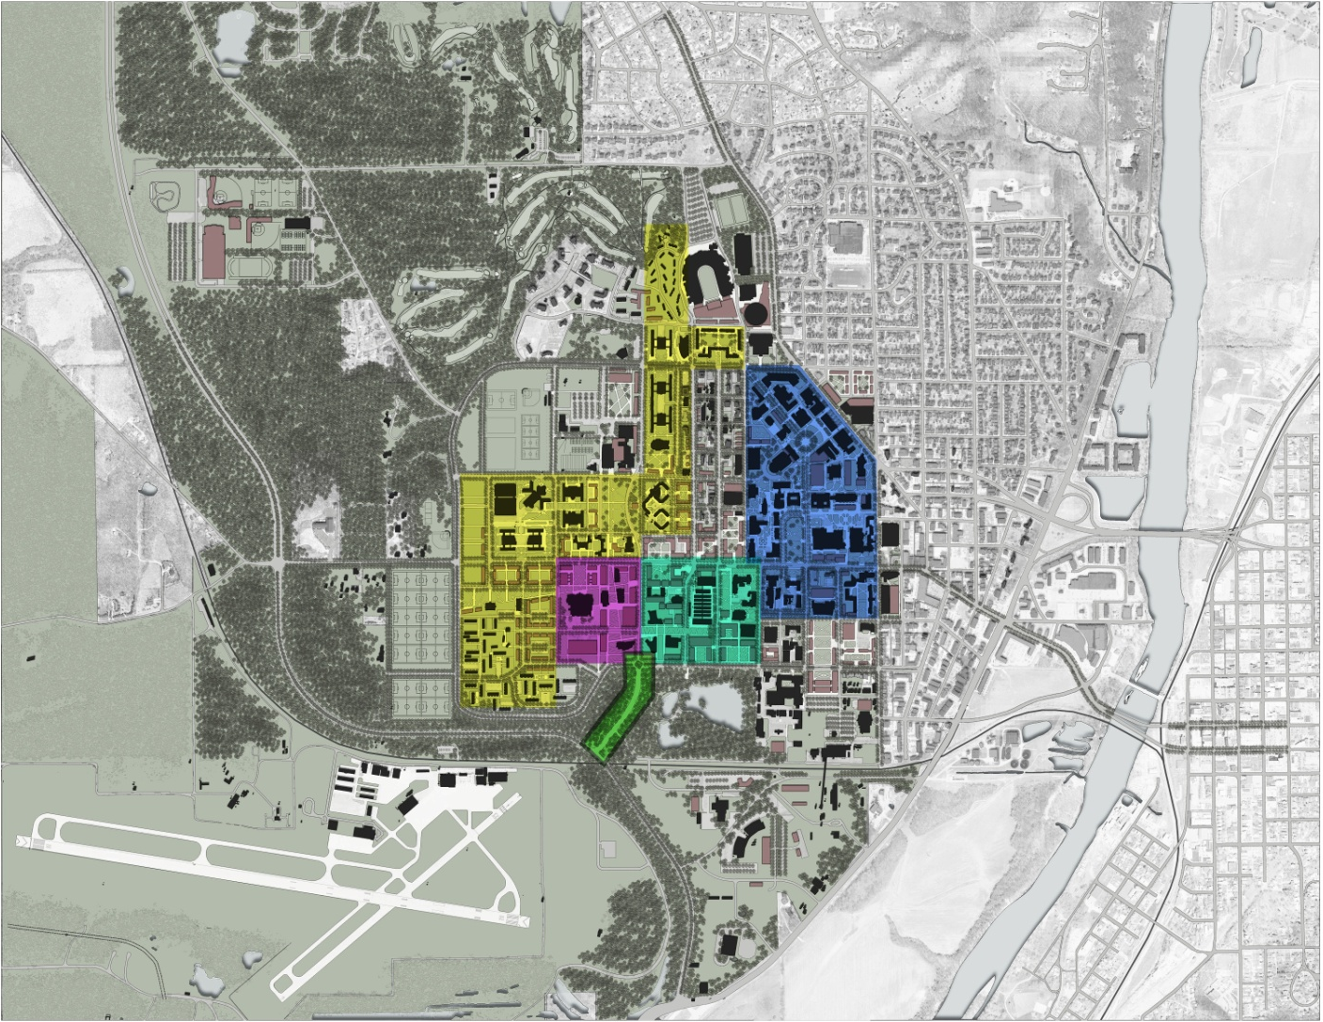
Current Campus Reference
Life and Health Sciences Park

Slide 9
Current Campus Reference
Student Success Corridor

Slide 10
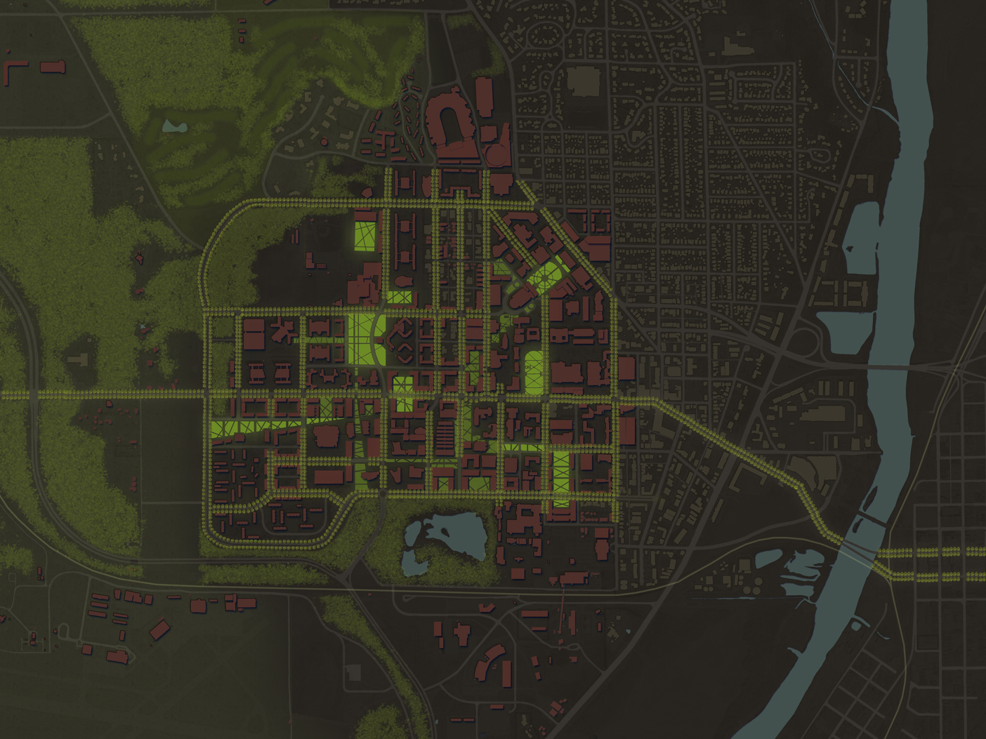
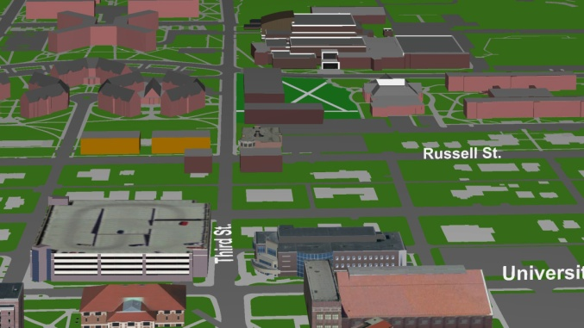
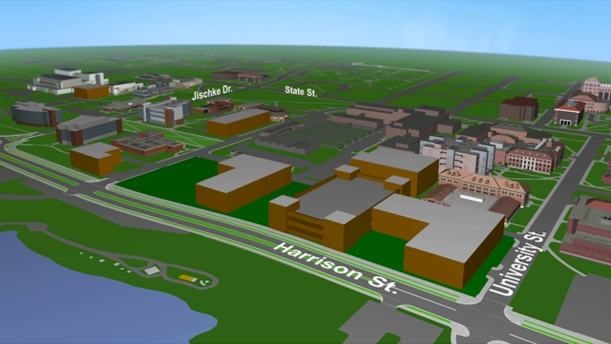
Synergies Through Mixed-Use Districts
Student Success
Corridor
Residential
Student Life
Student Success Corridor
State Street
State Street
Collaborative
Academic
Life and
Health Sciences
Park
Life and Health
Sciences Park
Research

Slide 11
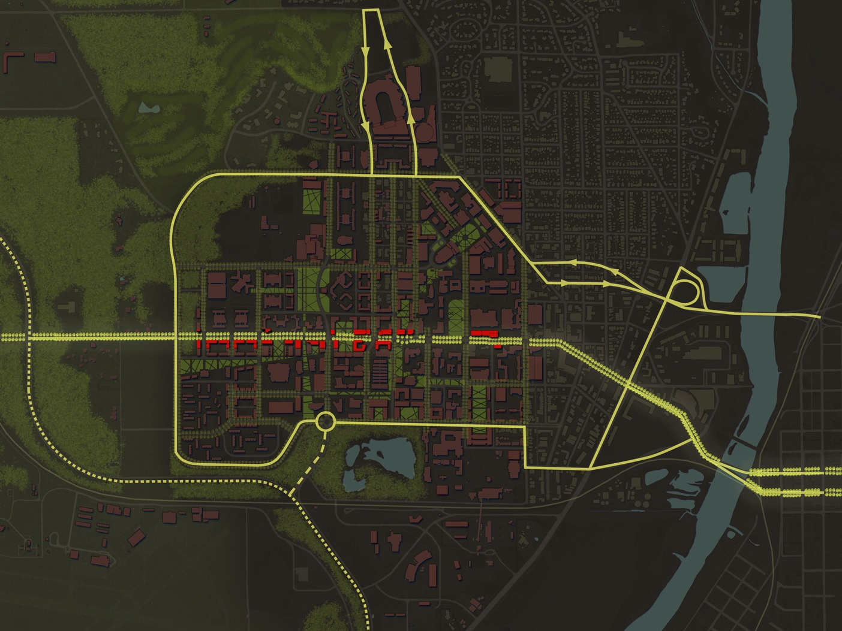
Campus Master Plan
Transportation System
Create a simple, and integrated transportation system with a perimeter parkway.
This will make Third Street and State Street more pedestrian Friendly.
Student Success Corridor
Life and
Health Sciences
Park
Shuttle Loop

Slide 12
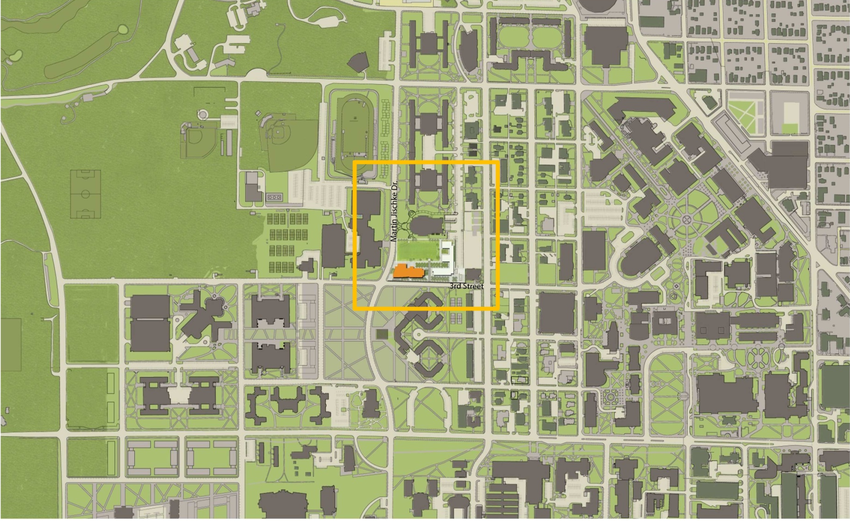
Student Success Corridor
C-SEL as Anchor

Slide 13
Center for Student Excellence and Leadership
Footprint

Slide 14
Center for Student Excellence and Leadership
Center for Student Excellence & Leadership (C-SEL)
Vision established as part of New Synergies strategic
plan
Planning group included twice as many students as
administrators
Provide a transformative environment to support student
collaboration, development, and leadership
Create a hub for student organization activities and
interaction
Gather student success programs and activities into a
“one-stop shop”
Total Cost: $30,000,000
From: $18,000,000 Unrestricted Endowment
(pursuing gifting opportunities)
$12,000,000 Athletics TV Revenue

Slide 15
Center for Student Excellence and Leadership
C-SEL Central Space
Additional interactive and flexible
space is needed for academic success
programs, advising, and student
organizations
A building at the center of our Student
Success Corridor symbolizes the
priority the institution places on
student success
C-SEL will be a hub for student
interaction; a bustling “third” space at
the intersection of the academic and
co-curricular campuses

Slide 16
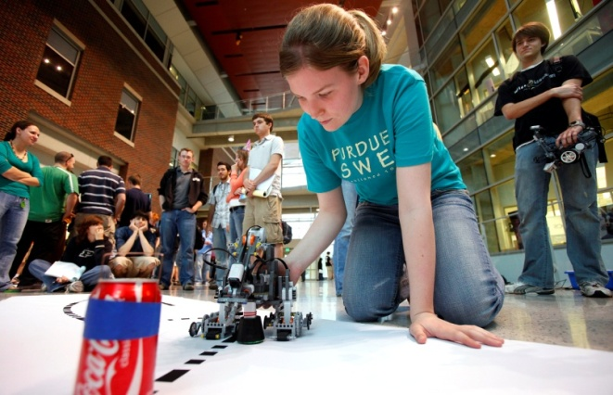
Center for Student Excellence and Leadership
C-SEL Enhanced Experience
Honors programs
Global awareness
Undergraduate research
Entrepreneurship
Service learning
Leadership development
Career development
Every student will have an enhanced experience

Slide 17
Center for Student Excellence and Leadership
C-SEL Student Engagement
Learning communities ( +3.1% retention)
Academic support (Purdue Promise +4.6%)
Orientation programs (Boiler Gold Rush +4.4%)
91% of student organization members had a GPA of 3.0 or higher
(overall average GPA: 2.94)
Engagement enhances student success

Slide 18
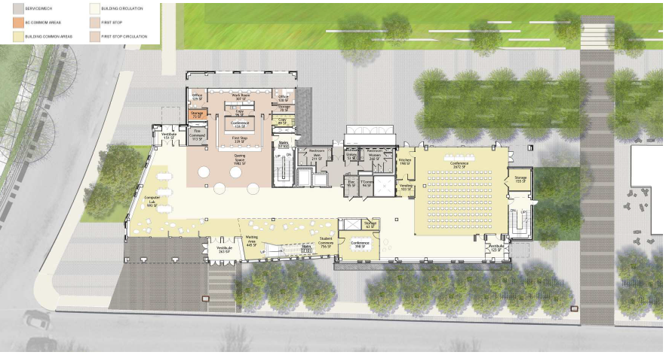
Center for Student Excellence and Leadership
Floor Plans
First Floor
Second Floor
Third Floor
Fourth Floor

Slide 19
Center for Student Excellence and Leadership
First Floor - “The Main Street”
Student study lounges with wireless access, creating an e-community
One-stop student help desk for academic and co-curricular activities
Large gathering room for student organization events and meetings

Slide 20
Center for Student Excellence and Leadership
Second Floor - “Student Organization Hub”
Purdue Student Government, Inter-Fraternity Council, Panhellenic, etc.
Flexible shared space to allocate to other student groups.
The number of student organizations have expanded to more than
900 since Stewart Center was built in the 1950's.

Slide 21
Center for Student Excellence and Leadership
Third Floor - “Student Organization Support Services”
Student Leadership Development (SLD)
Boiler Volunteer Network (BVN)
Student Activities & Organizations (SAO)
Business Office for Student Organizations (BOSO)

Slide 22
Center for Student Excellence and Leadership
Fourth Floor - “Academic Success Hallway”
Student Access, Transition & Success (SATS) program
Boiler Gold Rush (BGR) & Learning Communities Development
Purdue Promise and Horizons
Academic Success Center

Slide 23
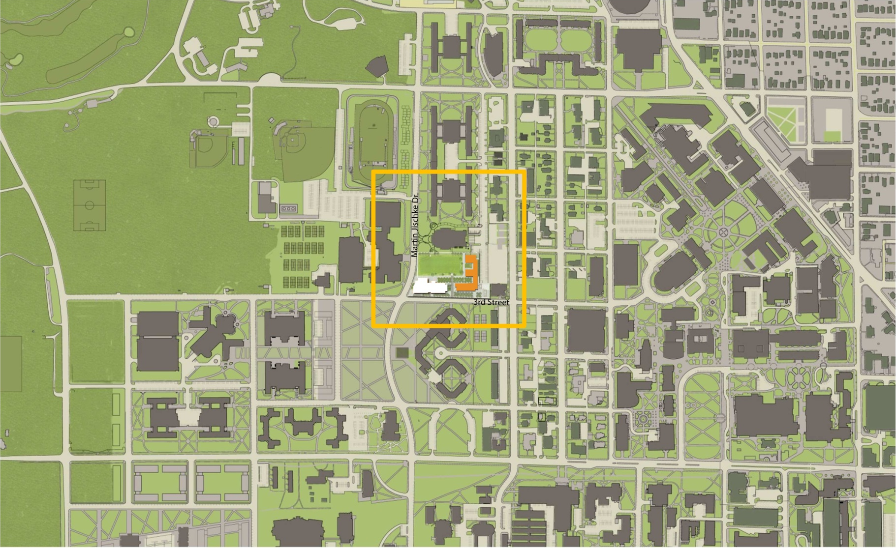
Student Success Corridor
Vawter Field Housing

Slide 24
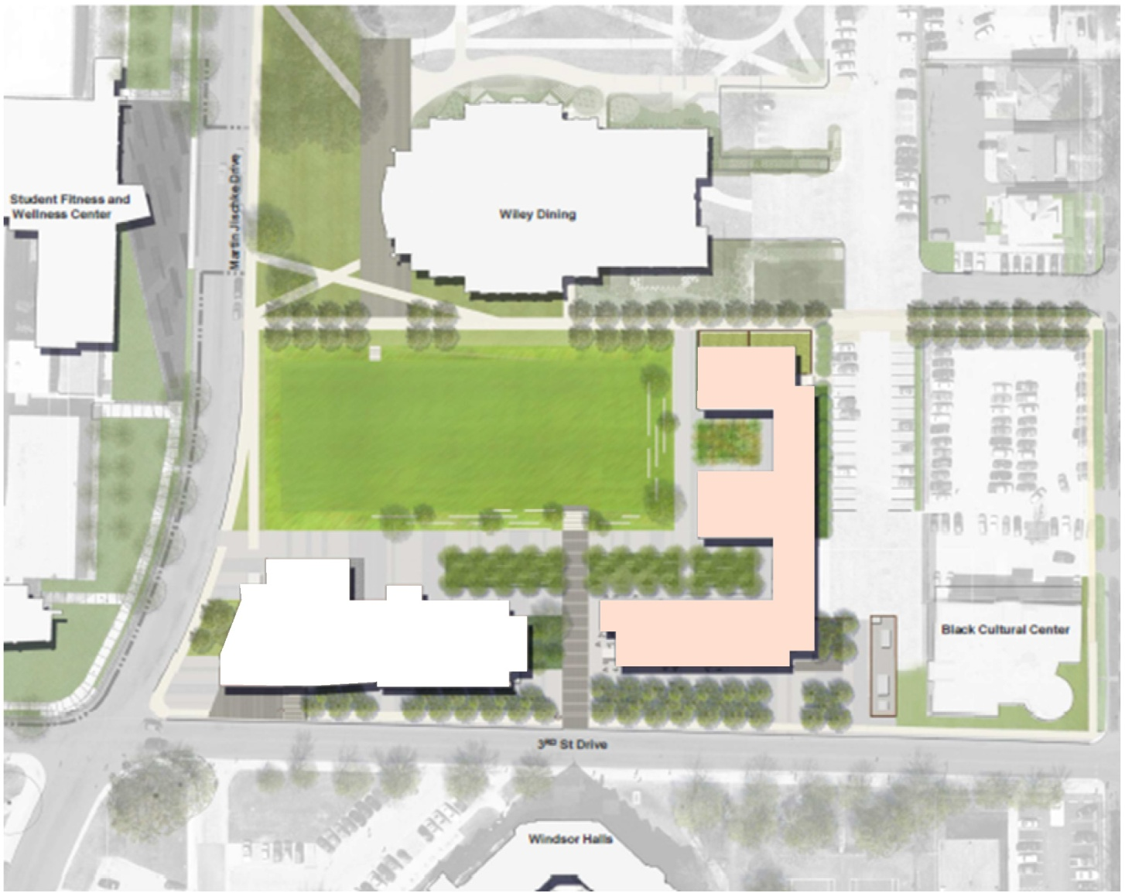
Vawter Field Housing
Footprint

Slide 25
Vawter Field Housing
Vawter Field Housing
Living Setup
~300 bed move-up option
New style housing option with enhanced suites
On-campus option for upperclassmen
Enhanced learning communities
Space to support student success
All-hours retail space
Priced in the middle of housing options
Total Costs: $39,900,000
From: Residence Hall System Revenue

Slide 26
Vawter Field Housing
Student Success Space
Considerations
- Flexibility of furniture
- Location of voice/elec/data

Slide 27
Vawter Field Housing
Interactive Learning Spaces
Learning spaces
- Student and faculty
can work together
- Small group work
- Individual work
Learning aisles
- Pre-class and post-class
informal discussions
- Located along transition
spaces
- Small group work

Slide 28
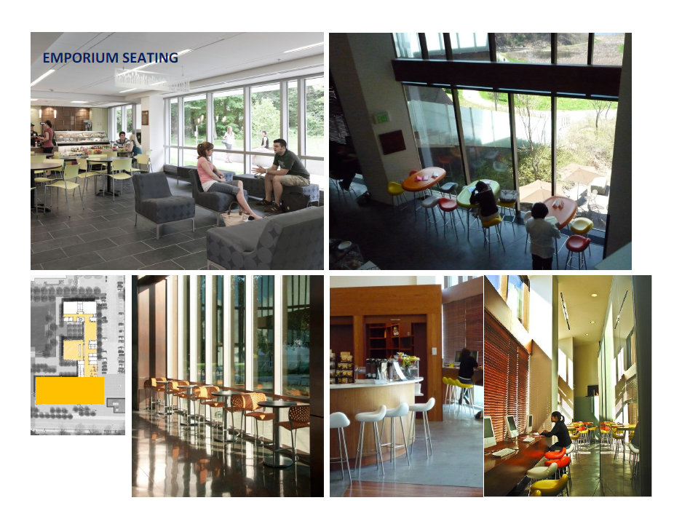
Vawter Field Housing
First Floor Emporium

Slide 29
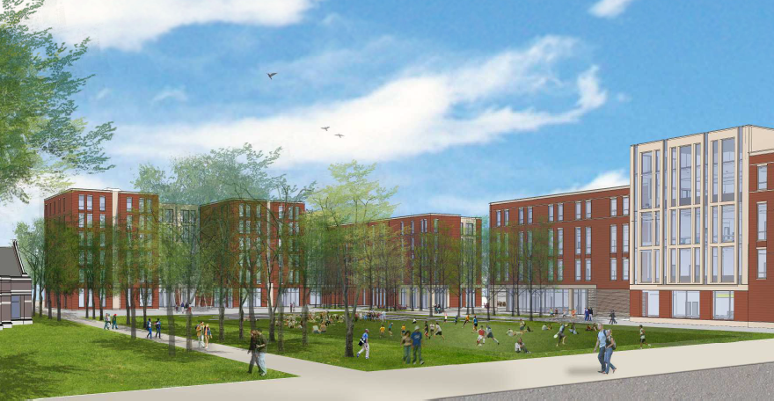
Vawter Field Housing
Courtyard Elevation

Slide 30
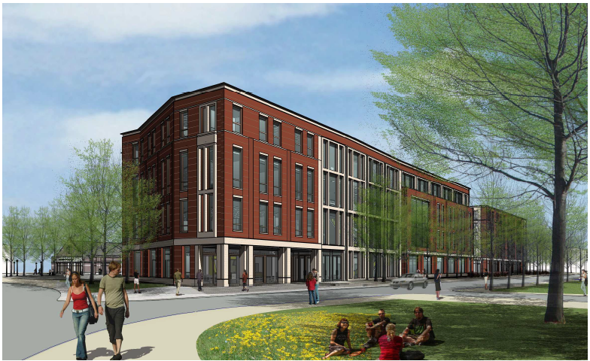
Center for Student Excellence and Learning
Third Street Elevation

Slide 31
Student Success Corridor

