Slide 1
Table of Contents
Topic 1: Understanding You & CTE Pathways
Topic 2: Credentials of Value
Topic 3: Postsecondary & Career Alignment
Topic 4: Creating a Personalized Credential Completion Plan

Slide 2
Understanding You & CTE Pathways
Topic 1
Notes:
NOTE: (This is a lightly formatted version of the slide deck. Please feel free to use this information in your own design or template.)

Slide 3

Reflect on elementary school…
What was your answer when someone asked, “What do you want to be when you grow up?”
Is that the same goal you have now or has it changed?
Notes:
Instructor: Have a few students share out their thoughts out loud? Share your own experience if you choose.
We’ll talk about different career areas (called “career clusters”) to help you make a plan for your future—one that fits who you are and what you want out of life.
Whether you already have a dream job in mind or you're still figuring it out, this class will help you discover new possibilities and take your next step with confidence.
Let’s explore, learn, and start building a future that’s right for you!
Photo by Nathan Cima on Unsplash

Slide 4
Students will be able to explain the purpose and structure of Indiana’s Career and Technical Education (CTE) system and how pathways guide their career development.
Students will gain understanding of CTE and the specialized skills needed for different career opportunities related to the program of study.
Students will explore resources available for students to research and select CTE pathways.
Students gain an overview of the various CTE pathways available in Indiana and better understand the importance of aligning personal interests and skills with career pathways.
Today’s Competencies:

Slide 5



What skills do you think are essential in these careers?
Technology/Informatics
Healthcare/Medical/Surgical Nurse
Supply Chain/Logistics Specialist
Notes:
Sample photos include Healthcare/Medical/Surgical Nurse, Technology/Informatics and Supply Chain/Logistics Specialist to represent of three pathways which provide pathways courses, stackable credentials, and transferable skills. These careers portray a variety of experiences that can fit any of the 3Es (enrollment, enlistment, or employment). If you are an instructor in a different pathway, you may want to swap out the images for the discussion.
Instructor: What skills pay the bills? Look at the three sample career images. Share some skills one might need to be successful in those roles. (guide discussion to general career ready skills (communication, collaboration, critical thinking) and not just industry specific, technical skills)
Photo sources:
Healthcare Photo by National Cancer Institute on Unsplash
Informatics Photo by ZBRA Marketing on Unsplash
Logistics/Supply Chain Photo by Adrian Sulyok on Unsplash

Slide 6

Let’s explore!
Let’s take a deeper dive into your personality and skills profile in the Agilities Work Profiler.
Use your school email address or one you can check to receive your results!
Notes:
Instructor: While some of you may have completed an interest inventory in past year’s, let’s all review and see if there have been changes or tweaks to your skills.
Give students time to complete Agilities Profiler
Instructor needs to have access to a learning management system for the students to access linked resources (Canvas, Powerschool, Schoology, etc.) for students.

Slide 7
Agilities Discussion
Why is it important to align personal skills to your career pathways?
Discuss the importance of aligning personal interests with career pathways.
Share a personal account of someone who loves their job. Why do think they love it?
Notes:
Instructor: (Again feel free to share a personal experience that you have had related to your interests. Possibly vulnerable enough to share a job or career that was not aligned to your interests as well.
Lead some students to share responses for each question by modeling a response.)

Slide 8
Journey to a Credential Completion Plan (CCP)
CCP
Begin Mapping Process
Connect Postsecondary & Career Alignment
Identify Credentials of Value
Discover Diploma & Seals
Discuss +/- of Influences
Learn about CTE/NLPS Pathway
You are here!
Start
Completed Agilities
Profiler
Start
Notes:
Instructor: “We have taken our first step in the journey to your Credential Completion Plan (CCP), and more important steps will follow in the lessons to come.

Slide 9
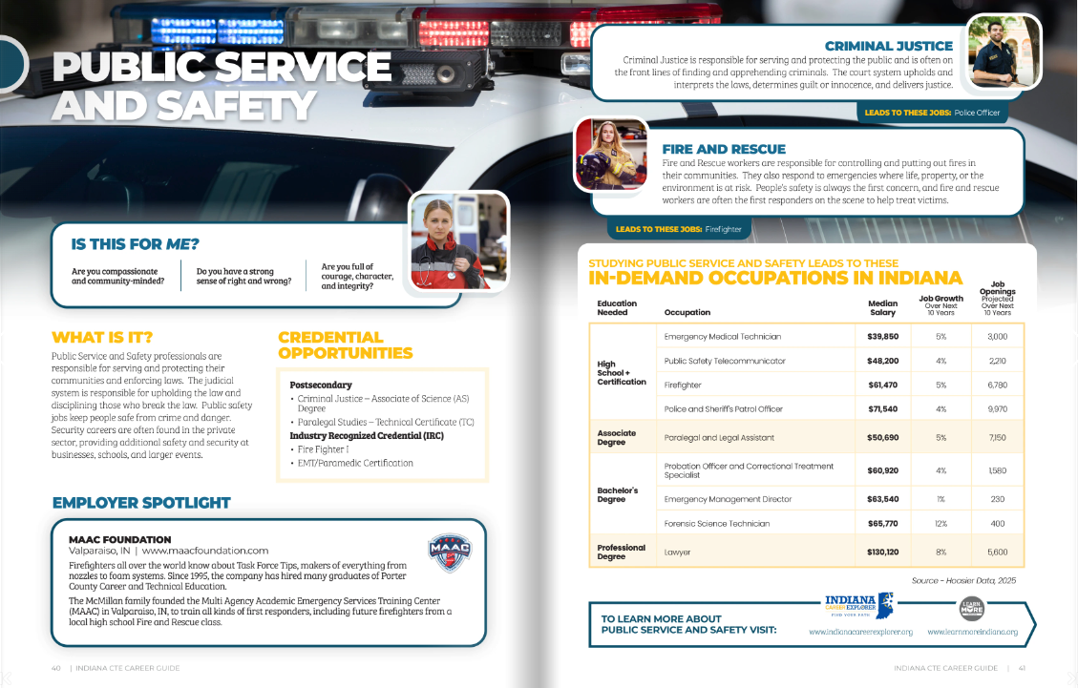

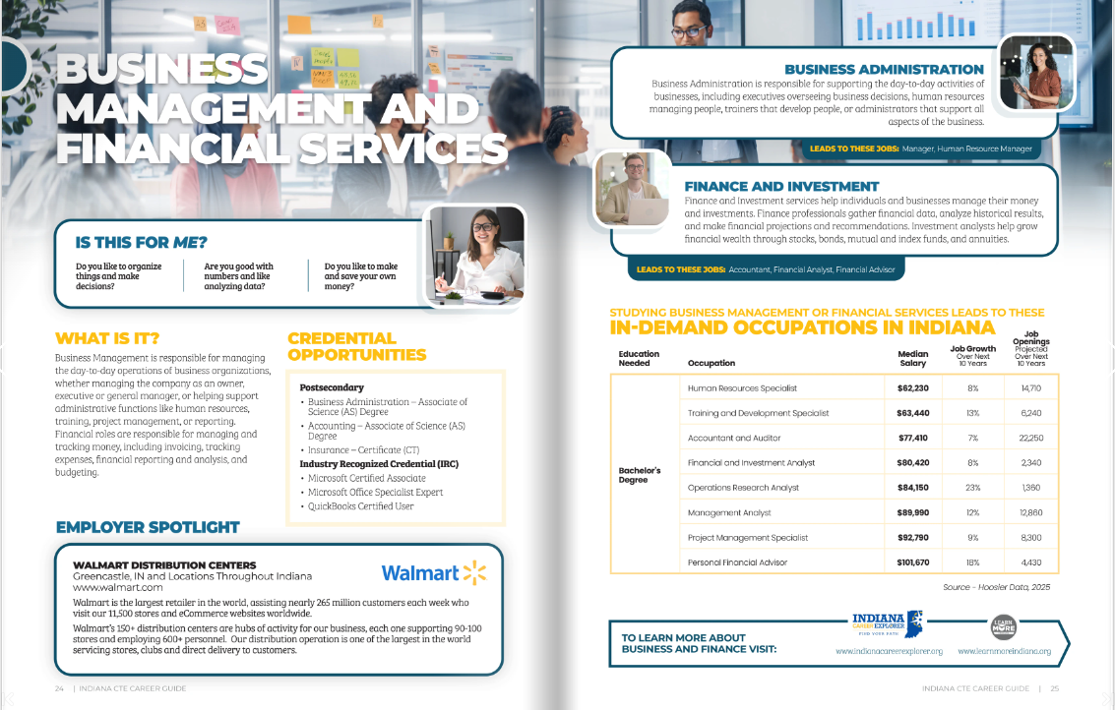
Indiana CTE Career Guide
Explore the new
Indiana CTE Career Guide.
Think about your career goals, your Agilities results, and the industry forecast for careers in this field.
Notes:
Instructor: Ask students to explore the CTE Career Guide. Draw their attention to page 10/11 for the skills for Work Based Learning and page 14/15 for NLPS overview. Career Snapshot pages start on page 18.
Now that you have your key skills identified. Choose a career pathway of interest and decide if it aligns? If it does, what do you need to do–courses, concentrators, credentials, training, education, etc
Using the resource link provided find your initial career of choice pathway and explore.
What NLPS can lead you to your pathway? (page 51)

Slide 10
Career Guide Insights
What did you notice? What did you wonder?
What certifications or dual credit options are available for each pathway/career?
What is the entry level wage for each pathway/career?
Does anything surprise you?
Notes:
Activity 1 in the Topic 1 Curriculum Content -

Slide 11
Partner on the Pathway
Indiana has developed Next Level Programs of Study (NLPS) and the CTE Pathways to be your partner in developing your Credential Completion Plan!

Slide 12
Indiana’s NLPS (Next Level Programs of Study)
60 + programs of study in sequenced pathways
Aligned to high‑demand industries, dual‑credit courses at Ivy Tech Community College and Vincennes University
Recognized industry certifications
Notes:
Instructor notes:

Slide 13
Key Benefits for You!
Students can take required classes at the same time instead over multiple years.
  Stacking courses (Principles, Concentrators A & B)
  NLPS allows you to earn Honors Seals and Seals Plus Diploma
  Most Advanced Courses total 6 college credits
Students can earn dual credit, but don’t need to earn college credit to receive a CTE Concentrator.
Capstone course includes time for work-based learning experiences, like internships or hands-on job training.

Slide 14
Journey to a Credential Completion Plan (CCP)
CCP
Begin Mapping Process
Connect Postsecondary & Career Alignment
Identify Credentials of Value
Discover Diploma & Seals
Discuss +/- of Influences
Learn about CTE/NLPS Pathway
You are here!
Start
Completed Agilities
Profiler
Start
Notes:
Instructor: “We have now added some knowledge about NLPS courses and pathways and how all of these can help build your Credential Completion Plan (CCP).”

Slide 15
Let’s Reflect!
Name one major goal of an NLPS pathway which supports career development.
Share a resource that you explored today which was helpful and informative to you.
Think about your Agilities results and reflect on the connection between your results and your future career goal.
Notes:
Either discuss or use the Exit Ticket review in the curriculum.

Slide 16
Exit Activity: Reflection w/ Peer Feedback
After drafting your reflection
Read a classmate’s draft
Use the strategy below to provide feedback
1 | 2 | 3 | 4
Compliment: Start with a positive note. Find a specific point to compliment. | Comment: Make a comment about something relevant and meaningful that the student shared. | Connect: Look to make a connection with something that was written. Explain that connection. | Question: Ask a specific question that may assist student in elaborating further on a topic.
Notes:
Aligns with reflection activity in the Instructor’s Guide

Slide 17
Credentials of Value (CoV)
Topic 2
Notes:
NOTE: (This is a lightly formatted version of the slide deck. Please feel free to use this information in your own design or template.)

Slide 18
Imagine 5 years into the future…
What are you doing? College? Working? Enlisting? Starting your own business?
What skills or experiences helped you get there?
Notes:
Hold a pair share or whole class discussion on the questions.

Slide 19
Today’s Competencies
Examine licensing, certification, and credentialing requirements for different career opportunities related to the program of study.
Students will explore the role of CoVs, matching them with relevant career opportunities.
Identify a career goal, including opportunities available while in high school, for obtaining the specialized skills and credentials needed for a career related to the program of study.
Notes:
Instructor “Remember…:this isn’t just about meeting graduation requirements or doing exactly what your friends are doing — it’s about designing a future you’re excited about.”
Let’s dive in and start connecting what you’re learning now to where you want to go next.
With that in mind, let’s talk a little about what might influence your decisions.

Slide 20

What are some factors that influence your career choices?
What are some factors that influence your career choices?
Notes:
Instructor: You may want to share example to get them thinking (i.e. family, friends). Pause to allow students jot down a few of their own ideas. (Note the these may be more personal in nature and students should reflect, but not be asked to share out loud.)
Photo by Marsha Reid on Unsplash

Slide 21
Who or What Influences You?
Access to Opportunities
Personal Interests
Peer Influence
Media Exposure
Family Influence
Your Career Choices
Personality Traits
Academic Performance
Career Exposure
Job Market Trends
Community Influence
Social Status / Prestige
Financial Considerations
Notes:
Instructor: (Use these ideas below others like this to guide some discussion.)
“How many of you had 3-4 of these listed?” (allow for show of hands)
“How many of you had 5+ of these listed?” (pause again)
“Notice some have been covered in our lessons: personal interests, personality traits, job market trends”

Slide 22
Impact of Influences
Are there positive and negative influences on your list?
Do some of these influences support your goals and choices?
Do some of these influences hold you back from your goals and choices?
Notes:
Instructor: “Let’s think about how the influences you identified can be positive or negative for you. Look at the list you created and reflect adding some notes as to how your influences support you or hold you back.” Give students a few minutes to jot down positive and/or negative influence.
Instructor: For example, peer influence and/or pressure can be both positive and negative. A peer can be there to promote and support your goals and cheer you on, OR a peer can be there to distract and downplay them. (Ask for volunteers to share a couple positives or negatives.
Instructor: Remember in Topic 1, we mentioned we are helping guide you to achieve your goals.

Slide 23
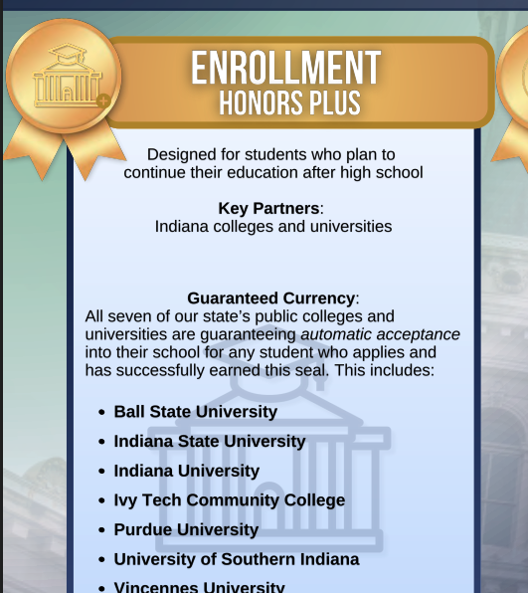
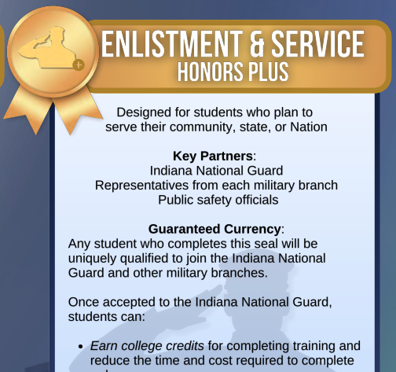
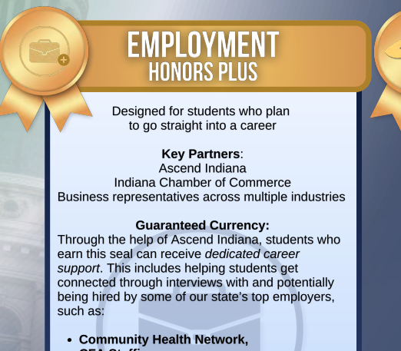
Partner
on the Pathway
Notes:
Instructor: “Now that we have learned more opportunities to graduate with real skills and more aligned to your interests and influences, let’s take a moment to think about how you will continue shaping your own journey with your high school diploma.”

Slide 24
Journey to a Credential Completion Plan (CCP)
CCP
Begin Mapping Process
Connect Postsecondary & Career Alignment
Identify Credentials of Value
Discover Diploma & Seals
Discuss +/- of Influences
You are here!
Learn about CTE/NLPS Pathway
Start
Completed Agilities
Profiler
Start
Notes:
Instructor: “We are well on our way to our goal for you to create a personalized Credential Completion Plan(CCP). Now we will shift to learning more about the new Indiana Diploma and the Honors Seals.”

Slide 25
Indiana’s New Diploma & Seals
Indiana now offers a flexible diploma beginning with the class of 2029, but some students can earn the diploma now if their school has opted in to offer it now.
Students must complete:
  Foundational Core Courses
Students have the flexibility to complete:
  Readiness Seals – Enrollment, Employment, or Enlistment
Notes:
Instructor: “Indiana’s New Graduation Requirements, launching with the Class of 2029, focus on increased flexibility and career readiness.”

Slide 26
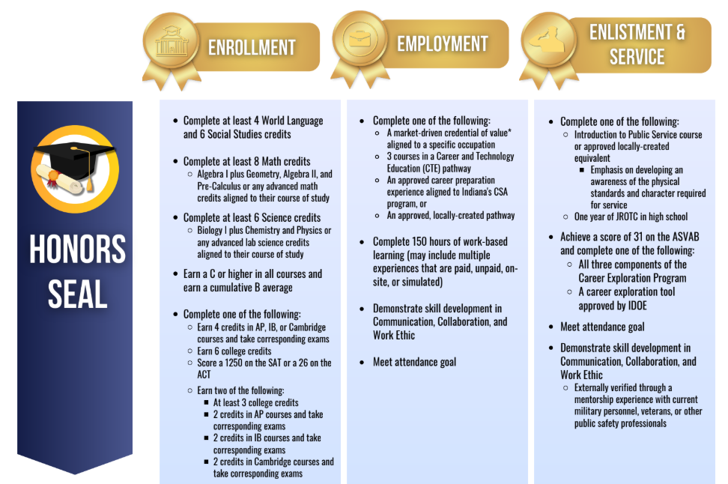
Indiana Diploma
Readiness Seals
Notes:
Instructor: “Students must earn:
a Graduation Pathway Diploma by completing core coursework
A graduation profile aligned to their interests (including project-, service-, or work-based learning)
AND demonstrate postsecondary readiness
They also choose from Graduation Seals—such as Employability, Enrollment, or Enlistment—to showcase skills and preparedness for life after high school.”
Link to IN Diploma Seals image (If you wish to create handouts)
Link to IN Diploma Comps image (Titled-Current and Future IN Diploma:Comparison)

Slide 27
Diploma & Seals Jigsaw Activity
Expert Topics:
Foundation Requirements (core subjects/credits)
Technical/Academic Specializations
Enrollment Honors Seal
Employment Honors Seal
Enlistment & Service Honors Seal
🧩 Experts: Students gather by topic, read, discuss, and summarize key points
🧩 Group Reflection: Students create a visual/written/slide summary of New IN Diploma & Seals
Notes:
(Slide details student jigsaw activity)
Divide students into groups of 4-5

Slide 28
In Your Expert Group…
Use both Diploma Seal resources to research your topic.
Discuss with your team to identify the key points.
Select a spokesperson from your group to share:
Describe/summarize your topic.
Why it matters to students?
As a class, share how these topics completes a whole picture of the new Indiana Diploma.
Notes:
(If smaller class, may choose to cover Expert Group topic 1 in whole group and then break into 4 groups to research topics 2-5)
Foundation Requirements (core subjects, credits)
Technical/Academic Specializations
Employability Skills Seal
Postsecondary Ready Competency Seal
Indiana College & Career Readiness Seal
Outcomes for this activity will be added to resource and linked with slide deck. (This activity will continue at end of lesson.)

Slide 29
Journey to a Credential Completion Plan (CCP)
CCP
Begin Mapping Process
Connect Postsecondary & Career Alignment
Identify Credentials of Value
Discover Diploma & Seals
You are here!
Discuss +/- of Influences
Learn about CTE/NLPS Pathway
Start
Completed Agilities
Profiler
Start
Notes:
Instructor: “We are well on our way to our goal for you to create a personalized Credential Completion Plan(CCP). Next, we’ll look at credentials of value and how they can support your plans after high school.”

Slide 30
What are Credentials of Value (CoV)?
A certification, license, or recognized training
Aligned to a high-wage, high-demand career
Often earned while in high school through your CTE pathway
Notes:
Instructor: “What do you think employers look for when hiring someone out of high school?” (Pause for some responses–e.g. Someone who… knows a certain skill that fits their industry; has some on the job training)
Do you know anyone who has earned a certificate or badge for a skill — like AWS certifications (American Welding Society), CNA(Certified Nurse Assistant), Microsoft Excel Specialization? Those are Credentials of Value — and help you stand out to employers. Credentials of Value connect directly to real careers. These are more than just pieces of paper — they’re your first tickets into high-demand, high-wage jobs while you're still in high school or right after graduation.

Slide 31

Benefits of Diploma + CTE + Credentials
Rigorous skill development
Stackable credentials and dual credit opportunities
Clear pathway alignment with postsecondary programs and career fields
NLPS ensures credentials are not random
Begin thinking about your own strategic pathway toward future success in–enrollment, employment, and/or enlistment.
Notes:
Instructor: So we have talked about the NLPS Pathways and your interests and now we are seeing the benefits of aligning those. You can earn industry-recognized credentials as part of a structured sequence of courses that prepares them for college, apprenticeships, or entry-level careers.
Photo by ThisisEngineering on Unsplash

Slide 32
Additional Perks:
CoVs Increase Postsecondary Options!
Qualify for apprenticeships and technical programs
Earn dual credit and college-level certifications
Strengthen applications for college admission, scholarships, and employment
Notes:
High-quality credentials offer alternative and affordable paths to good-paying careers, especially for students who may not pursue a traditional four-year degree. They provide a way to gain confidence, purpose, and financial opportunity—starting in high school.
Now that we have learned flexibility to graduate with real skills and real options, let’s think about how you might further shape your own journey with this next activity.

Slide 33

“Connect the Credential” Activity
Use the Career Clusters (printed or digital format).
Match the given Credentials of Value to the correct CTE Career Cluster.
Example:
AWS Certified Welding (credential) → Advanced Manufacturing (career cluster) (spoiler!)
Notes:
Instructor: The purpose of this activity is to help you explore how Credentials of Value and Career and Technical Education (CTE) programs fit into your future — whether that’s college, a trade, or the workforce. (See Lesson Notes for more details.)
Resource: Credentials & Career Cluster Cards
Upon completion discuss:
Why did you match each credential where you did?
Were any surprising or difficult to match?

Slide 34


Key Points
✅ Decrease overall college expense
✅ Shows employers what you can do
✅ Helps you qualify for jobs faster
✅ Connects directly to CTE programs and career clusters
✅ Can lead to better pay and more career options
Decrease overall college expense
Shows employers what you can do
Helps you qualify for jobs faster
Connects directly to CTE programs and career clusters
Can lead to better pay and more career opportunities
Notes:
Instructor: Let’s review! Credentials help you prove your skills — before you even graduate. Think of them like a ‘fast pass’ to your future career!
Top Photo by Dave Michael on Unsplash
Photo by National Cancer Institute on Unsplash

Slide 35
Journey to a Credential Completion Plan (CCP)
CCP
Begin Mapping Process
Connect Postsecondary & Career Alignment
Identify Credentials of Value
You are here!
Discover Diploma & Seals
Discuss +/- of Influences
Learn about CTE/NLPS Pathway
Start
Completed Agilities
Profiler
Start
Notes:
Instructor: “One step closer to and more information learned for your CCP. Now we will shift to importance of postsecondary and career alignment.”

Slide 36
Wrap Up
Reflection Journal:
Student reflection of New IN Diploma & Seals, as well as their new ideas and interest in Credentials of Value:
Which diploma seal and credentials of value do you want to pursue?
How will you make that happen?
Notes:
As we end today’s lesson, hopefully you are beginning to get a clearer picture of how the new Indiana diploma gives you more choices and flexibility to shape your high school experience around your goals, and how adding credentials to prove your skills and increase your value benefits you as well! Let’s

Slide 37
Postsecondary & Career Alignment
Topic 3
Notes:
NOTE: (This is a lightly formatted version of the slide deck. Please feel free to use this information in your own design or template.)

Slide 38
What do you think is more important for your future success:
a college degree or
a specific skill?
Notes:
Instructor: Facilitate a brief discussion to generate interest.
Examples of people who are successful in trades right out of HS(AWS welders; construction trades, masonry, etc); those who are successfully entering health sciences careers with CoVs while still training or enrolling in school (i.e. Taking Ivy Tech courses and working simultaneously, and then entering a state university as a Junior saving $$), enlisting in military in cyber security to begin work and further train on the government funds to further your career in or post-service.

Slide 39
Today’s Competencies
Evaluate the impact of the Credentials of Value (CoV) on their selected career cluster.
Apply career exploration insights to define a personalized pathway within their selected career cluster.
Select and justify a pathway as part of their personalized Credential Completion Plan (CCP).
Start to develop a personalized Credential Completion Plan (CCP) that reflects your interests and strengths.
Notes:
Share today’s competencies with your students.

Slide 40
What determines the value of credentials?
CoVs receive their value based on data from:
Occupations linked to the credential
State licensing requirements
Job demand in the state
Business & Industry input
Indiana agencies maintain a CoV list that is updated annually based on changes in state data
Notes:
Instructor: “There are many factors influencing CoV and these are reviewed every year to ensure they continue to align with the demands across all entities.”

Slide 41
High Wage, In Demand Careers with Credentials of Value
Top IN employment areas:
Advanced Manufacturing
Transportation & Logistics
Information Technology
Healthcare
Notes:
Instructor: “Why do you think these might be the highest in our state?” (Possible answers: crossroads of America (many items transported through our state on national highways/interstates. Distribution centers are all over the surrounding area of Indpls, and with that there is a need for growth in manufacturing, etc. Healthcare is a hot area across the nation.)
More information can be found on the Department of Workforce Development's(DWD) list of Promoted Industry Certifications and resources like the NextLevel Jobs website

Slide 42
Benefits of High Quality Credentials of Value
For individuals: Increase career opportunities and earning potential
For employers: Access to a skilled workforce and reduced hiring costs
For educational institutions: Improved program alignment and industry relationships
For state: Economic growth through a more skilled workforce
Great resource: TopJobs Indiana
Notes:
Instructor: “Indiana's ongoing efforts focus on creating a stronger and more responsive workforce, benefiting individuals, and the state's economy.”

Slide 43
CoV Scenario Activity
Each team receives a scenario to research
Once assigned, read and research the scenario focusing on the specific questions
Each group needs to identify a notetaker and presenter
Create a summary of your scenario with input from all
Presenters will share their scenario summary with class
Notes:
Instructor: “Let’s review the purpose of the CoV Scenario Activity before you begin the research.”
You will work together to complete your assigned scenario(s).
Each one presents a career and asks you to research the educational path, identify the most relevant credential(s), and analyze the CoV’s impact on starting pay.
You will need to have someone designated as a notetaker and someone as a presenter, but remember all of you are doing the work.
To help students understand the value of different career paths, here are scenarios for a group activity focusing on Indiana's "Credentials of Value"
I’m going to share some scenarios for you to work together will complete your given scenarios. These include in-demand credentials that lead to high-wage, high-skill jobs in the state.
Each scenario presents a career and asks you to research the educational path, identify relevant credentials, and analyze their impact on costs and starting pay.

Slide 44
Recap:
Share Out
Listen & Learn!
Listen to key points from each presenter and NOTE credentials that may benefit you.
Learn information that may guide you in your Credential Completion Plan process (jot down ideas).
Notes:
Instructor: Remind students that this information may be helpful for them as they work on their CCP in Topic 4, so notetaking is encouraged.

Slide 45
Journey to a Credential Completion Plan (CCP)
CCP
Begin Mapping Process
Connect Postsecondary & Career Alignment
Identify Credentials of Value
You are here!
Discover Diploma & Seals
Discuss +/- of Influences
Learn about CTE/NLPS Pathway
Start
Completed Agilities
Profiler
Start
Notes:
Instructor: “We are well on our way to our goal for creating a personalized credentials completion plan. Now we will shift to study the importance of postsecondary and career alignment.”

Slide 46
Why align your post secondary plan with your career choice?
Increase motivation/become self-driven
Improve your interest in HS
Target your skill development
Increase opportunities
Higher earning potential
Reduce financial stressors
Faster completion time
Notes:
Instructor: Aligning a postsecondary plan with a chosen career path is vital to maximize student success in their future endeavors.

Slide 47
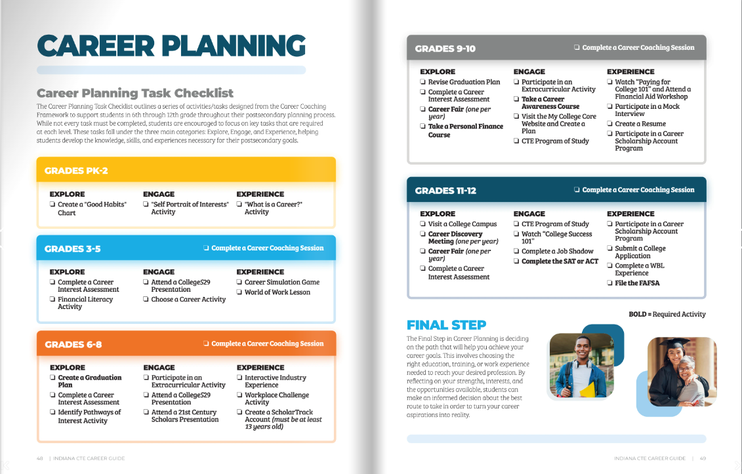
Notes:
Instructor: Use of this image shows alignment of our course and reinforces the benefits of having a well designed plan will benefit them.

Slide 48
Building Postsecondary Alignment Activity: Your Dream Career Board
Choose a peer with a common interest
Together, create a visual board of Your Dream Career
  Describe your dream career.
  What would your typical day look like?
  What impact do you want to make doing this work?
  How do you see your life balance of work vs personal? (i.e. Spending extra money & time on ‘fun’ things regularly or limited manner)
Save your creation, whether digital or paper format, for whole group sharing in Topic 4.
Notes:
Instructor: (See Topic 3 Lesson Notes regarding timing notes for this activity.) Watch end of period timing, this activity may need to rollover to day 4 for finalization. The sharing of it is the beginning of Day 4 anyway, so allowing a few minutes for completion prior to sharing is doable.

Slide 49
Journey to a Credential Completion Plan (CCP)
CCP
Begin Mapping Process
Connect Postsecondary & Career Alignment
You are here!
Identify Credentials of Value
Discover Diploma & Seals
Discuss +/- of Influences
Learn about CTE/NLPS Pathway
Start
Completed Agilities
Profiler
Start
Notes:
Instructor: “We are so close to you building your own CCP! We have covered almost all the necessary steps and built your knowledge base in many facets along the way.”

Slide 50
Let’s Recap Postsecondary & Career Alignment
Your choices are your inspiration. That becomes your drive!!
Alignment saves you and your family $$$
Increases your chances to earn more $$$
Helps guide your decisions in enrollment, enlistment, or employment
Notes:
Instructor: Use the details on this slide to recap importance of alignment.

Slide 51
Wrap up
Learned more about the impact of high quality Credentials of Value (CoV).
Learned the importance of aligning your postsecondary and career plans early to save stress and money!
Collected ideas and resources to start your personalized Credential Completion Plan (CCP).
Notes:
Instructor: Today we covered several ideas regarding postsecondary and career alignment to help guide you further into creating your own CPP.

Slide 52
Creating a Personalized
Credential Completion Plan
(CCP)
Topic 4

Slide 53
Today’s Competencies
Students will demonstrate their understanding of the requirements for earning credentials and how those align with their career goals.
Students will further understand the importance of setting realistic goals and timelines for credential completion.
Notes:
Instructor: Share today’s competencies with students.

Slide 54
Journey to a Credential Completion Plan (CCP)
CCP
Begin Mapping Process
Connect Postsecondary & Career Alignment
You are here!
Identify Credentials of Value
Discover Diploma & Seals
Discuss +/- of Influences
Learn about CTE/NLPS Pathway
Start
Completed Agilities
Profiler
Start
Notes:
Instructor: “We are so close to you completing your own CCP! We have covered almost all the necessary steps and now we’re ready to begin the process.”

Slide 55
Why create a CCP?
A personal roadmap for high school
A way to connect your interests and skills to your future goals
A tool to help you make the most of the new Indiana Diploma options and Readiness Seals
Notes:
Instructor: “Let’s review the importance of a personalized CCP. It is more than a random selection of classes. A CCP will help you choose a meaningful course plan that includes opportunities to succeed after graduation.“

Slide 56
What is included in your CCP?
Interests and skills from your Agilities Profile
Your NLPS Career Pathway choice
Credentials/certifications aligned to your career choice
Diploma and Seal choice
Career goal and plan for success
Notes:
Instructor: “Let’s review what is to be included in your CCP. All of these items have been covered in Topic 1-3 activities and lessons. Please refer back to these as your resource for your CCP.”

Slide 57
“Your Dream Career” Part 1 of CCP
Revisit Your Dream Career board to reflect:
Interests: What do you love to do?
Skills: What are you good at?
Influences: Who influences you?
Values: What is important to you?
Career: What are your career aspirations?
Notes:
Instructor: “Let’s begin with a quick sharing of your partner activity “Dream

Slide 58
Your Career Goal
Consider all the possibilities…
There are a lot of right answers!
2-year college (like a community college)
4-year college or university
Entering the workforce
Joining the military
Starting an apprenticeship or training program
Notes:
Instructor: “Ok, now you have a portion of your CCP ready to create. Let’s move to your career choice/goal. There are so many ways to plan for your future. As a school, our goal is to set ALL students up for success.” (Once Vision handout is done, share the CCP Handout or link for student to begin. Allow some time for transfer of vision to CCP to occur.)

Slide 59
Diploma & Seals Requirements
New IN Diploma: flexible diploma with more personalized electives
Choose your Readiness Seal(s): Seals prove to employers and colleges that you are ready for a specific pathway:
Employment Seal (for college and careers)
Enrollment Seal (for college)
Enlistment & Service Seal (for military)
How do your seal choices align with your career ideas?

Slide 60
Build
Your CCP
As you work, make sure your choices include:
Courses
Credentials/Certifications
Work-Based Learning
Additional Experiences
Notes:
Instructor: This is where is gets REAL! Remember this is your plan, and there may be more than one option to complete it.

Slide 61
Your CCP is a living document!
It's okay to change your mind and update your plan.
This is about making an intentional plan for your high school experience.
Use CCP to communicate with parents/counselors.
It empowers you to take control of your path to success.
Your future is in your hands, make it great!
Notes:
Instructor: These are all important reminders. “The goal of creating this plan is to make is actionable. Use it to track your progress. Use it to guide your conversations with your parents/mentor/counselor as you progress through high school. Then use it to plan forward as you enroll in college, enlist in military, or seek employment. This is a tool for you to brag and share you worth.”

Slide 62
Journey to a Credential Completion Plan (CCP)
CCP
Begin Mapping Process
Connect Postsecondary & Career Alignment
Plan in hand!
Identify Credentials of Value
Discover Diploma & Seals
Discuss +/- of Influences
Learn about CTE/NLPS Pathway
Start
Completed Agilities
Profiler
Start
Notes:
Instructor: “We’ve completed the Credential Completion Plan process and now you have a living document to help you plan and keep on track as you complete high school and look to what’s next.”

