Slide 1
INDIANA PUBLIC ACCESS LAWS
Presented by
Luke Britt, Indiana Public Access Counselor

Slide 2
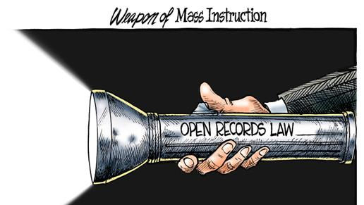
LEGISLATIVE INTENT
Indiana Code 5-14-3-1 through 5-14-3-10
Enacted in 1983 (APRA)
‘A fundamental philosophy of the American Constitutional form of representative government is the servant of the people and not their master.
Accordingly, it is the public policy of the state that all persons are entitled to full and complete information regarding the affairs of government and the official acts of those who represent them as public officials and employees.
Providing person with the information is an essential function of a representative government and an integral part of the routine duties of public officials and employees, whose duty it is to provide the information.’

Slide 3
The Public Access Counselor provides advise and assistance concerning Indiana’s public access laws (the Access to Public Records Act and the Open Door Law) to members of the public, government agencies and its employees.
PUBLIC ACCESS COUNSELOR
Conduct research.
Prepares interpretive and education materials and programs in cooperation with the office of the attorney general.
Distributes educational materials concerning public access laws to newly elected or appointed public officials.
Responds to informal inquiries made by the public and public agencies by telephone, in writing, in person, by facsimile, or by electronic mail concerning public access laws.
Issues advisory opinions to interpret the public access laws upon the request of a person or a public agency.
Makes recommendation to the general assembly concerning ways to improve public access.

Slide 4
FY 2022-2023
Received approximately 10000 requests for assistance.
556 formal complaints filed
13 informal inquiries filed
Conducted 47 educational trainings and presentations across Indiana
Opinions & Annual Report found at www.in.gov/pac
*reports filed with General Assembly every July 1

Slide 5
INDIANA OPEN DOOR LAW (ODL)
“… it is the intent of this chapter that the official action of public agencies to be conducted and taken openly, unless otherwise expressly provided by statute, in order that the people may be fully informed…”
IC5-14-1.5-1

Slide 6
Basic Rule
Majority
Governing Body
Official Action
Public Business
48 Hours Notice
Must be open to the public

Slide 7
REQUIRED NOTICE
48 BUSINESS Hours
Date, Time & Place
Generally, no requirements to publish in newspaper
Public Hearings are different than Public Meetings
Annual Notices are permitted
Emergency Meetings are the exception
Must post at principal location of business or meeting location
Website or newspaper notice is insufficient
Special Meetings of County Executives
IC 36-2-2-8 must state specific subject matter
Prohibition on ‘Serial Meetings’

Slide 8
Example of a public notice
Notice of Public Meeting:
Pawnee Town Council
Tuesday, February 24, 2015
@ 5:30pm
City Hall, Room 104
1414 Main Street, Pawnee Indiana

Slide 9
Executive Sessions
The ‘Exception’ to meetings that are open to the public.
Notice must include statuary purpose(s) for excluding public.
Minutes or Memoranda must include certification that only topics permitted under ODL were discussed during session.
Should be irregular
NO FINAL ACTION

Slide 10
Executive Session Notice
NOTICE OF EXECUTIVE SESSION
Pawnee Town Council Executive Session
Tuesday, August 1, 2015
@ 6:00pm
City Hall, Room 104
1414 Main Street, Pawnee Indiana
The Council will meet to discuss job performance of an individual employee as authorized under
IC 5-14-1.5-6.1(b)(9)

Slide 11
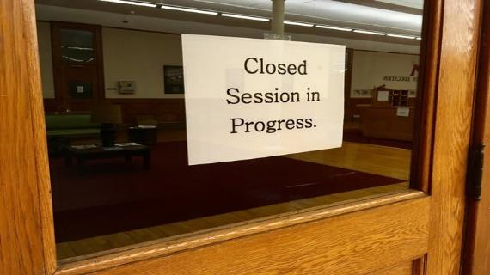
COMMON EXECUTIVE SESSIONS
To discuss:
records classified as confidential by state or federal statute
the alleged misconduct of an employee
strategy with respect to pending litigation or litigation threatened in writing
To receive information and interview prospective employees
Full list at Ind. Code § 5-14-1.5-6.1(b)

Slide 12
Virtual meetings
When a public health emergency is in effect, Ind. Code § 5-14-1.5-3.7 applies.
Completely virtual meetings are allowed IF there is a roll call.
If no PHE exists, Ind. Code § 5-14-1.5-3.6 applies to state and regional governing bodies and charter schools.
This is unchanged from pre-pandemic statutes.
Remote participation is allowed IF greater of: 2 members OR 1/3 of membership is present.
Boards should craft polices to internally regulate procedures for remote participation.

Slide 13
MISCELLANEOUS CONSIDERATIONS
No right to speak under ODL unless some other statute requires it (i.e. public hearings, schools – including )
No right to participate by public
Minutes/Memoranda (Draft copies)
Electronic Meetings
No secret ballots when voting

Slide 14
Access to public records
“Public record” means any writing, paper, report, study, map, photograph, book, card, tape recording or other material that is created, received, retained, maintained, or filed by or with a public agency and which is generated on paper, paper substitutes, photographic media, chemically based media, magnetic or machine-readable media, electronically stored data or any other material, regardless of form or characteristics.
Indiana Code § 5-14-3-2 (n)

Slide 15
Reasonable period of time
All records must be provided within a ‘reasonable period of time’ after the request is received.
Facts considered:
How broad is the request?
Where are the records located?
How much redaction is necessary?
Busy time at the agency?
Common sense factors?
What I like to see:
Communication – Status Updates, Timeline
Piecemeal disclosures

Slide 16
Reasonable particularity
A request from the public must be reasonably particular – a subjective standard
Two conflicting cases
Can you find it?
Are there objective elements in the query?
What I like to see:
No blank denial
Cooperate to narrow request

Slide 17
Three categories of public records

Slide 18
The good – disclosable records
Meeting minutes
Budgets
Invoices
Receipts
RFPs
Contracts

Slide 19
The bad – confidential public records
Personal Health Information
Trade secrets
Student records
Social Security Numbers
Those declared confidential by state statute or federal law

Slide 20
The ugly – discretionary public records
Investigatory records of law enforcement agencies
Attorney work product / client communication
Deliberative material
Personnel files of public employees

Slide 21
Emails
A public records includes electronic media that is created, received, retained, maintained, or filed by / with a public agency.
Electronic mail must be available for inspection and copying by the governing body unless and exception to disclosure, based on content, applies.
Electronic mail must be maintained in accordance with records retention reschedules, pursuant to IC 5-15.
Most agencies have their own retention schedules.

Slide 22
Denials
ORALLY
DENIAL MAY BE ISSUED ORALLY
BEFORE TRIAL COURT and
PAC OFFICE
WRITTEN
DENIAL MUST BE IN WRITING
BURDEN IS ON AGENCY TO DEMONSTRATE DENAIL COMPLIED WITH APRA
COURT MAY REVIEW THE RECORDS IN-CAMERA; MAY REVIEW RECORDS IF REDATIONS OF RECORDS HAS OCCURRED

Slide 23
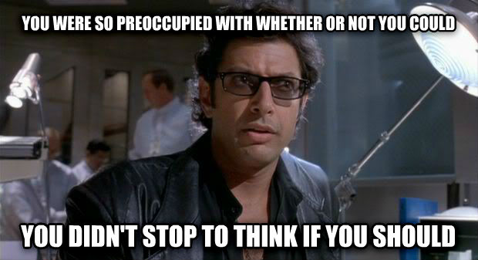
NONCOMPLIANCE
Consequences
Complaint to Public Access Counselor
Lawsuit
Penalties
Court action seeking order to produce & potentially order to pay attorney’s fees
Fines for knowing and intentionally withholding of public records or violation of the ODL
Bad press and damages to public perception

Slide 24
Common misconceptions of citizens
A public agency should;
Answer questions under APRA
Give me immediate access
Keep public records forever
Handle public records requests before handling other matters of the public agency
Keep public records in a format that is most convenient for me

Slide 25
PUBLIC ACCESS HANDBOOK
http://www.in.gov/pac/files/pac_handbook.pdf
PUBLIC ACCESS COUNSELOR WEBSITE:
http://www.in.gov/pac
CONTACT INFORMATION:
Indiana Public Access Counselor
402 W. Washington Street, W470
Indianapolis, IN 46204
317.234.0906
pac@opac.in.gov

