Slide 1
State Road (SR ) 225 over Wabash River Bridge Rehabilitation Tippecanoe County Des. No. 2002077 Indiana Department of Transportation March 4, 2024 6:00 pm Battle Ground Elementary

Slide 2
Agenda
Welcome & Introductions
Project Overview
Proposed Improvements
What to Expect During Construction
Final Steps
Adjourn Formal Meeting
We Want Your Feedback
You are invited to the display area for Q & A with the project team after the hearing is adjourned
Notes:
The purpose of this hearing is to inform the public about the proposed project and to receive public comments. We will introduce the project team and stakeholders, provide important project details and updates on the project, and provide details on where to find more information on the project and submit public comments. We ask that you please visit our sign-in table for project handouts and information on accessing this presentation. This presentation will cover the proposed project, the purpose and need, how traffic will be maintained during construction, and review the anticipated project schedule and next steps. Finally, we will cover project resource locations and how to submit written public comments at the end.

Slide 3
Project Team
Indiana Department of Transportation (INDOT) Crawfordsville District
Arshad Ahmed – Project Manager
Blake Dollier – Public Relations Director
Egis
Tyler Wolf – Senior Bridge Engineer
Brian Shaw – Environmental Services Director
Grace Gjerde – Environmental Analyst
____________________________________________________________
Handouts:
Welcome Letter
Comment Form
Ways to Submit Public Comments
Bridge Fact Sheet

Slide 4
Project Stakeholders
Indiana Department of Transportation
Indiana Division Federal Highway Administration
Tippecanoe County, Battle Ground
Elected and local officials
Residents and citizens
Commuters
Businesses
Emergency services
Schools
Churches
Community organizations
Notes:
Project stakeholders engaged at various stages throughout this project include local officials, as well as local residents, businesses, schools, churches and community organizations.

Slide 5
Project Development
Project selection
Early coordination
Environmental phase begins
Purpose & Need
Develop alternatives
Preliminary design phase
Release environmental document for public review and comment
Additional work to finalize environmental document and project design
Real estate acquisition
Construction
Public Hearing
Public Involvement – Communicate Project Decision
Notes:
Looking at the project development process, we are currently in the public hearing phase after having coordinated with project stakeholders, determining the purpose and need for the project, developing alternatives, and completing the preliminary design phase and the draft environmental document for public review. Following this hearing, comments will be addressed, and the environmental document and project design will be finalized prior to the start of construction.

Slide 6
Why a Public Hearing?
Conducted as a requirement to the National Environmental Policy Act (NEPA)
NEPA requires evaluation of potential impacts to surrounding Natural, Cultural, and Social environments.
Impacts are described in an environmental document.
Requires opportunity for the public to be involved and comment in the decision-making process.
Part of the Historic Bridges Programmatic Agreement (PA)

Slide 7
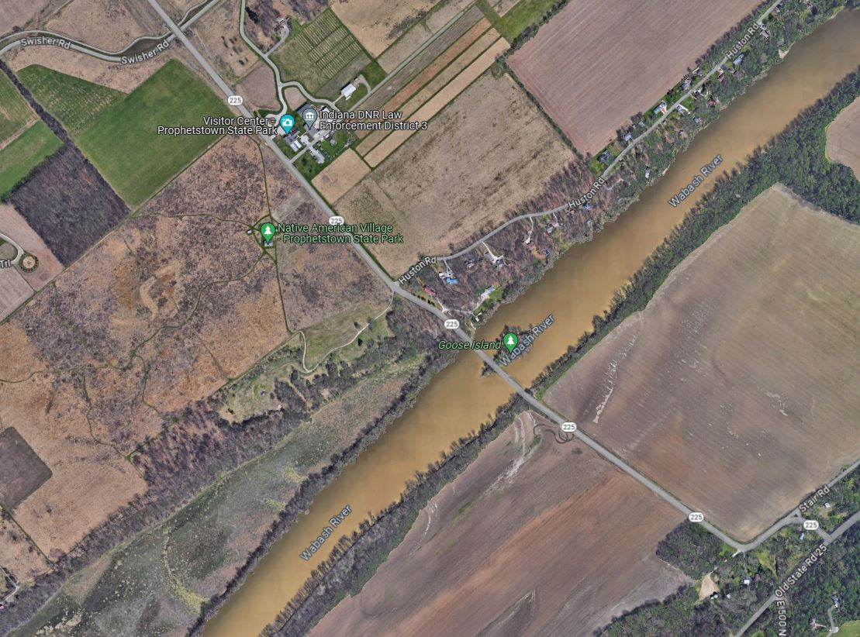
Location SR 225 over Wabash River
SR 225, approximately 0.60 mile north of Old SR 25
Over the Wabash River
West Lafayette, Tippecanoe and Washington Townships, Tippecanoe County
Lafayette East 7.5 Minute U.S. Geological Survey Topographic Map
Bridge No. 046-15-01987 A
Flow
SR 225
Wabash River
Old State Road 25

Slide 8
Environmental Document
Level 4 Categorical Exclusion -Classification means the actions do not have a significant effect on the environment.
Environmental document released for public involvement
Draft Environmental Document was released for public involvement by INDOT in February 2024
Egis Published Legal Notice
The Journal & Courier newspaper on February 16th & 23rd, 2024
Direct mailing of legal notices to adjacent property owners
Documents available for viewing: https://www.in.gov/indot/about-indot/central-office/welcome-to-the-crawfordsville-district/
Notes:
The environmental document is a requirement under the National Environmental Policy Act, or NEPA, and it requires INDOT to analyze and evaluate the potential impacts of a project on the environment. This process included developing a purpose and need, examining different alternatives and determining the preferred alternative.
The potential impacts of the project, and ways to avoid or minimize them, are evaluated as part of the environmental process.
The environmental document for this project was released for public involvement on May 15, 2023, and is available for review via the INDOT Seymour District website. Part of the public involvement for the environmental process includes this hearing and collecting public comments on the project, which we will discuss at the end of the presentation. Once all comments have been addressed, the environmental document can be finalized.

Slide 9
Examples of Items Evaluated
Right-of-way
Streams, wetlands, and other waters
Floodplains
Endangered species
Farmland
Cultural resources (historic/archaeological)
Parks and recreational lands (trails)
Air quality
Noise
Community impacts
Environmental justice
Hazardous materials
Permits
Mitigation
Public involvement
Commercial development
Notes:
A few examples of items evaluated as part of the environmental process include right-of-way, water resources, including streams wetlands and floodplains, endangered species, cultural resources, community impacts and environmental justice, among others listed here.

Slide 10
SR 225 Bridge over Wabash River
National Bridge Inventory (NBI)#: 029150
Built in 1912 and rehabilitated eight times between 1954 and 2014
Four-span, Steel, Pratt Truss Bridge
4 equal spans at 158 feet
Total structure length of 664’
2 spans primarily over Wabash River
Bridge is determined individually eligible for the National Register of Historic Places (NRHP) under Criterion C for its engineering significance
A “Select” Bridge
Excellent examples of a given type of bridge
Classified as most suitable for preservation
FHWA will not consider demolition to be a prudent alternative and will not participate in a project that results in the demolition of a Select Bridge
Bridge must be preserved

Slide 11
Historic Select Bridge
Following the Alternative Analysis per the Historic Bridges Programmatic Agreement (PA)
Will a rehabilitation meet the purpose and need?
Is it cost effective as compared to a new bridge?
Cost of rehabilitation compared to the estimated increase in the bridge life.
If yes, then no other alternatives considered.
Feasible
Meet
engineering requirements
Prudent
Cost effective

Slide 12
Bridge Alternative Analysis
Rehabilitation is the preferred alternative
The Secretary of the Interior defines rehabilitation as
“the act or process of making possible a compatible use for a property through repair, alterations, and additions while preserving those portions or features which convey its historical, cultural, or architectural values.”
Will follow the Historic Bridges PA
Standard Treatment Approach for Historic Bridges
Notes:
For this project, rehabilitation has been determined as the preferred alternative. The secretary of the interior defines rehabilitation as “the act or process of making possible a compatible use for a property through repair, alterations, and additions while preserving those portions or features which convey its historical, cultural, or architectural values”. The project will follow the historic bridges programmatic agreement which sets the standard treatment of historic bridges. Now I’ll turn it over to Alfred to discuss the existing conditions and proposed work.

Slide 13
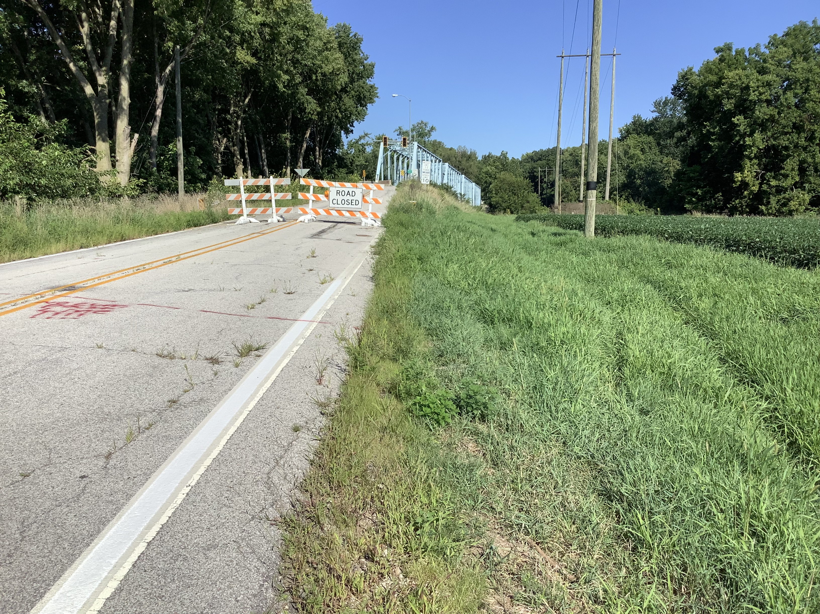
Purpose & Need SR 225 over Wabash River
Project Need
Structure Condition
Truss members and gusset plates in poor condition
due to roadway drainage runoff
Load Capacity & Structural Deficiencies
HS-15 Design Load Factor Rating = 0
Cracking and weathering of Abutments
Project Purpose
Preserve the integrity of the structure
Improve portions of the bridge as required to increase the load capacity of the bridge to improve its condition
Meet an HS-15 Loading
protect the members that are at risk of future deterioration

Slide 14
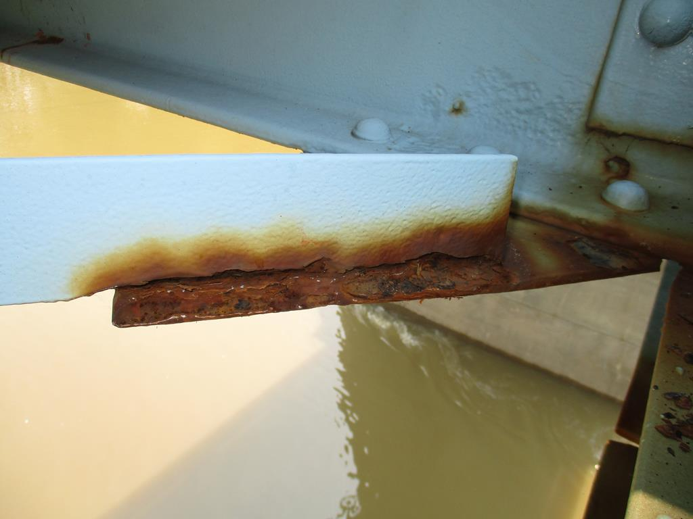
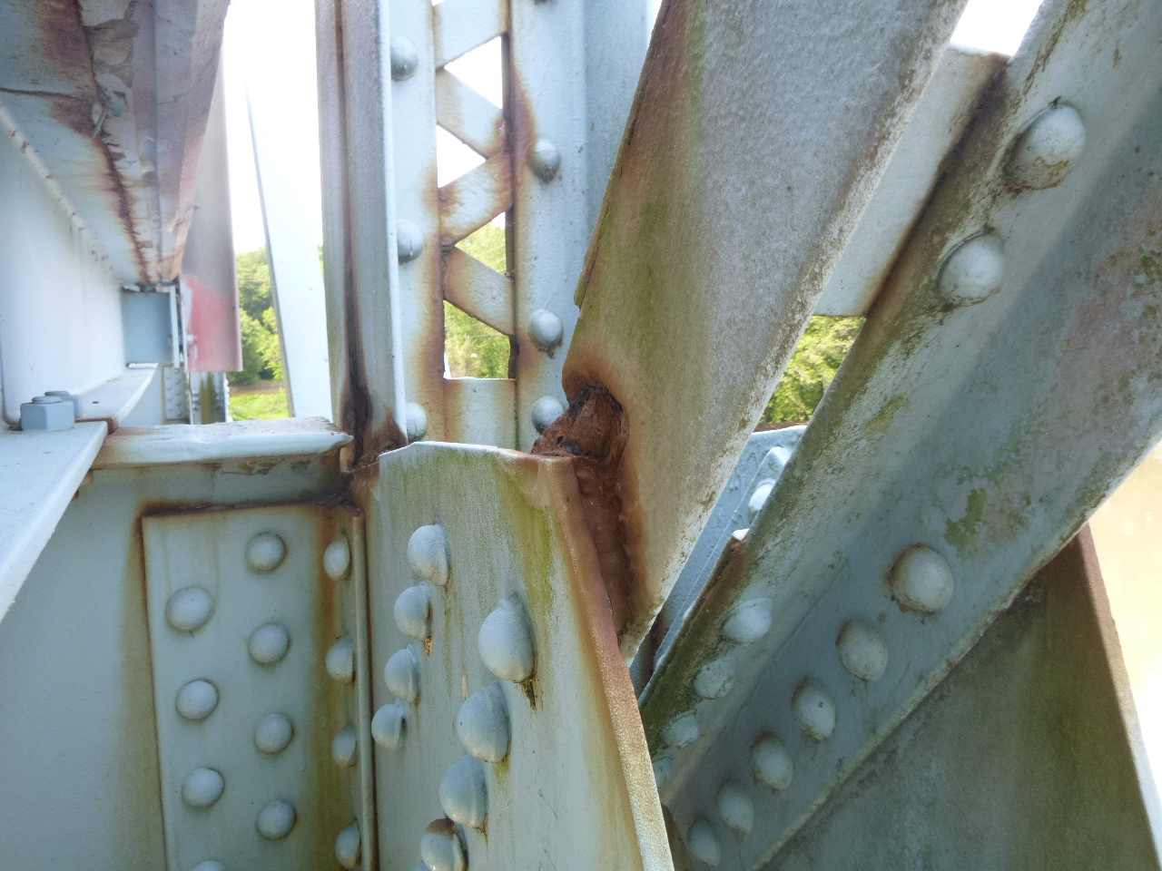
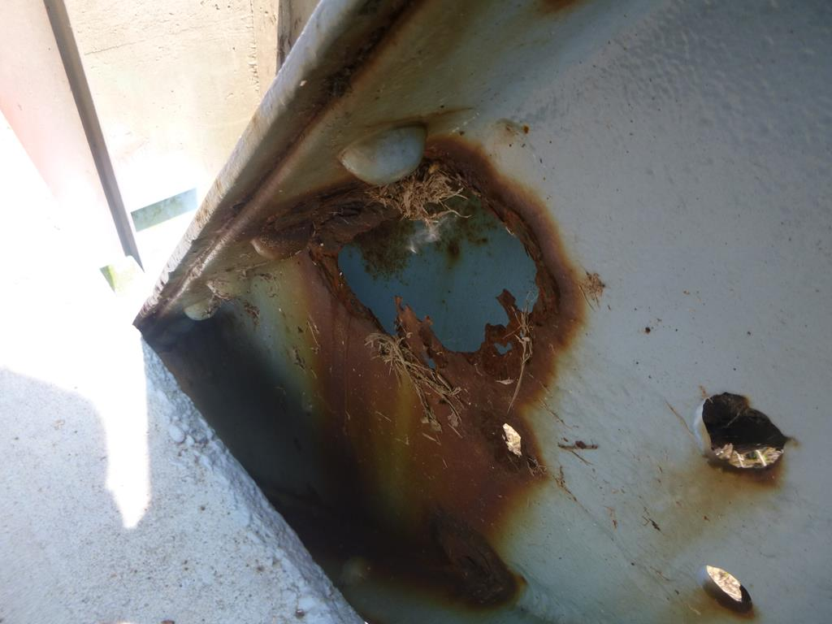
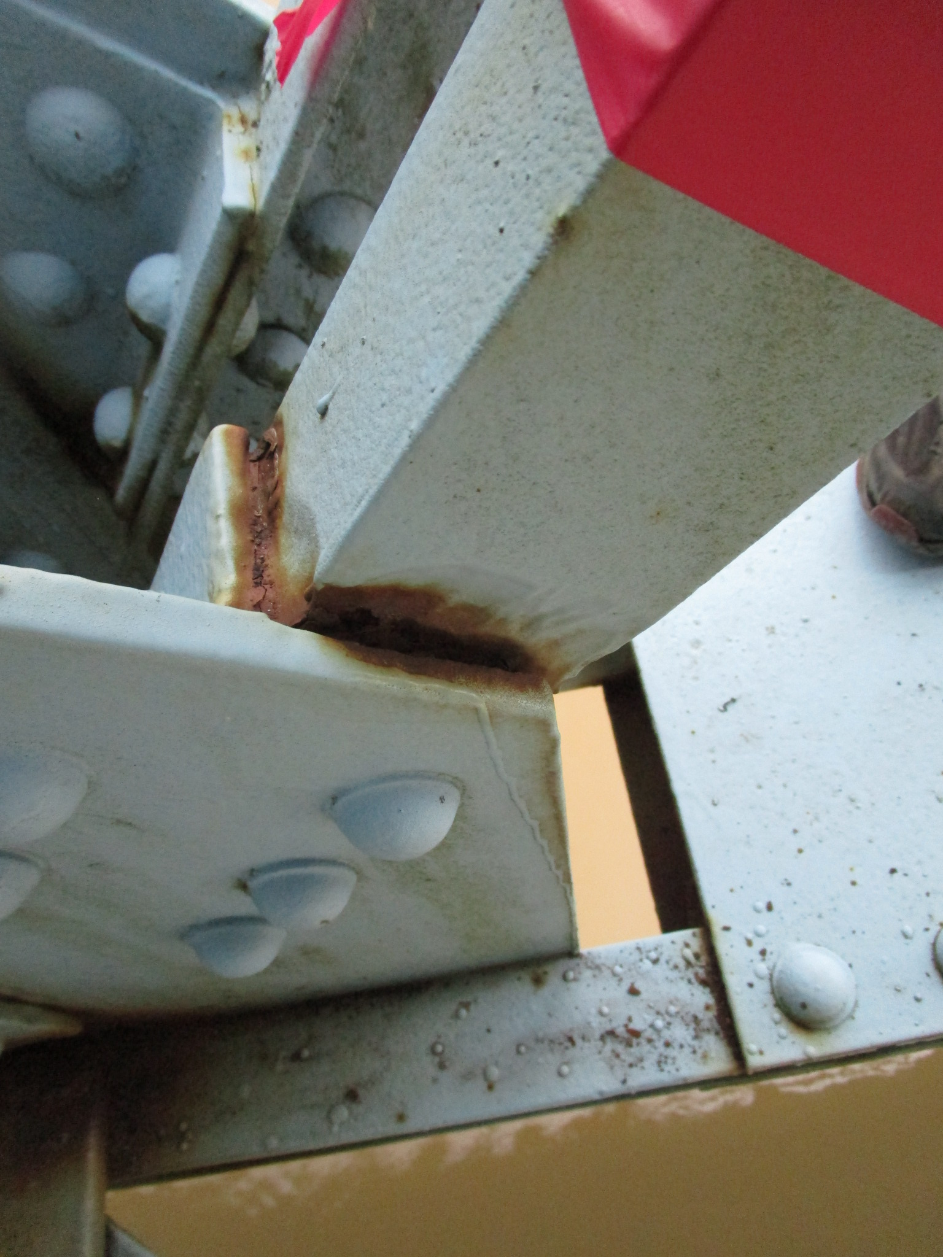
Existing Conditions SR 225 over Wabash River
The bridge deck is experiencing cracking, leaching, and spalling with up to 17% delamination per span.
There is widespread deterioration of truss members and gusset plates due to existing curbs not able to protect the truss members from roadway drainage runoff.

Slide 15
Existing Conditions SR 225 over Wabash River
A substantial number of the truss and superstructure members do not have a load capacity meeting the Indiana Design Manual requirements
Replace or repair truss gusset plates, bearings, verticals, diagonals, low chords, low chord splices, bottom lateral connections and bracing, stringers, and floor beams

Slide 16
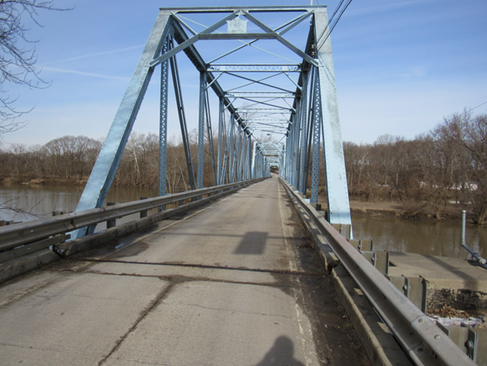
Proposed Work - SR 225 over Wabash River
Remove the existing concrete deck, curbs, approach slabs, railing, and portions of mudwalls
Reset truss bearings
Clean and paint truss and stringers
Replace or patch portions of abutments and wings
Construct deck, rails, portions of mudwalls, joints, portions of bridge seats, and approach slabs
Transition milling to tie into the bridge at each end and surface sealing the approach roadways

Slide 17
Proposed Work - SR 225 over Wabash River
Place revetment riprap on geotextiles around the wingwalls
Place Class 1 Riprap around Piers 2 and 4
Construct riprap drainage turnouts at all four corners of the bridge
Construct wildlife crossings composed of compacted No. 53 stone against both abutments

Slide 18
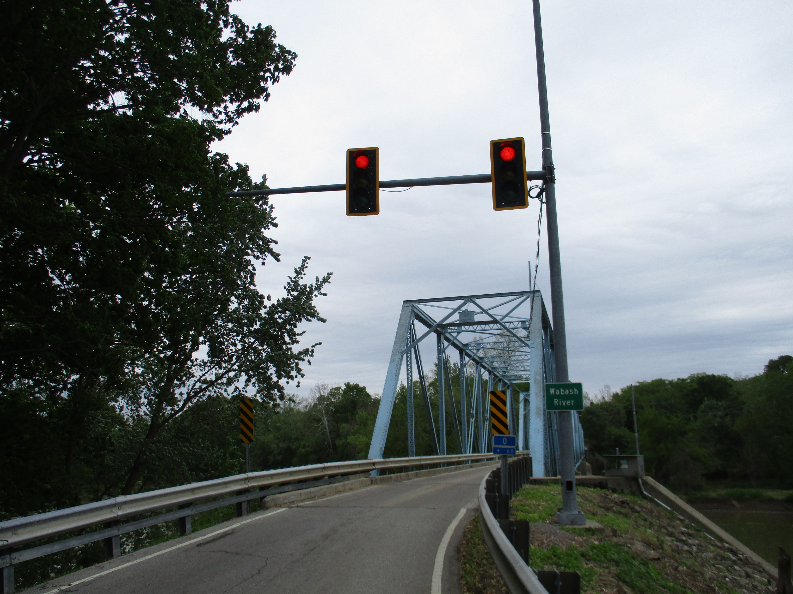
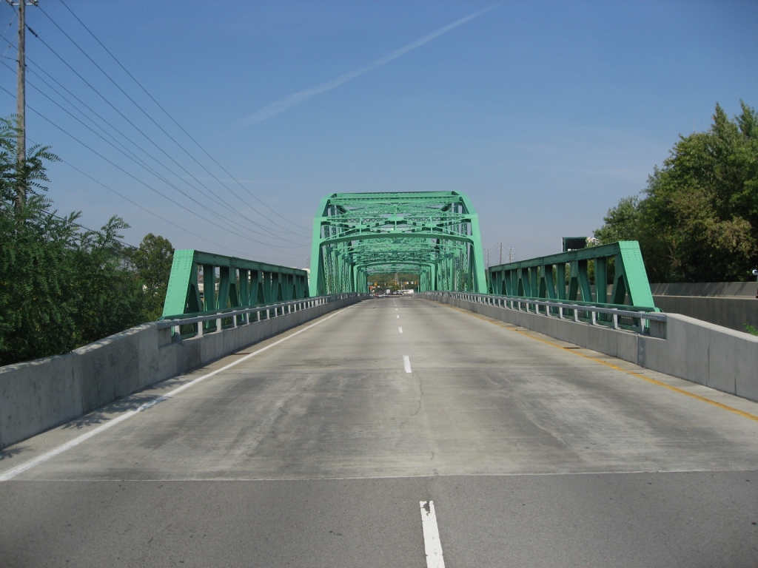
Proposed Work - SR 225 over Wabash River
Paint the structural steel to match the existing color
Replace the existing railing with PF-1 railing
Roadway would remain one lane with Traffic Signal
Example PF-1 Bridge Railing

Slide 19
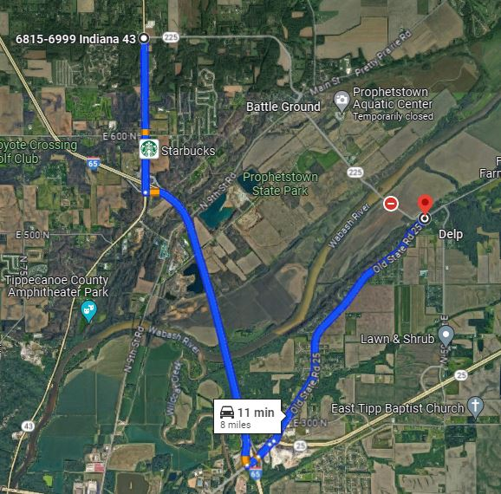
Maintenance of Traffic (MOT) SR 225 Bridge
Official detour for through traffic will use Old SR 25, I-65, and North River Road/SR 43.
This detour adds four miles for motorists and is already in place since the May 2022 bridge closure to thru traffic due to structural damage.
North River Road
Project Location
SR 225
Old State Road 25
I-65

Slide 20
Construction Timeline SR 225 over Wabash River
Bid and Letting in November 2024
Construction is anticipated to start in January 2025 and be completed by Fall 2026

Slide 21
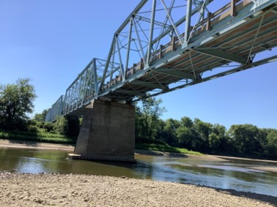
Next Steps
Public and project stakeholder input
Comment Period Ends March 19, 2024
Submit comments via options described in the project handout
INDOT review and evaluation
All comments are given full consideration during the decision-making process.
Certification of Public Involvement
Address comments, finalize and approve the environmental document, and complete the project design.
Communicate a decision
INDOT will notify project stakeholders of the decision.
Work through local media, social media outlets, and a legal notice.
Make project documents accessible via repositories.
Questions? Contact the Public Involvement Team.

Slide 22
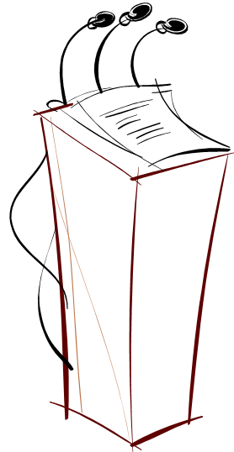
Comment Session
Speakers sign-in sheet.
Open to the floor for additional public comment.
Please come forward to the podium so that we may accurately record your statements.
Please be courteous and mindful of appropriate language.

Slide 23
Project Resource Locations
An announcement of this public hearing was posted to INDOT’s website and ran in a local paper.
A copy of the presentation and project documentation is available online via INDOT’s Crawfordsville website.
Follow Crawfordsville on X and Facebook!
INDOT West Central on Facebook
@INDOT_WCentral on X
855-463-6848 • INDOT4U.com • INDOT@indot.in.gov

Slide 24
Contact Information for Comments
Statements will be recorded at public hearing.
Written Statements:
Raquel Walker
Egis 8320 Craig Street Indianapolis, IN 46250
E-Mail:
Raquel.walker@egis-group.com
arahmed@indot.in.gov
Respectfully request comments be postmarked by March 19, 2024
All comments will be reviewed, evaluated, and given full consideration before final design decisions.
Arshad Ahmed
INDOT Crawfordsville District Office
41 West 300 North, Crawfordsville, IN 47933

Slide 25
Thank You
Please visit with project officials following the public comment session.
Informal questions and answers
View displays and preliminary plans
Thank you for your attendance this evening.
This public hearing is adjourned.

